Slide 1
Viral Diseases
Prof. Dr. Ananda Kumar Saha
Dept. of Zoology
Rajshahi University

Slide 2
Viral Diseases
Viral diseases are structural or functional disorder of an organism caused by infection of viruses.
Depending on the virus and the person's state of health, viruses can infect almost any type of body tissue, from the brain to the skin.
There are many types of viral diseases but the most common is the common cold.

Slide 3
Types of Viral Diseases
Depending on the organ or organ system infected by virus:
Pneumotropic Viral Disease
(eg. Influenza, Common cold, Respiratory Syncytial Disease)
Dermotropic Viral Disease
(eg. Herpex Simplex, Chickenpox, Measles)
Viscerotropic Viral Disease
(eg. Yellow Fever, Dengue Fever, Hepatitis)

Slide 4
Pneumotropic Viral Disease

Slide 5
Influenza or Flu
An acute, contagious disease of the upper respiratory tract
Transmitted by droplets
Caused by virion belonging to the Orthomyxoviridae family of virus
Three types: Influenzavirus A, Influenzavirus B, Influenzavirus C.

Slide 6
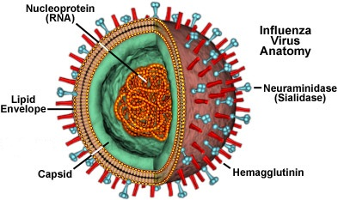
Structure of Influenza Virus

Slide 7
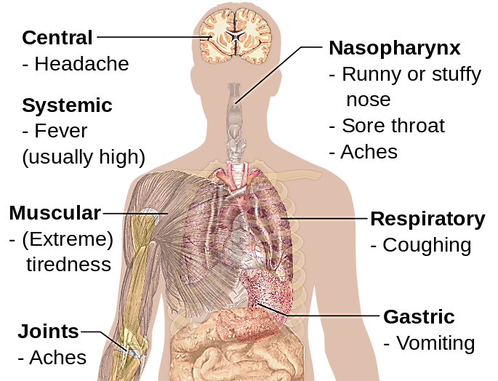
Symptom of Influenza

Slide 8
Diagnosis of Influenza
By pattern of spread of disease in a community
By observation of disease symptoms
By viral culture
By commercial rapid influenza diagnostic tests
By routine serological test

Slide 9
Prevention and Treatment
Influenza can be prevented by Vaccination
Influenza can be treated with Antiviral drugs such as:
- Neuraminidase inhibitors (Oseltamivir and Zanamivir)
- M2 protein inhibitors
(Amantadine and Rimantadine)

Slide 10
Adenovirus Infections
Adenoviruses can infect the membranes (tissue linings) of the respiratory tract, eyes, intestines, and urinary tract.
The upper respiratory tract infection by Adenoviruses is know as Common cold

Slide 11
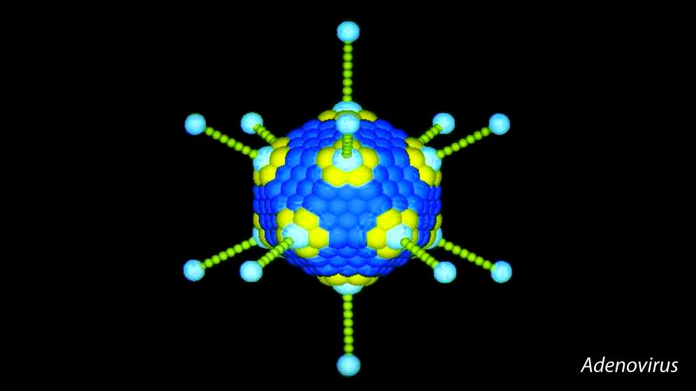
Structure of Adenovirus
penton
Hexon

Slide 12
Symptom of Adenoviral infection
# Common cold # Sore throat
# Bronchitis. # Pneumonia
# Diarrhea # Conjunctivitis
# Fever
# Bladder inflammation or infection
# Inflammation of stomach and intestines
# Neurologic disease (Viral meningitis)

Slide 13
Prevention and Treatment of Adenoviral infection
Prevention: Currently no adenovirus vaccine available to the general public
Treatment: No specific treatment for people with adenovirus infection.
Most adenovirus infections are mild and may require only care to help relieve symptoms.

Slide 14
Respiratory Syncytial Disease
A major cause of lower respiratory tract infections and hospital visits during infancy and childhood
Infection take place in the bronchioles and air sacs of lung
Infected cells tend to fuse and form giant cells called Syncytia
Often known as viral pneumonia

Slide 15
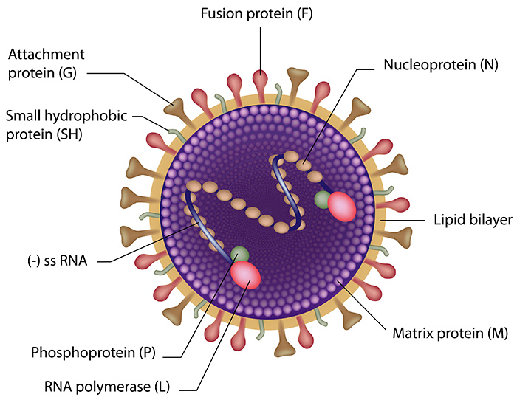
Structure of Syncytial Virus

Slide 16
Symptoms of Respiratory Syncytial Disease
Cough.
Stuffy or runny nose.
Mild sore throat.
Earache.
Fever.

Slide 17
Treatment of Respiratory Syncytial Disease
Use of antiviral Drugs such as Ribavirin
Use of nebulized hypertonic saline
Use of Salbutamol if bronchospasm present

Slide 18
Rhinovirus Infections
Name “Rhinovirus” is originated from the Greek word “rhinos” meaning “nose”.
The most common viral infectious agents in humans
Infect upper-respiratory tract
Predominant cause of the common cold.

Slide 19
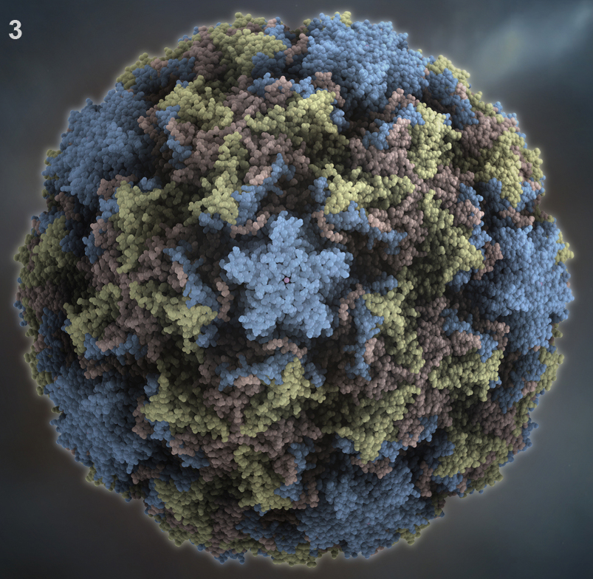
Structure of Rhinovirus

Slide 20
Symptoms of Rhinovirus
Rhinorrhea,
Sore throat,
Nasal congestion,
Sneezing,
Cough, and
Headache.

Slide 21
Treatment of Rhinovirus infection
Treatment is generally focused on symptomatic relief and prevention of person-to-person spread and complications.
The mainstays of therapy include rest, hydration, antihistamines, and nasal decongestants.

Slide 22
Dermotropic Viral Disease

Slide 23
Herpes Simplex
Collection of viral diseases caused by DNA virion
One of the most common virus in environment
Virus passes from one cell to another by intercellular bridges
Virus stay in the nerve cells untill something triggers it to multiply

Slide 24
Structure of Herpes Virus

Slide 25
Symptoms of Herpes Simplex
Tingling, itching, or burning
Sores
Flu-like symptoms
Problems urinating
An eye infection (herpes keratitis)

Slide 26
Treatment of Herpes Simplex
Use acetaminophen for fever and muscle aches
Drink plenty of fluids to prevent dehydration.
Use antiviral cream or ointment
Use antiviral oral medicines such as Acyclovir, Famciclovir, Valacyclovir

Slide 27
Chickenpox
Also known as varicella.
A common illness that causes an itchy rash and red spots or blisters (pox) all over the body.
Most common in children.
The most communicable of all diseases
Infection begins in the respiratory tract

Slide 28
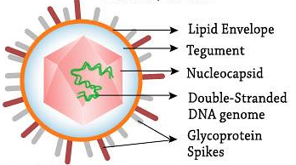
Structure of Chickenpox Virus

Slide 29
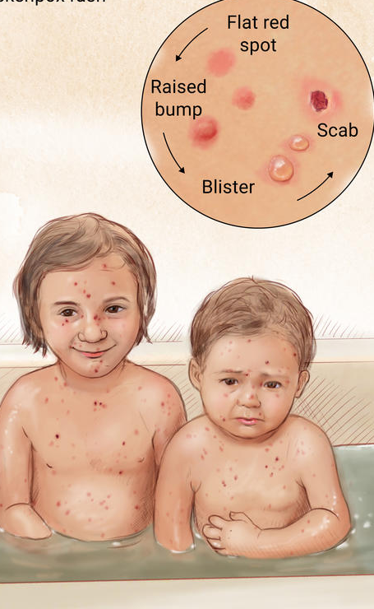
Symptoms of Chickenpox
Whole body: fatigue, fever, loss of appetite, or malaise
Skin: red rashes, scab, ulcers, or red spots
Also common: blister, headache, itching, pus, sore throat, or swollen lymph nodes

Slide 30
Treatment of Chickenpox
Following medicine can be used for treatment:
Antiviral drug: Valacyclovir, Acyclovir
Antihistamine: Diphenhydramine by mouth or to the affected area
Pain reliever: Acetaminophen
Soothing remedies: Calamine, Moisturizer, Oatmeal bath

Slide 31
Measles
Also known as morbilli, rubeola, or red measles,
A highly contagious infection caused by the measles virus.
An airborne disease which spreads easily through the coughs and sneezes
May be spread through contact with saliva or nasal secretions

Slide 32
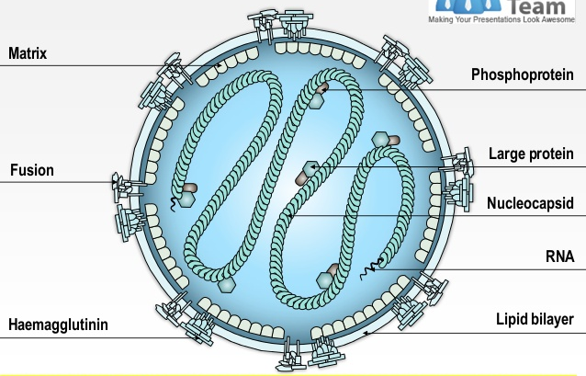
Structure of Measles Virus

Slide 33
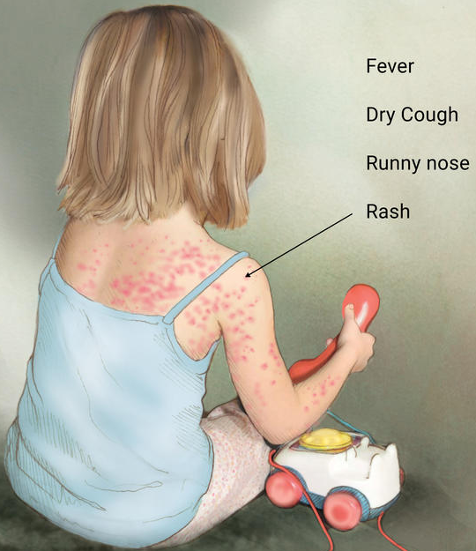
Symptoms of Measles
Dry cough
Fatigue and fever
Loss of appetite,
Malaise
Runny nose or sneezing
Skin rashes or red spots
Swollen lymph nodes

Slide 34
Treatment of Measles
Following medicine can be used for prevention and treatment:
Vitamin A
Self-treatment
Acetaminophen for Pain relieve
MMR vaccine for prevention

Slide 35
Mumps
Also known as epidemic parotitis
Caused by the mumps virus which is RNA helical virion of the Paramyxoviridae family
Highly contagious and spreads rapidly
The virus is transmitted by respiratory droplets, fomites or direct contact with an infected person

Slide 36
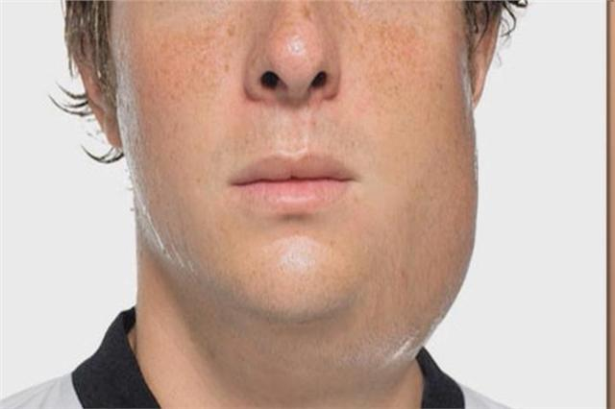
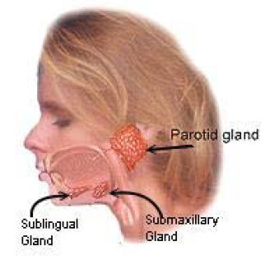
Symptoms of Mumps
Some people experience no symptoms.
Swollen and painful salivary glands
Fever
Headache
Fatigue
Loss of appetite

Slide 37
Treatment of Mumps
Get plenty of bed rest
Take painkillers
Drink plenty of fluids, but avoid acidic drinks such as fruit juice
Apply a warm or cool compress to your swollen glands to help reduce any pain
Eat foods that don't require a lot of chewing

Slide 38
Viscerotropic Viral Disease

Slide 39
Yellow Fever
An acute viral haemorrhagic disease
Caused by one of the smallest virus known as arbovirus (Arthropod-borne)
Transmitted by infected mosquitoes
The "yellow" in the name refers to the jaundice
Up to 50% of severely affected persons without treatment will die

Slide 40
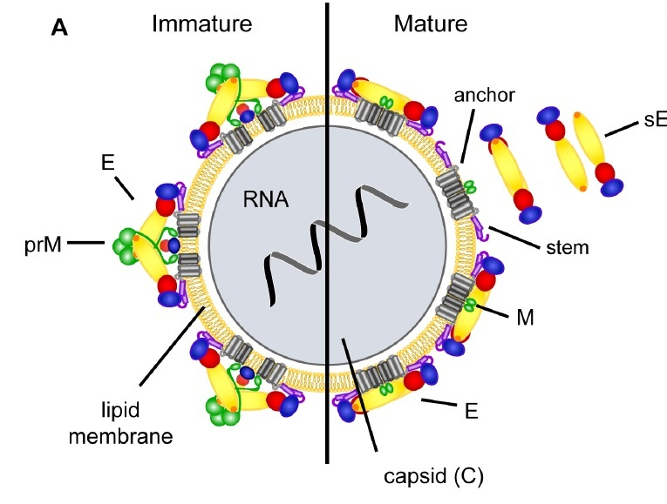
Structure of Yellow Fever Virus

Slide 41
Symptoms of Yellow Fever
Stage 1 (infection): Headache, muscle & joint aches, fever, flushing, loss of appetite, vomiting, and jaundice are common.
Stage 2 (remission): Fever and other symptoms go away.
Stage 3 (intoxication): Problems with many organs may occur, including the heart, liver, and kidney.

Slide 42
Treatment of Yellow Fever
Because there is no cure for the viral infection itself, medical treatment of yellow fever focuses on easing symptoms:
Get plenty of bed rest
Take painkillers, but avoid aspirin other nonsteroidal anti-inflammatory drugs
Drink plenty of fluids, but avoid acidic drinks such as fruit juice
Can be prevented by vaccination

Slide 43
Dengue Fever
Also known as breakbone fever
A mosquito-borne tropical disease
Caused by the dengue virus (RNA icosahedral virion)
Transmitted by several species of mosquito within the genus Aedes, principally A. aegypti
Disease develops into the life-threatening dengue hemorrhagic fever

Slide 44
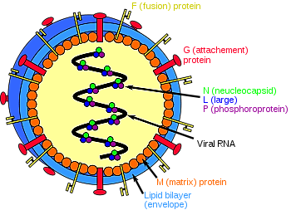
Structure of Dengue Virus

Slide 45
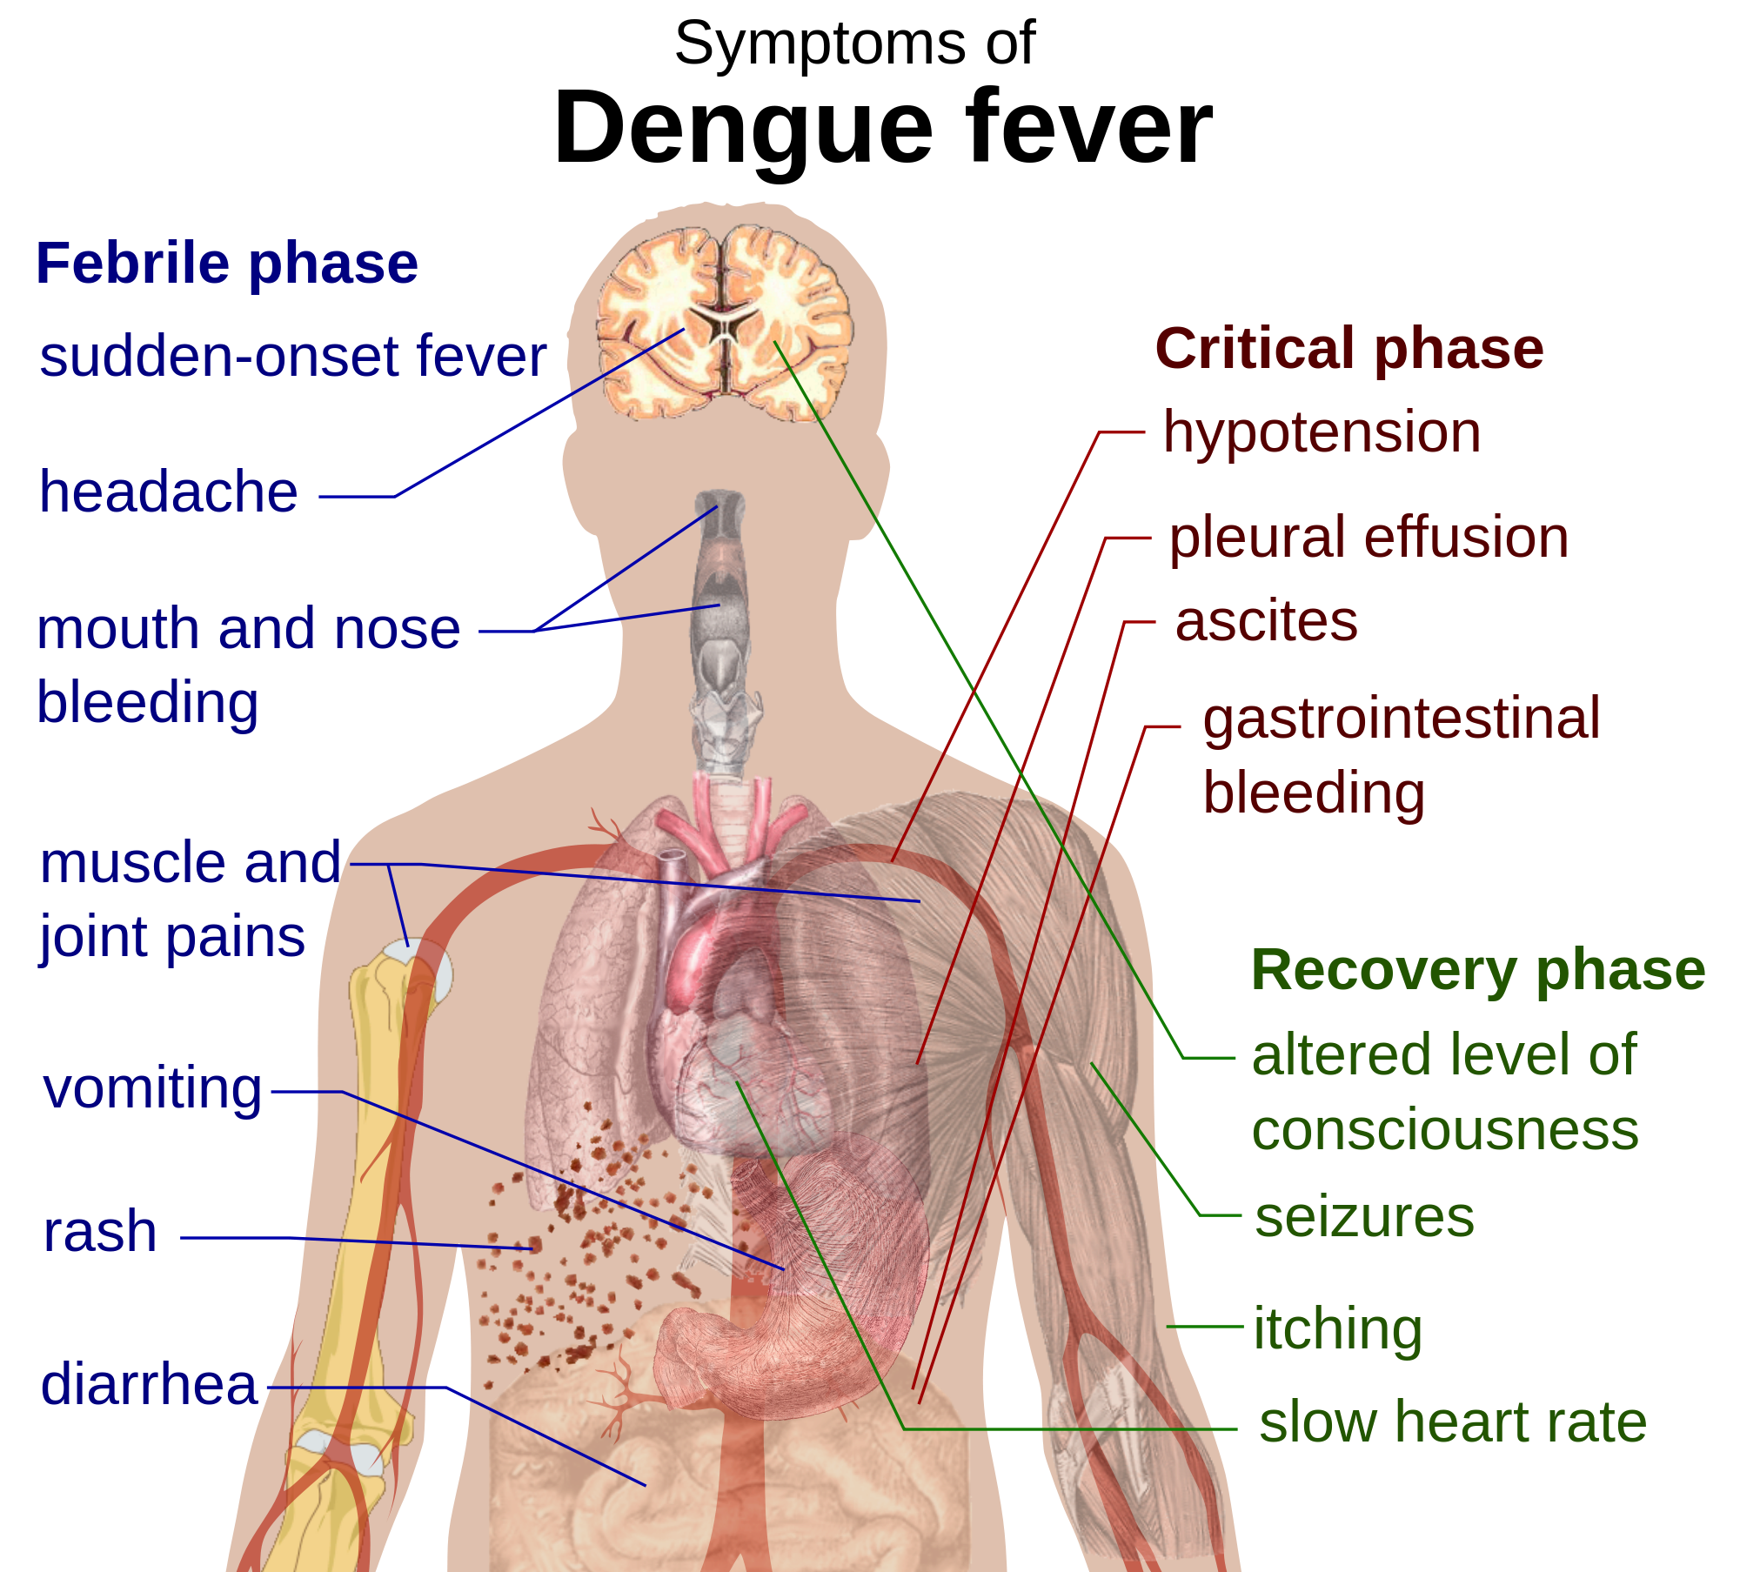
Symptoms of Dengue Fever

Slide 46
Treatment of Dengue Fever
There is no specific medicine to treat dengue infection, medical treatment of Dengue fever focuses on easing symptoms:
Get plenty of bed rest
Take painkillers, but avoid aspirin other nonsteroidal anti-inflammatory drugs
Drink plenty of fluids, but avoid acidic drinks such as fruit juice
Be admitted to a hospital immediately

Slide 47
Hepatitis A
A viral liver disease caused by a small virion referred as hepatitis-RNA-virus.
Transmitted through ingestion of contaminated food and water or through direct contact with an infectious person.
Almost everyone recovers fully from hepatitis A, but very small proportions die from fulminant hepatitis.
Infection risk is associated with a lack of safe water and poor sanitation

Slide 48
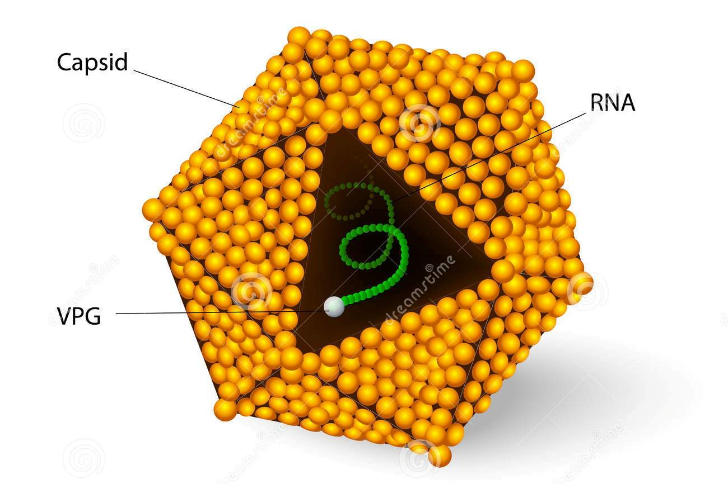
Structure of Hepatitis A Virus

Slide 49
Symptoms of Hepatitis A
Fatigue.
Nausea and vomiting.
Abdominal pain or discomfort, especially in the area of your liver on your right side beneath your lower ribs.
Clay-colored bowel movements.
Loss of appetite.
Low-grade fever.

Slide 50
Treatment of Hepatitis A
There is no specific treatment for hepatitis A.
Recovery from symptoms following infection may be slow and may take several weeks or months.
Therapy is aimed at maintaining comfort and adequate nutritional balance, including replacement of fluids that are lost from vomiting and diarrhea.

Slide 51
Hepatitis B
A viral infection caused by a DNA virus known as hepatitis-DNA-virus
Infect the liver and can cause both acute and chronic disease.
The virus is transmitted through contact with the blood or other body fluids of an infected person.
Hepatitis B is an important occupational hazard for health workers.
However, it can be prevented by currently available safe and effective vaccine.

Slide 52
Structure of Hepatitis B Virus

Slide 53
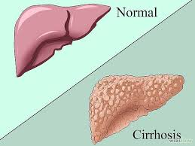
Symptoms of Hepatitis B
Abdominal pain.
Dark urine.
Fever.
Joint pain.
Loss of appetite.
Nausea and vomiting.
Weakness and fatigue.
Yellowing of your skin and the whites of your eyes (jaundice)

Slide 54
Treatment of Hepatitis B
There is no specific treatment for acute hepatitis B.
Care is aimed at maintaining comfort and adequate nutritional balance
Chronic hepatitis B infection can be treated with antiviral agents such as tenofovir or entecavir
Treatment using interferon injections may be considered in some people
Liver transplantation is sometimes used in people with cirrhosis

