Slide 1
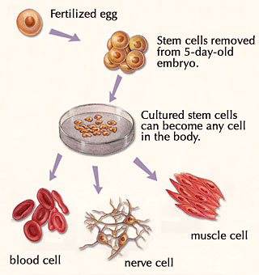
Stem Cell
Ananda Kumar Saha
Department of Zoology
University of Rajshahi

Slide 2
What is stem cell?
An undifferentiated cell of a multicellular organism which is capable of giving rise to indefinitely more cells of the same type, and from which certain other kinds of cell arise by differentiation.

Slide 3
Stem Cell

Slide 4
Stem Cell
Stem cell have the remarkable potential to develop into many different cell types in the body during early life and growth.
When a stem cell divides, each new cell has the potential either to remain a stem cell or become another type of cell with a more specialized function, such as a muscle cell, a red blood cell, or a brain cell.

Slide 5
Stem Cell

Slide 6
Stem Cell

Slide 7
Differences between normal and stem cell
Stem cells are distinguished from other cell types by two important characteristics. First, they are unspecialized cells capable of renewing themselves through cell division,
Second, under certain physiologic or experimental conditions, they can be induced to become tissue- or organ-specific cells with special functions.

Slide 8
Types of stem cell
Until recently, scientists primarily worked with two kinds of stem cells from animals and humans:
Embryonic stem cells
Non-embryonic "somatic" or "adult" stem cells.

Slide 9
Types of Stem Cell
Totipotent: Stem cells form after the division of a fertilized egg first and can develop into a complete individual. These totipotent cells forms a blastocyst, a mass of cells.
Pluripotent: The inner layer of blastocyst contains pluripotent stem cells. Pluripotent stem cells have the potential to develop more than 200 different cell types.
Multipotent: Stem cells are found in mature tissue and are formed by the body to replace worn out cells in tissues and organs. Blood cells are the example of multipotent cells.

Slide 10
Types of Stem Cell

Slide 11
Stages of Development
Embryonic stem cells form at a very early age in human development , approximately five to seven days after fertilization, and remain in an undifferentiated state for only a short period of time.
Stage 1: Development begins when a sperm fertilizes an egg and creates a single cell at this point in the potential to form an entire human being. At this point it is totipotent.
Stage 2: After approximately four days this cell divides into two identitical totipotent cells.
Stage 3: Then the cell divides further into four cells.
Stage 4: Then there is further division of the cell in eight cells.
Stage 5: After approximately five days , the totipotent cell enters the next stage of development in which a hollow sphere is formed called a blastocyst.

Slide 12
Embryonic Stem Cell

Slide 13
Stem Cell Culture

Slide 14
Importance of Stem Cell
In the 3- to 5-day-old embryo, called a blastocyst, the inner cells give rise to the entire body of the organism, including all of the many specialized cell types and organs such as the heart, lungs, skin, sperm, eggs and other tissues.
In some adult tissues, such as bone marrow, muscle, and brain, discrete populations of adult stem cells generate replacements for cells that are lost through normal wear and tear, injury, or disease.
Given their unique regenerative abilities, stem cells offer new potentials for treating diseases such as diabetes, and heart disease.

Slide 15
importance of stem cell

Slide 16
Importance of Stem Cell

Slide 17
Importance of Stem Cell
The most important potential application of human stem cells is the generation of cells and tissues that could be used for cell-based therapies.
Stem cells, directed to differentiate into specific cell types, offer the possibility of a renewable source of replacement cells and tissues to treat diseases including macular degeneration, spinal cord injury, stroke, burns, heart disease, diabetes, osteoarthritis, and rheumatoid arthritis.

Slide 18
What are the unique properties of stem cells?
All stem cells—regardless of their source—have three general properties: they are
1. Capable of dividing and renewing themselves for long periods
2. They are unspecialized and
3. They can give rise to specialized cell types.

Slide 19
How are embryonic stem cells stimulated to differentiate?
As long as the embryonic stem cells in culture are grown under appropriate conditions, they can remain undifferentiated (unspecialized). But if cells are allowed to clump together to form embryoid bodies, they begin to differentiate spontaneously.

Slide 20
How are embryonic stem cells stimulated to differentiate?

Slide 21
Transcription Factor
Using specific techniques to determine the presence of transcription factors that are typically produced by undifferentiated cells. Two of the most important transcription factors are Nanog and Oct4.
Transcription factors help turn genes on and off at the right time, which is an important part of the processes of cell differentiation and embryonic development

Slide 22
What are the similarities and differences between embryonic and adult stem cells?
Embryonic stem cells can become all cell types of the body because they are pluripotent. Adult stem cells are thought to be limited to differentiating into different cell types of their tissue of origin.
Embryonic stem cells can be grown relatively easily in culture.
Adult stem cells are rare in mature tissues, so isolating these cells from an adult tissue is challenging, and methods to expand their numbers in cell culture have not yet been worked out.

Slide 23
Adult Stem cell
In adult organisms, stem cells and progenitor cells act as a repair system for the body, replenishing adult tissues.
The primary roles of adult stem cells in the body are to maintain and repair the tissues in which they are found. These stem cells are also called somatic stem cells instead of adult stem cells as they may be found in persons of all ages (not just adults)

Slide 24
Application of Stem Cell

Slide 25
hematopoietic stem cell
It is generally accepted that a blood-forming cell in the bone marrow—which is called a hematopoietic stem cell

Slide 26
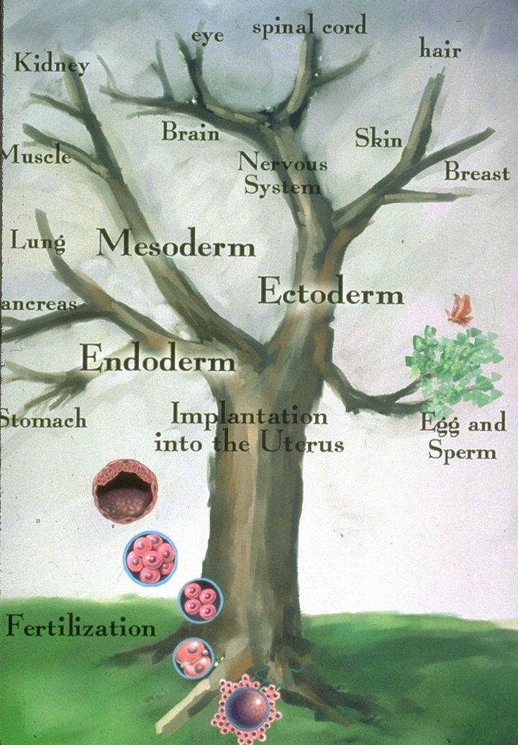
Tree of Embryonic Development

Slide 27
Thank You

