Slide 1
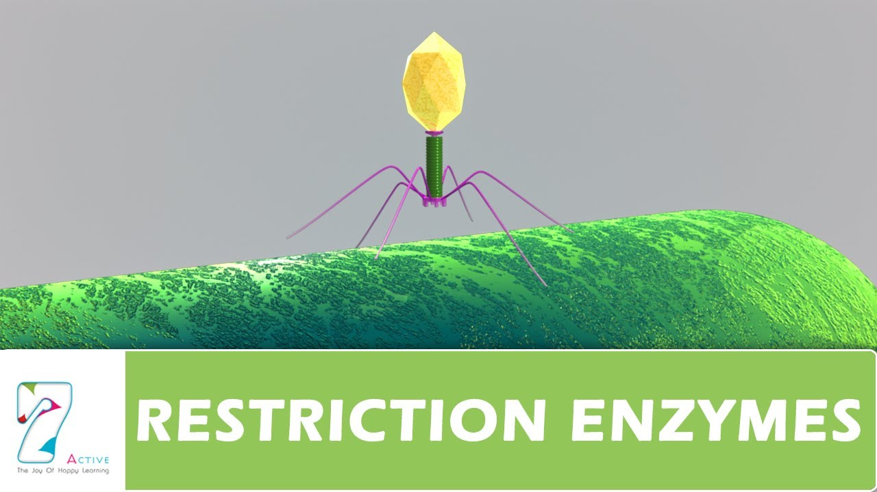
.

Slide 3
Nuclease Enzymes
Exonucleases: An enzymes that breaks down nucleic acid molecule by breaking the phosphodiester bonds at end 3/ or 5/.
Endonucleases: An Enzyme that hydrolyzes internal phosphodiester bonds in a polynucleotide chain or nucleic acid molecules.

Slide 4
Restriction Enzymes
Enzymes are grouped into five broad classes depending on the type of reaction:
Nucleases: Enzymes that cut, shorten or degrade nucleic acid molecules.
Ligases: Join nucleic acid molecules together
Polymerases: Make copies of molecules
Modifying Enzymes: Remove or add chemical groups.
Topoisomerases: Introduce or remove supercoils from covalently closed circular DNA.

Slide 7
Noble Prize (1978)
W. Arber
H.Smith
D.Nathans

Slide 8
Werner Arber
In 1978, microbiologist Werner Arber received a Nobel Prize in Physiology or Medicine (sharing the honor with Daniel Nathans and Hamilton O. Smith) for the discovery of restriction enzymes and their application to molecular genetics. Restriction enzymes cut DNA at specific places called restriction sites

Slide 9
In 1978, microbiologist Werner Arber received a Nobel Prize in Physiology or Medicine (sharing the honor with Daniel Nathans and Hamilton O. Smith) for the discovery of restriction enzymes and their application to molecular genetics.

Slide 10
Hamilton O. Smith
Hamilton O. Smith
Born: 23 August 1931, New York, NY, USA
award: Johns Hopkins University School of Medicine, Baltimore, MD, USA
Field: genetics, molecular biology

Slide 11
Daniel Nathans
Dr. Nathans' work demonstrated the immense utility of restriction enzymes for genome analysis, and transformed molecular biology

Slide 14
Nomenclature of Restriction Enzymes

Slide 18
Restriction Enzymes
Isozyme: They are isolated two different sources but posses similar recognition and cleavage site.
Hind iii and Hsu I
Alkaline Phophatase: Inhibition of recircularization of Plasmid DNA.

Slide 19
Thank You

