Slide 1
Research methodology
Dr. Md Fazlul Haque
Associate Professor
Dept. of Zoology
Rajshahi University

Slide 2
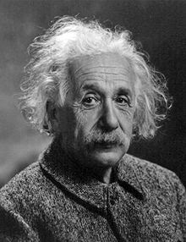
Introduction to research
“If we knew what we were doing, it wouldn’t be called research, would it?”
Albert Einstein?
Notes:
Spinach, it turns out, is not an especially good source of iron. As the story goes, people believe it’s a good source of iron because of a misplaced decimal point in a publication in the 1930s, reporting the iron content of spinach as ten times its actual level.

Slide 3
Definition of Research
Research is the process of asking questions and answering them in an organized way through:
  Survey
  Experiment
It involves:
  Examination of limits of knowledge
  Assessing what is known up to that point
  Defining unanswered questions
  Devising ways of answering them in an organized and meaningful way
It will be within the capability of every thinking person
Notes:
The research process can be performed by every thinking person.
There are well tried paths which can be seen in published works.
Knowledge of basic rules greatly facilitate any beginner.

Slide 4

Definition of Research
# Research is a systematized effort to gain new knowledge. -Redman and Mory.
# Research is the systematic process of collecting and analyzing information (data) in order to increase our understanding of the phenomenon about which we are concerned or interested.

Slide 5
Definition of Research
Research is knowledge acquisition gained
  through reasoning
  through intuition
  but most importantly through the use of appropriate methods (The scientific method)
                -Polgar, Thomas
Research is an endeavour to discover answers to intellectual and practical problems through the application of scientific method.

Slide 6
Scientific method
Scientific method is the systematic collection of data (facts) and their theoretical treatment through-
  proper observation,
  experimentation and
  interpretation.
Scientific method attempts to achieve a systematic interrelation of facts by experimentation, observation, and logical arguments from accepted postulates (Hypothesis) and a combination of these three in varying proportions.

Slide 7
basic postulates in scientific method
It relies on empirical (Experimental) evidence.
It utilizes relevant concepts.
It is committed to only objective considerations.
It presupposes ethical neutrality.
It results into probabilistic predictions.
The methodology is made known.
Aims at formulating scientific theories.

Slide 8
Objectives of Research
The purpose of research is to discover answers through the application of scientific procedures.
The objectives are:
To gain familiarity with a phenomenon or to achieve new insights into it – Exploratory or Formulative Research.
To portray accurately the characteristics of a particular individual, situation or a group – Descriptive Research.
To determine the frequency with which something occurs or with which it is associated with something else – Diagnostic Research.
To test a hypothesis of a causal relationship between variables – Hypothesis-Testing Research.

Slide 9
Characteristics of research
Research is directed towards the solution of a problem.
Research is based upon observable experience or empirical evidence.
Research demands accurate observation and description.
Research involves gathering new data from primary sources or using existing data for a new purpose.
Research activities are characterized by carefully designed procedures.
Research requires expertise i.e., skill necessary to carryout investigation, search the related literature and to understand and analyze the data gathered.
Research is objective and logical – applying every possible test to validate the data collected and conclusions reached.
Research involves the quest for answers to unsolved problems.
Research requires courage.
Research is characterized by patient and unhurried activity.
Research is carefully recorded and reported.

Slide 10
Good Research Process
Research is an extremely cyclic process.
This isn’t a weakness of the process but is part of the built-in error correction machinery.
Because of the cyclic nature of research, it can be difficult to determine where to start and when to stop.

Slide 11
Steps of a good research process
Raising a Question.
Suggest Hypothesis.
Literature Review.
Literature Evaluation.
Acquire Data.
Data Analysis.
Data Interpretation.
Hypothesis Support.

Slide 12
Step 1 A question is raised
A question occurs to or is posed to the researcher for which that researcher has no answer.
    Example: What is the impact of microplastic on the growth and reproduction of aquatic animals in the Padma river, Bangladesh?
The question needs to be converted to an appropriate problem statement like that documented in a research proposal.
    Example: What if microplastic affect the growth and reproduction of aquatic animals in the Padma river, Bangladesh?

Slide 13
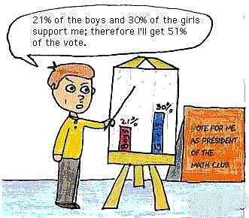
Step 2 Suggest hypothesis
The researcher generates intermediate hypotheses to describe a solution to the problem.
    This is at best a temporary solution since there is as yet no evidence to support either the acceptance or rejection of these hypothesis.
Impact of microplastic on aquatic animals in the Amazon river was reported; therefore microplastic will affect aquatic animals in the Padma river

Slide 14

Step 3 Literature review
The available literature is reviewed to determine if there is already a solution to the problem.
    Existing solutions do not always explain new observations.
    The existing solution might require some revision or even be discarded.

Slide 15
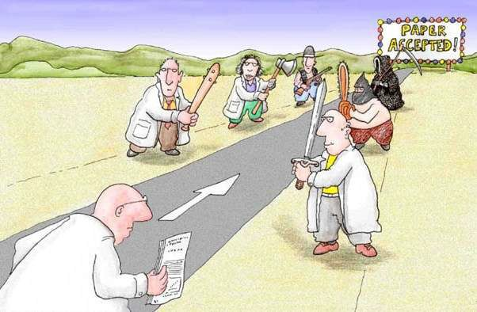
Step 4 Literature Evaluation
It’s possible that the literature review has yielded a solution to the proposed problem.
On the other hand, if the literature review turns up nothing, then additional research activities are justified.

Slide 16

Step 5 acquire data
The researcher now begins to gather data relating to the research problem.
The means of data acquisition will often change based on the type of the research problem.

Slide 17
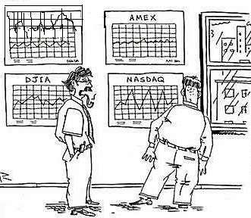
Step 6 data analysis
The data that were gathered in the previous step are analyzed as a first step in ascertaining their meaning.

Slide 18

Step 7 data interpretation
The researcher interprets the newly analyzed data and suggests a conclusion.
  This can be difficult.
  Keep in mind that data analysis that suggests a correlation between two variables can’t automatically be interpreted as suggesting causality between those variables.

Slide 19

Step 8 hypothesis support
The data will either support the hypotheses or they won’t.
  This may lead the researcher to cycle back to an earlier step in the process and begin again with a new hypothesis.
  This is one of the self-correcting mechanisms associated with the scientific method.

Slide 20
Types of scientific research
The research is broadly classified into two main classes:
  1. Fundamental or basic research
  2. Applied research.
Both basic and applied researches are generally of two kinds:
  1. Normal research
  2. Revolutionary research.
In addition, both basic and applied researches can be classified into three types:
  Quantitative
  Qualitative
  Even both (mixed research).

Slide 21
Types of scientific research
  Fundamental or basic research
  Study or investigation of some natural phenomenon or relating to pure science are termed as basic research.
  It is also called theoretical research.
  Basic research is an investigation on basic principles and reasons for occurrence of a particular event or process or phenomenon.
  It is not concerned with solving any practical problems of immediate interest.
  But it is original or basic in character.

Slide 22
Types of scientific research
  Fundamental or basic research
  It provides a systematic and deep insight into a problem and facilitates extraction of scientific and logical explanation and conclusion on it.
  It helps build new frontiers of knowledge.
  The outcomes of basic research form the basis for many applied research.
Main Characteristics
  Seeks generalization
  Aims at basic processes
  Attempts to explain why things happen
  Tries to get all the facts
  Reports in technical language of the topic

Slide 23
Types of scientific research
  Applied research
  In an applied research one solves certain problems using well known and accepted theories and principles.
  Most of the experimental research, case studies and inter-disciplinary research are essentially applied research.
  Applied research is helpful for basic research.
  A research, the outcome of which has immediate application is also termed as applied research.

Slide 24
Types of scientific research
  Applied research
  Main Characteristics
  Studies individual or specific cases without the objective to generalize
  Aims at any variable which makes the desired difference
  Tries to say how things can be changed
  Tries to correct the facts which are problematic
  Reports in common language

Slide 25
Types of scientific research
  Normal research
  In any particular field, normal research is performed in accordance with a set of rules, concepts and procedures called a paradigm, which is well accepted by the scientists working in that field.
  Revolutionary research
  In the context of science and technology, a revolution can be defined as a complete or marked change in rules, concepts and procedures called a paradigm. A revolutionary research will result in a paradigm shift that provides a new or perhaps highly revised map of the knowledge as it is currently understood.

Slide 26
Types of scientific research
  Quantitative research
  It is numerical, non-descriptive, applies statistics or mathematics and uses numbers.
  It is an iterative process whereby evidence is evaluated.
  The results are often presented in tables and graphs.
  It is conclusive.
  It investigates the what, where and when of decision making.
Notes:
iterative process: A process for arriving at a decision or a desired result by repeating rounds of analysis or a cycle of operations.

Slide 27
Types of scientific research
  Qualitative research
  It is non-numerical, descriptive, applies reasoning and uses words.
  Its aim is to get the meaning, feeling and describe the situation.
  Qualitative data cannot be graphed.
  It is exploratory.
  It investigates the why and how of decision making.
  Mixed research
  Mixed research that involves the mixing of quantitative and qualitative methods or paradigm characteristics.
  Nature of data is mixture of variables, words and images.

Slide 28
Types of scientific research
  OTHER TYPES OF RESEARCH
  Exploratory research
  Exploratory research might involve a literature search or conducting focus group interviews.
  The exploration of new phenomena in this way may help the researcher’s need for better understanding, may test the feasibility of a more extensive study, or determine the best methods to be used in a subsequent study.
  For these reasons, exploratory research is broad in focus and rarely provides definite answers to specific research issues.
  The objective of exploratory research is to identify key issues and key variables.

Slide 29
Types of scientific research
  OTHER TYPES OF RESEARCH
  Exploratory research
  Exploratory research might involve a literature search or conducting focus group interviews.
  The exploration of new phenomena in this way may help the researcher’s need for better understanding, may test the feasibility of a more extensive study, or determine the best methods to be used in a subsequent study.
  For these reasons, exploratory research is broad in focus and rarely provides definite answers to specific research issues.
  The objective of exploratory research is to identify key issues and key variables.

Slide 30
Types of scientific research
Descriptive research
The descriptive research is directed toward studying “what” and how many off this “what”. Thus, it is directed toward answering questions such as, “What is this?”.
Explanatory research
  Its primary goal is to understand or to explain relationships.
  It uses correlations to study relationships between dimensions or characteristics off individuals, groups, situations, or events.
  Explanatory research explains (How the parts of a phenomenon are related to each other).
  Explanatory research asks the “Why” question.

Slide 31
Types of scientific research
Longitudinal Research
Research carried out longitudinally involves data collection at multiple points in time.
Longitudinal studies may take the form of:
  Trend study- looks at population characteristics over time, e.g. organizational absenteeism rates during the course of a year
  Cohort study- traces a sub-population over time, e.g. absenteeism rates for the sales department;
  Panel study- traces the same sample repeatedly over time, often many year, e.g. graduate career tracks over the period 1990 – 2000 for the same starting cohort.
Notes:
Panel studies are a particular design of longitudinal study in which the unit of analysis is followed at specified intervals over a long period, often many years. The key feature of panel studies is that they collect repeated measures from the same sample at different points in time.

Slide 32
Types of scientific research
Cross-sectional Research
One-shot or cross-sectional studies are those in which data is gathered once, during a period of days, weeks or months.
Many cross-sectional studies are exploratory or descriptive in purpose.
They are designed to look at how things are now, without any sense of whether there is a history or trend at work.
While longitudinal studies will often be more time consuming and expensive than cross-sectional studies, they are more likely to identify causal relationships between variables.

Slide 33
Types of scientific research
Action Research
Action research can be defined as “an approach in which the action researcher and a client collaborate in the diagnosis of the problem and in the development of a solution based on the diagnosis”.
Action study assumes social world to be constantly changing, both, researcher and research being one part of that change.
Policy-Oriented Research
Reports employing this type of research focus on the question ‘How can problem ‘X’ be solved or prevented?’

Slide 34
Types of scientific research
Classification research
It aims at categorization of units in to groups
To demonstrate differences
To explain relationships
Comparative research
To identify similarities and differences between units at all levels
Causal research
It aims at establishing cause and effect relationship among variable
Theory-testing research
It aims at testing validity of a unit
Theory-building research
To establish and formulate the theory

Slide 35
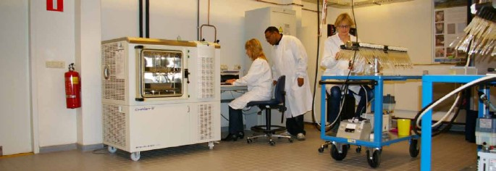
Problems and bottlenecks faced by researchers of Bangladesh
Lack of commitment in research work because of-
  Less research related job
  No incentive for good research
  No institutional system for filling a patent application for any invention and sharing the benefit between researcher and institute

Slide 36
Problems and bottlenecks faced by researchers of Bangladesh
Lack of research-friendly curriculum
Lack of knowledge and experience in research work
Lack of good supervision for research. A good supervision ensures-
  sufficient time,
  hands-on training,
  regular meeting
Allocation of inadequate time resulting in excess workload for research work
Lack of required instruments and reagents

Slide 37
Problems and bottlenecks faced by researchers of Bangladesh
Inadequate and problematic fund for research:
  Not enough fund for all
  Huge gape between proposed fund and allocated fund
  Time gape between allocation of fund and research schedule
  Usually no fund for long-term project for individual researcher
  No allocated fund for maintenance/repairing the valuable instruments
  Insufficient fund for good publication

Slide 38
Problems and bottlenecks faced by researchers of Bangladesh
Lack of central laboratory and related facilities in many institutes
Lack of research project/cell/council in many institutes resulting in-
  Inadequate guidance by the institute.
  No collaborative approach for research quality control
  Inadequate resources and staffs for research quality control such as Plagiarism check, Thesis writing format check, Biosafety ensure, Ethical assurance etc.

Slide 39
RESEARCH PROBLEM
What is a research problem?
The term ‘problem’ means a question or issue to be examined.
Research Problem refers to some difficulty /need which a researcher experiences in the context of either theoretical or practical situation and wants to obtain a solution for the same.
A research problem is a statement about an area of concern, a condition to be improved, a difficulty to be eliminated, or a troubling question that exists in scholarly literature, in theory, or in practice that points to the need for meaningful understanding and deliberate investigation.

Slide 40
RESEARCH PROBLEM
The purpose of a problem statement is to:
Introduce the reader to the importance of the topic being studied. The reader is oriented to the significance of the study and the research questions or hypotheses to follow.
Places the problem into a particular context that defines the parameters of what is to be investigated.
Provides the framework for reporting the results and indicates what is probably necessary to conduct the study and explain how the findings will present this information.

Slide 41
SOURCES OF PROBLEMS
Reading
Academic Experience
Daily Experience
Exposure to Field Situations
Consultations
Brainstorming
Research
Intuition

Slide 42
How to find a research problem?
Step 1: Identify a broad problem area
As you discuss and read about your topic, look for:
    under-explored aspects and
    areas of concern,
    conflict or controversy.
Your goal is to find a gap that your research project can fill.
To find the Practical or Theoretical research problems the focus will be different

Slide 43
How to find a research problem?
Practical research problems
If you are doing practical research, you can identify a problem by reading reports, following up on previous research, and talking to people who work in the relevant field or organization.
Theoretical research problems
Theoretical research focuses on expanding knowledge and understanding rather than directly contributing to change.
You can identify a research problem by reading recent research, theory and debates on your topic to find a gap in what is currently known about it.

Slide 44
How to find a research problem?
Step 2: Learn more about the problem
Next, you have to find out what is already known about the problem, and pinpoint the exact aspect that your research will address.
It have to include
  the context and background of problem
  specificity and relevance of problem

Slide 45
How to find a research problem?
Context and background
Who does the problem affect?
Has it been an issue for a long time, or is it a newly discovered problem?
What research has already been done?
Have any solutions been proposed?
What are the current debates about the problem, and what do you think is missing from them?

Slide 46
How to find a research problem?
Specificity and relevance
What particular place, time and/or animals/ people will you focus on?
What aspects will you not be able to tackle?
What will be the consequences if the problem is not resolved?
Whose will benefit from resolving the problem

Slide 47
SELECTION OF A RESEARCH TOPIC
The selection of one appropriate researchable topic out of the identified problems or topics requires evaluation of certain criteria. These are:
Internal / Personal criteria – Researcher’s Interest, Researcher’s Competence, Researcher’s own Resource: finance and time.
External Criteria or Factors – Researchable problem, Importance and Urgency, Novelty of the Problem, Feasibility, Facilities, Usefulness and Social Relevance, Research Personnel.

