Slide 1
Palaeontology

Slide 2
Palaeontology
Palaeontology is the branch of science concerned with fossil
Palaeontology is the study of fossils as a way of getting information about:
the history of life on earth and
the structure of rocks
Palaeontology is the study of:
prehistoric life forms (or fossils) preserved in rocks and ancient sediments and
the evolution of life on Earth.
It is a multidisciplinary science, involving not only geology but also aspects of biology and chemistry.

Slide 3
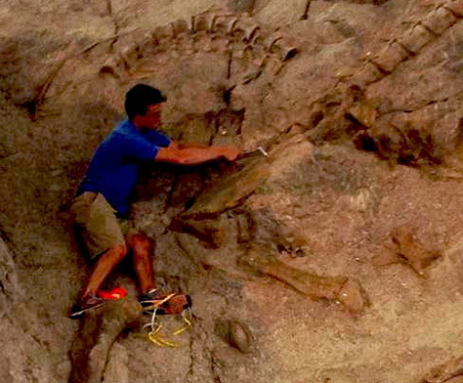
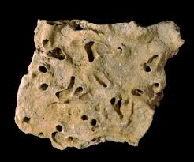
Fossils
The word ‘fossil’ comes from the Latin word fossus, which means ‘dug up’.
Fossils are evidence of ancient life forms or ancient habitats which have been preserved by natural processes.

Slide 4
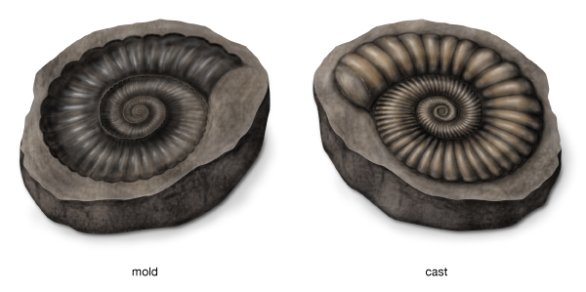
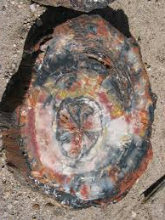
Fossils
Fossils are the remains or impression of a prehistoric organism preserved in petrified form or as a mould or cast in rock.

Slide 5
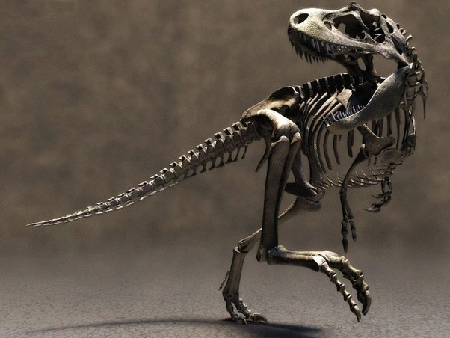
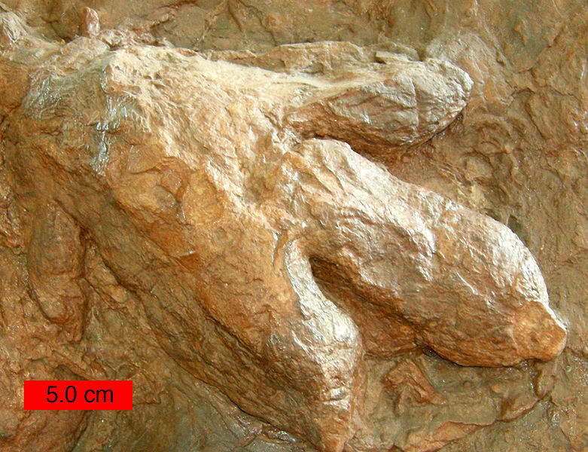
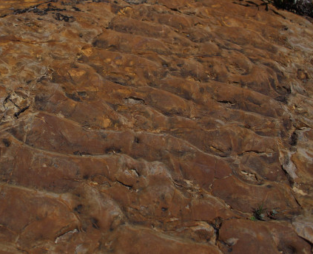
Fossils
Fossils can be
the actual remains of a once living thing, such as bones or seeds, or
The traces of past events such as dinosaur footprints, or
the ripple marks on a prehistoric shore.
Fossils are our window into the past.

Slide 6
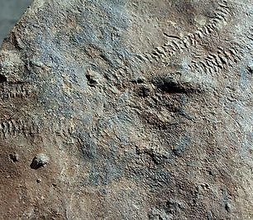
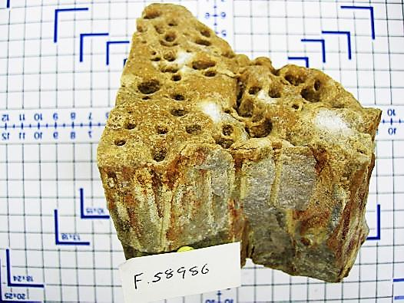
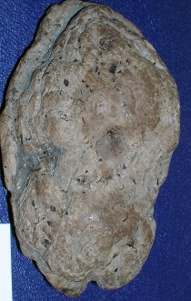
different types of fossils
Trace fossils
Trace fossils are the preserved evidence of an animal’s activity or behaviour, rather than the remains of the animal itself.
Examples of trace fossils that have been found include:
trilobite tracks
marine invertebrate burrows
ichthyosaur coprolites (fossilised poo)

Slide 7
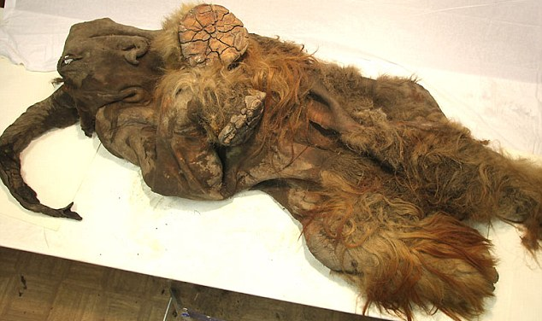
different types of fossils
Fossils with some organic material preserved
Animal and plant remains can undergo a variety of physical and chemical changes during fossilisation.
This results in fossils showing varying styles and degrees of organic preservation:
minimal decay with only some loss of soft tissue
Mammoth

Slide 8
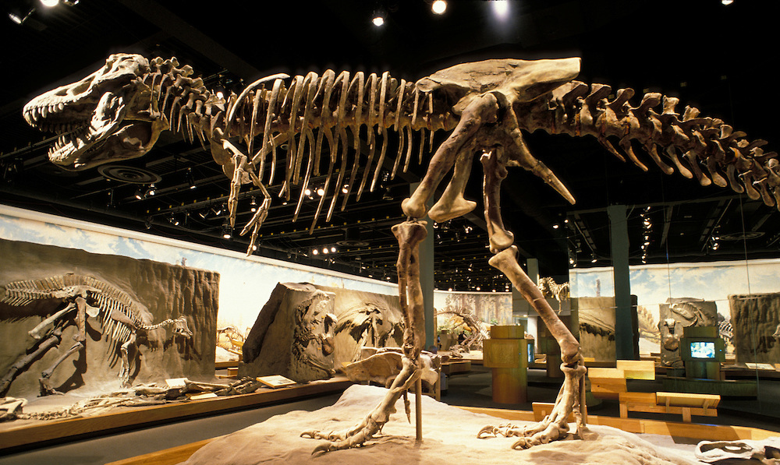
different types of fossils
Fossils with some organic material preserved
Animal and plant remains can undergo a variety of physical and chemical changes during fossilisation.
This results in fossils showing varying styles and degrees of organic preservation:
preservation of a skeleton with minimal change

Slide 9
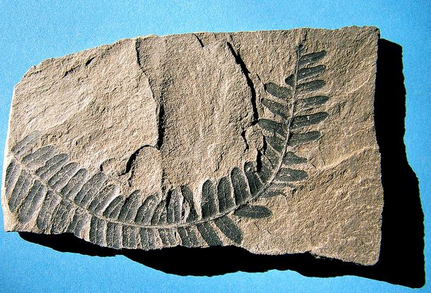
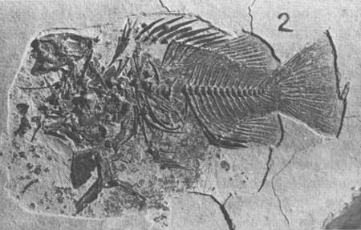
different types of fossils
Fossils with some organic material preserved
Animal and plant remains can undergo a variety of physical and chemical changes during fossilisation.
This results in fossils showing varying styles and degrees of organic preservation:
removal of all organic material except carbon, which remains as a film in the rock

Slide 10
different types of fossils
Mineralised fossils
These fossils are formed when organic matter in remains is gradually replaced with minerals, ultimately turning the remains to ‘rock’.
Types of replacement include:
Replacement of organic material in bone with minerals
Replacement of shell with pyrite
Replacement of shell with opal
Replacement of wood with silica – petrified wood

Slide 11
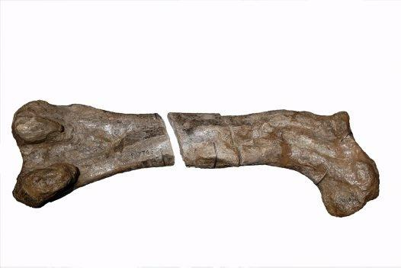
different types of fossils
Mineralised fossils
Replacement of organic material in bone with minerals
A mineralised bone of a dinosaur

Slide 12
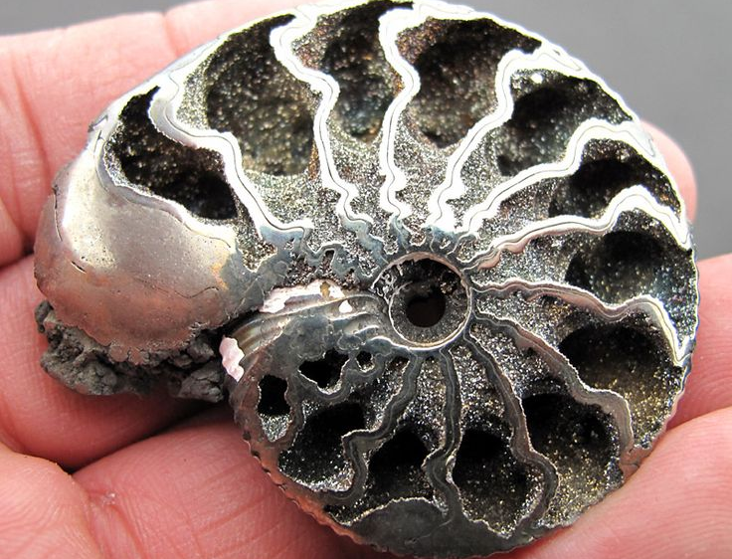
different types of fossils
Mineralised fossils
Replacement of shell with pyrite
Pyrite, also known as fool's gold, is an iron sulfide
A mineralised shell of a snail

Slide 13
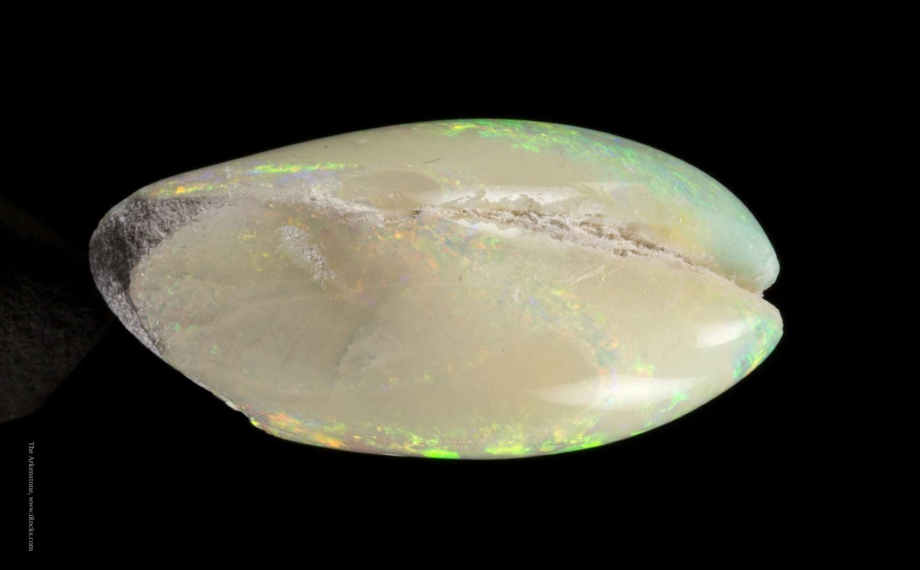
different types of fossils
Mineralised fossils
Replacement of shell with opal
Opal is a hydrated amorphous form of silica
A mineralised shell of a clam

Slide 14
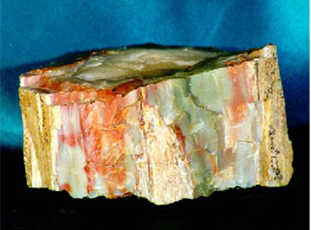
different types of fossils
Mineralised fossils
Replacement of wood with silica – petrified wood
Silica also known as Silicon dioxide is a chemical compound made of silicon and oxygen.
A petrified wood

Slide 15
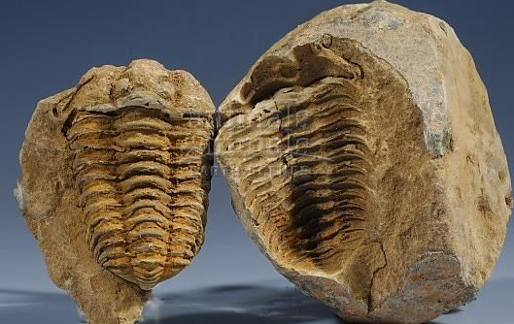
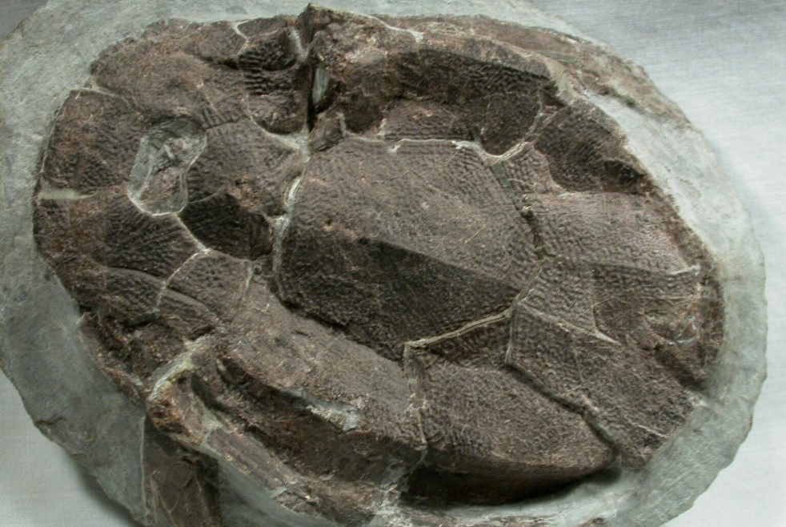
different types of fossils
Impression fossils
Fossils can also form when the remains decay completely but leave an impression in the sediment.
Impressions can be of the external shape or internal space (which may fill with other minerals or sediment).
Impressions of trilobites
Armoured fishes

Slide 16
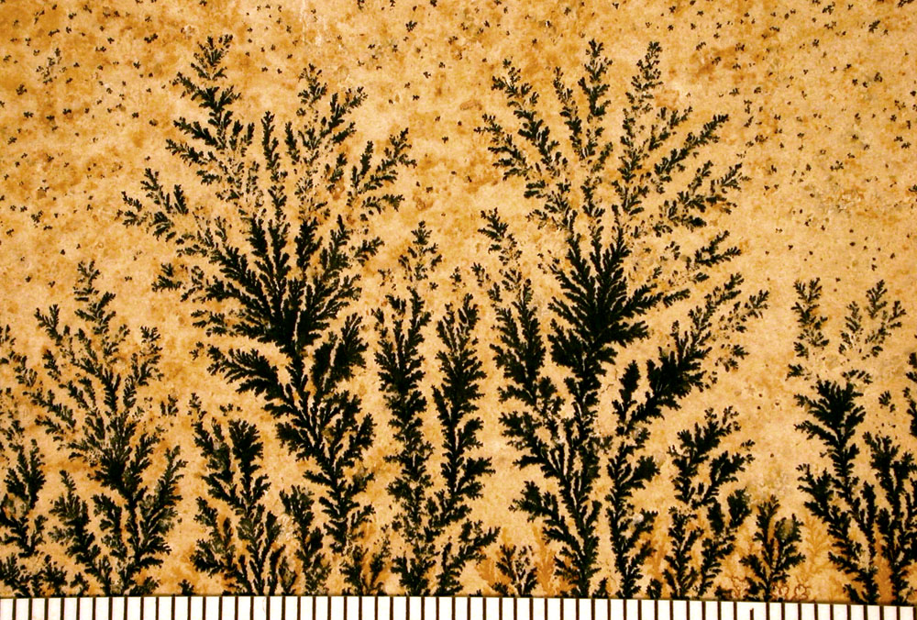
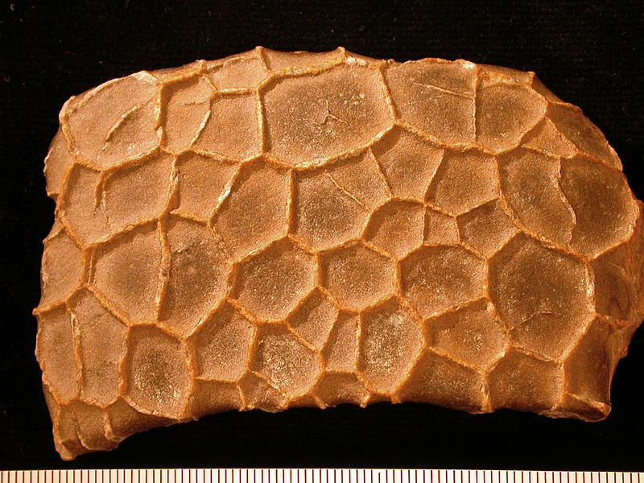
different types of fossils
Pseudofossils
Pseudofossils are inorganic objects, markings, or impressions that might be mistaken for fossils.
Manganese Dendrite (crystal) on a limestone
Concretion with calcite-filled septarian cracks.

Slide 17
different types of fossils
Chemical fossils
Chemical fossils are chemicals found in rocks that provide an organic signature for ancient life.
Two types:
Molecular fossils:
Molecular fossils are often referred to as biomarkers or biosignatures and represent products of cellular biosynthesis that are incorporated into sediments and eventually into rock.
Fossil fuels petroleum (crude oil), coal, and natural gas
Isotope ratios:
Isotope ratios represent another type of chemical fossil and result from metabolic processes that preferentially utilize one form of an isotope over another.
C-12 to C-13 ratios in photosynthesis

Slide 18
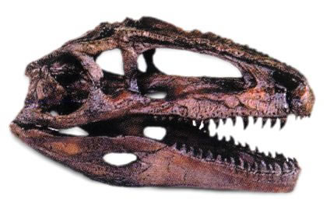
different types of fossils
Organ fossil
Organ fossils are naturally preserved organs of ancient life found in nature.
Eg. bone, teeth, shell, leaf etc.

Slide 19
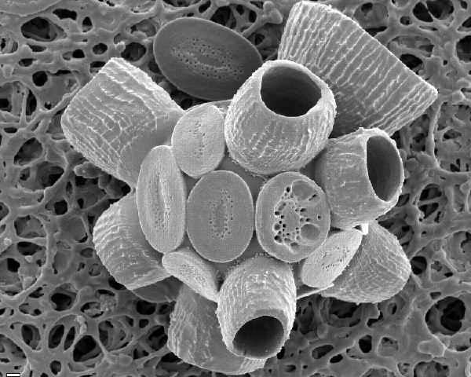
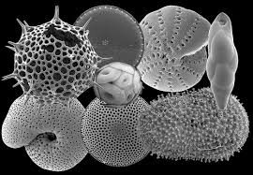
different types of fossils
Depending on Size
Nanno-fossil: Nanno-fossils are the fossil of a minute planktonic organism, especially a calcareous unicellular alga.
Microfossils: Microfossil are the fossils that are generally between 0.001mm and 1 mm in size, the study of which requires the use of light or electron microscopy.
Macrofossil: Macrofossils, also known as megafossils, are preserved organic remains large enough to be visible without a microscope.

Slide 20
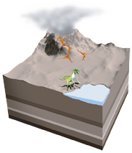
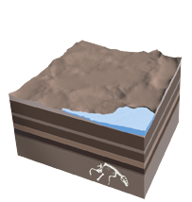
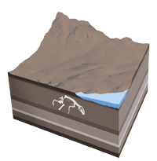
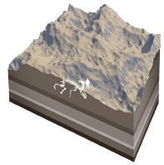
FOSSIL FORMATION
1. Sediment
An animal is buried by sediment, such as volcanic ash or silt, shortly after it dies. Its bones are protected from rotting by the layer of sediment.
2. Layers
More sediment layers accumulate above the animal’s remains, and minerals, such as silica (a compound of silicon and oxygen), slowly replace the calcium phosphate in the bones.
3. Movement
Movement of tectonic plates, or giant rock slabs that make up Earth’s surface, lifts up the sediments and pushes the fossil closer to the surface.
4. Erosion
Erosion from rain, rivers, and wind wears away the remaining rock layers. Eventually, erosion or people digging for fossils will expose the preserved remains.

Slide 21
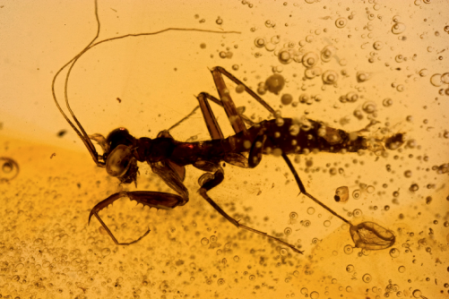
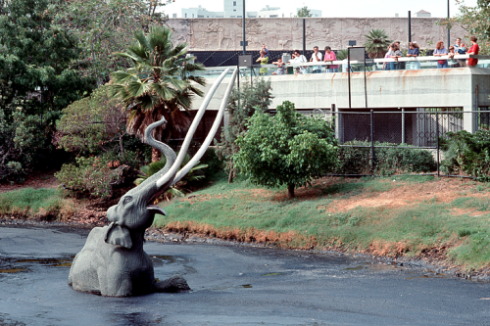
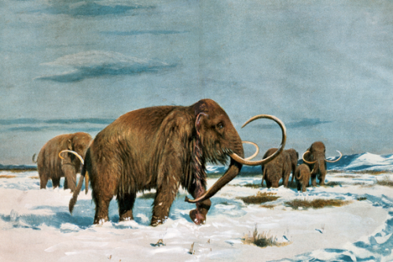
FOSSIL FORMATION
Some organisms get preserved in or close to their original states. Here are some ways that can happen.
Amber An organism, such as an insect, is trapped in a tree’s sticky resin and dies. More resin covers it, sealing the insect inside. It hardens into amber.
Tar An organism, such as a mammoth, is trapped in a tar pit and dies. The tar soaks into its bones and stops the bones from decaying.
Ice An organism, such as a woolly mammoth, dies in a very cold region. Its body is frozen in ice, which preserves the organism—even its hair!

