Slide 1
Learning Domain
Dr. Md Fazlul Haque
Assistant Professor
Dept. of Zoology
Rajshahi University

Slide 2
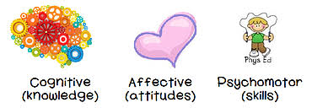
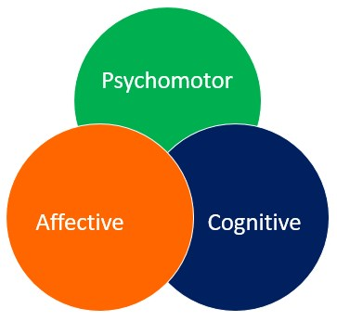
Three domains of Learning

Slide 3
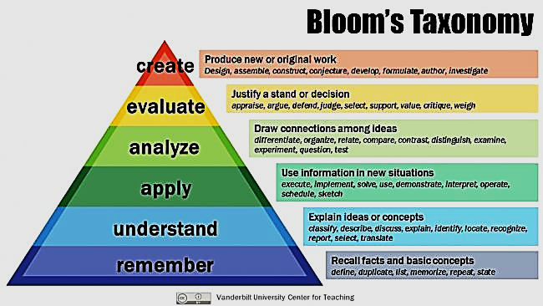
Cognitive Domain (Levels of learning)

Slide 4
Cognitive Domain
Level | Learning outcome examples The student will be able to:
1. Remember | 1. mention ways of prevention and control of Dengue
2. Understand | 2. describe prevention and control measures of Dengue
3. Apply | 3. implement prevention and control measures of Dengue in practical life
4. Analyze | 4. compare components of different prevention and control measure of Dengue
5. Evaluate | 5. select the best prevention and control measures of Dengue
6. Create | 6. develop novel prevention and control measures of Dengue

Slide 5
Psychomotor Domain
Both of them are learning how to write, but one is cognitive and another is psychomotor learning.
Learning how to write alphabet
Learning how to write an official report

Slide 6
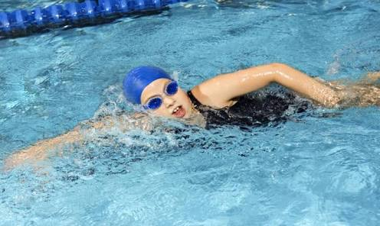
Psychomotor Domain
Both of them are learning how to swim, but one is cognitive and another is psychomotor learning.
Learning how to swim by physical practice
Learning how to swim by reading a book

Slide 7
Psychomotor Domain
Without physical exercise/ practice, psychomotor learning is not possible
Learning how to swim by physical practice
Learning how to write alphabet

Slide 8
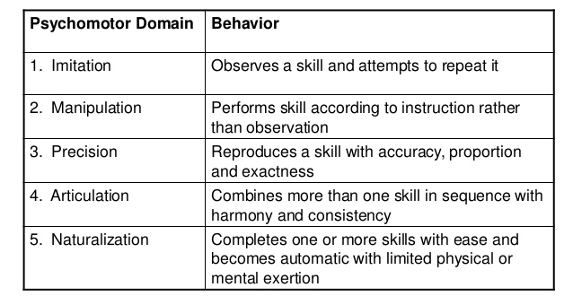
Psychomotor Domain (Levels of learning)

Slide 9
Psychomotor Domain
Level | Learning outcome examples The student will be able to:
1. Imitation | 1. copy each step of histological slide preparation by direct observation
2. Manipulation | 2. do each step of histological slide preparation according to instruction
3. Precision | 3. do each step of histological slide preparation with accuracy, proportion and exactness
4. Articulation | 4. prepare a perfect histological slide if attentive
5. Naturalization | 5. prepare a perfect histological slide easily with limited physical and mental effort

Slide 10
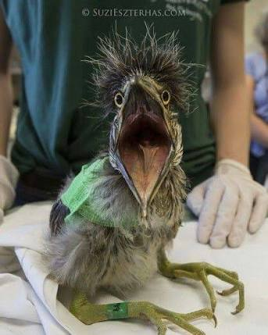
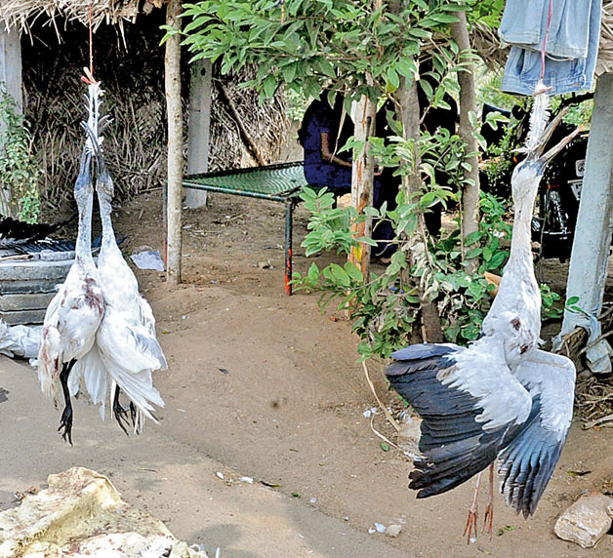
Affective Domain
Dealing with birds in both cases, but attitude/ behavior is different

Slide 11
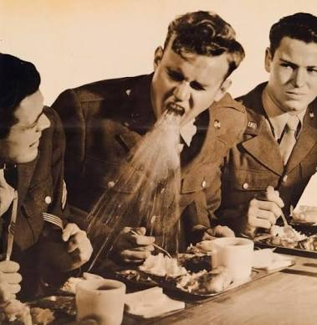
Affective Domain
Dealing with sneezing in both cases, but attitude/ behavior is different

Slide 12
Affective Domain
Without positive change in attitude/ behavior, affective learning is not possible

Slide 13
Affective Domain (Levels of learning)

Slide 14
Affective Domain
Level | Learning outcome examples The student will:
1. Receiving | 1. listen any lecture attentively on animal conservation
2. Responding | 2. ask related questions for further clarification on animal conservation
3. Valuing | 3. participate in optional program on animal conservation
4. Organizing | 4. arrange occasionally program on animal conservation
5. Characterizing | 5. arrange consistently program on animal conservation

