Slide 1
Gene:
Fine Structure of Gene

Slide 2
An imaginary overview

Slide 3

All information of our life is written in two Books

Slide 4
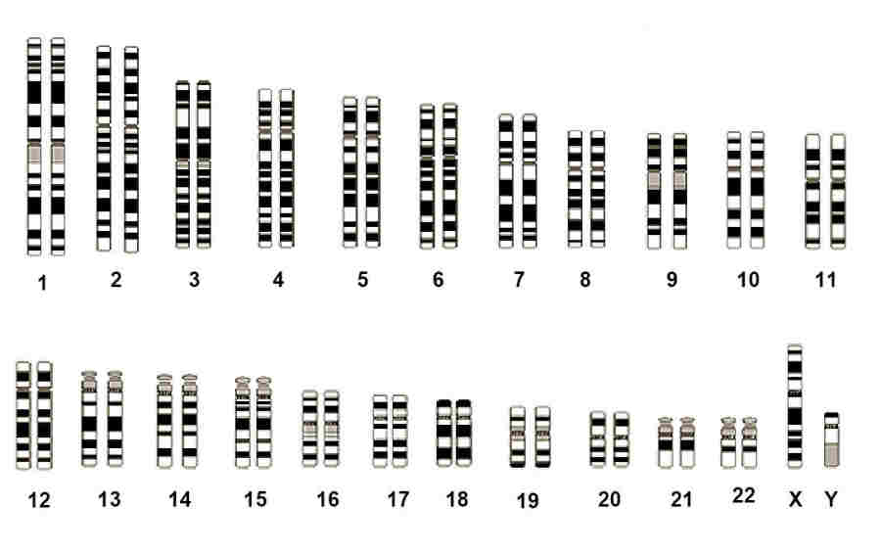
Two set (23 Pairs) of Chromosomes

Slide 5

One of these Books of life is written by Father

Slide 6
Set of chromosomes (23) inherited from Father

Slide 7

The another Book is written by Mother

Slide 8
Set of chromosomes (23) inherited from Mother

Slide 9

Both of these Books are preserved in a Bookshelf

Slide 10
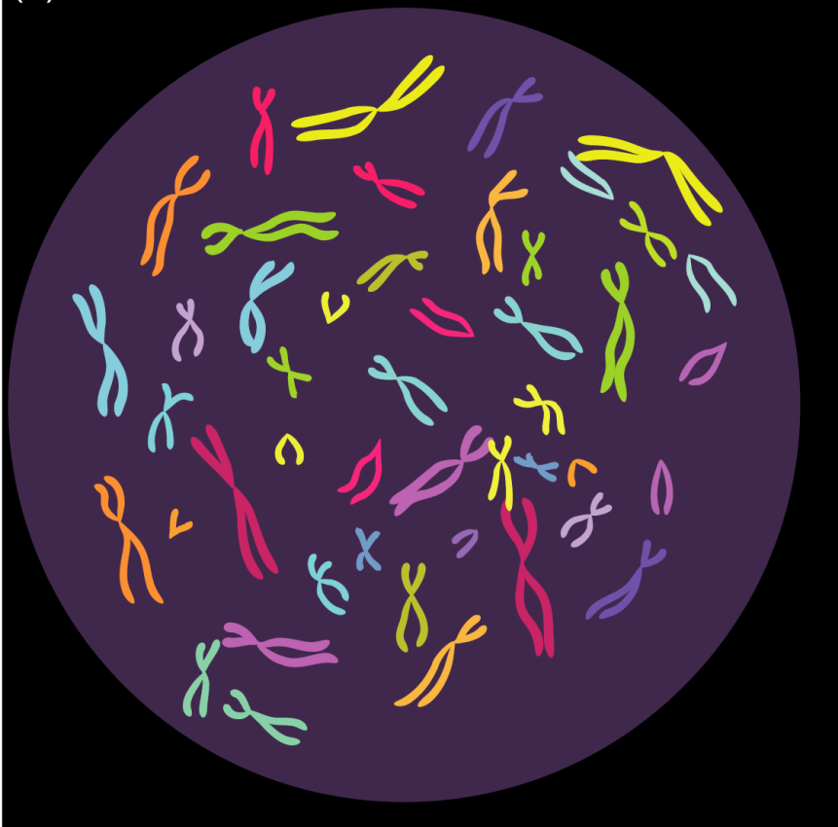
Both set of chromosomes are preserved in a Nucleus

Slide 11


Each Book of Life has 23 Chapters with same title except chapter number 23
Ch. 1:
Chromosome 1
Ch. ---:
Chromosome ---
Ch. 1:
Chromosome 1
Ch. ---:
Chromosome ---
Ch. 2:
Chromosome 2
Ch. 23:
Chromosome X
Ch. 23:
Chromosome X / Y
Ch. 2:
Chromosome 2

Slide 12
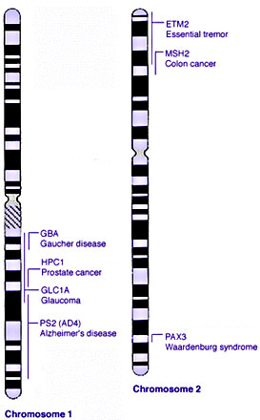
Each Chapter (Chromosome) has many subtitle (Gene)
Ch. 2:
Chromosome 2
Gene ETM2
Gene MSH2
Ch. 1:
Chromosome 1
Gene GBA
Gene HPC1
Notes:
Waardenburg syndrome is a group of genetic conditions that can cause hearing loss and changes in coloring (pigmentation) of the hair, skin, and eyes.
Alzheimer’s disease is an irreversible, progressive brain disorder that slowly destroys memory and thinking skills, and eventually the ability to carry out the simplest tasks

Slide 13
There are two copies (allele) of each subtitle (Gene) in a cell as each cell contains two books of life
Ch. 2:
Chromosome 2
Gene ETM2
Gene msh2
Ch. 2:
Chromosome 2
Gene ETM2
Gene MSH2
Ch. 1:
Chromosome 1
Gene GBA
Gene HPC1
Ch. 1:
Chromosome 1
Gene gba
Gene HPC1

Slide 14
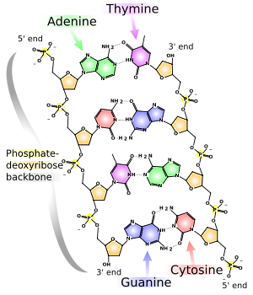
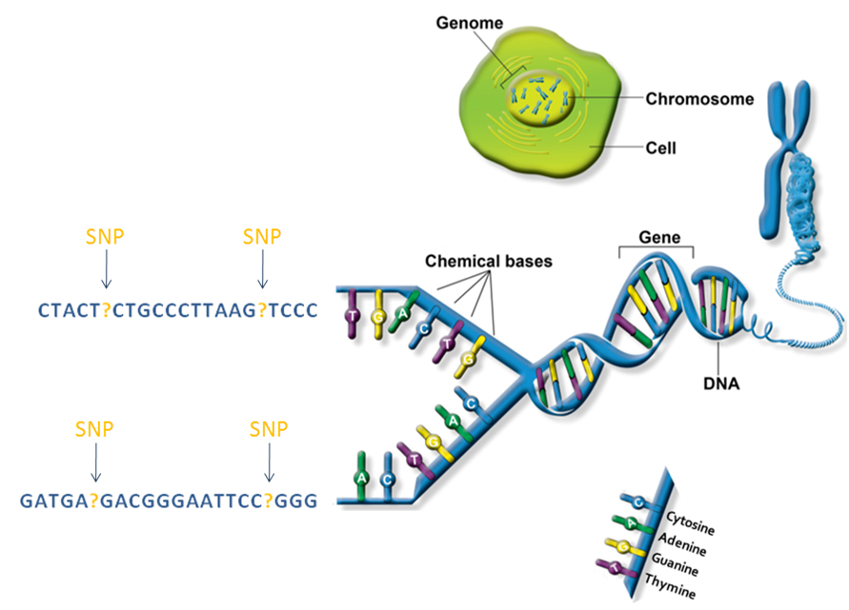
Each subtitle (Gene) is written with a 4 letters (A, T, G, C) language
Notes:
A Single Nucleotide Polymorphism (SNP, pronounced snip; plural snips) is a DNA sequence variation occurring commonly within a population (e.g. 1%) in which a single nucleotide — A, T, C or G — in the genome (or other shared sequence) differs between members of a biological species or paired chromosomes.

Slide 15
Depending on external and/or internal need, specific subtitle (Gene) is selected for reading by reader (Cell)
Ch. 2:
Chromosome 2
Gene ETM2
Gene MSH2
Ch. 1:
Chromosome 1
Gene GBA
Gene HPC1

Slide 16
Depending on comparative expression power, one of the copies (allele) of specific subtitle (Gene) become easily accessible for reading by reader (Cell)
Ch. 2:
Chromosome 2
Gene ETM2
Gene MSH2
Ch. 2:
Chromosome 2
Gene ETM2
Gene MSH2
Ch. 1:
Chromosome 1
Gene GBA
Gene HPC1
Ch. 1:
Chromosome 1
Gene gby
Gene HPC1

Slide 17
EVOLUTION OF GENE CONCEPT
YEAR | SCIENTIST | GENE CONCEPT
1866 | G.J. MENDEL | A unit factor that controls specific phenotypic trait
1902 | SIR A.E.GARROD | One gene –one metabolic block theory
1940 | BEADLE & TATUM | One gene-one enzyme theory
Notes:
Mendel law can not explain Pleiotropy (one gene can affect more than one character): eg. In case of pea, dominant gray seed-coat color is associated with purple flower color; Recessive white seed-coat color is accompanied by white flower color. In case of human, Cystic fibrosis (CFTR gene) is a good of example of pleiotropy, where a mutation in a single gene affects multiple systems in this case the lungs, pancreas, and sweat glands.
Garrod, in fact, took two big steps at once: from recognition of the relation of the specific altered gene to the particular blocked step in the metabolic pattern,and thence to the lack of the specific enzyme governing that metabolic step.
The one gene-one enzyme hypothesis is the idea that genes act through the production of enzymes, with each gene responsible for producing a single enzyme that in turn affects a single step in a metabolic pathway. The concept was proposed by George Beadle and Edward Tatum in an influential 1941 paper^{[1]} on genetic mutations in the mold Neurospora crassa, and subsequently was dubbed the "one gene-one enzyme hypothesis" by their collaborator Norman Horowitz.^{[2]} In 2004 Norman Horowitz reminisced that “these experiments founded the science of what Beadle and Tatum called ‘biochemical genetics.’ In actuality they proved to be the opening gun in what became molecular genetics and all the developments that have followed from that.”^{[3]} The development of the one gene-one enzyme hypothesis is often considered the first significant result in what came to be called molecular biology.^{[4]} Although it has been extremely influential, the hypothesis was recognized soon after its proposal to be an oversimplification. Even the subsequent reformulation of the "one gene-one polypeptide" hypothesis is now considered too simple to describe the relationship between genes and proteins.^{[5]}

Slide 18
EVOLUTION OF GENE CONCEPT
YEAR | SCIENTIST | GENE CONCEPT
1957 | U.M.INGRAM | One gene-one polypeptide theory
1960s | C.YANOFSKY & CO-WORKERS | Gene is a unit of recombination
Notes:
The theory that each gene is responsible for the synthesis of a single polypeptide. It was originally stated as the one gene-one enzyme hypothesis by the US geneticist George Beadle in 1945 but later modified when it was realized that genes also encoded nonenzyme proteins and individual polypeptide chains. It is now known that some genes code for various types of RNA involved in protein synthesis.
DNA recombination involves the exchange of genetic material either between multiple chromosomes or between different regions of the same chromosome. This process is generally mediated by homology; that is, homologous regions of chromosomes line up in preparation for exchange, and some degree of sequence identity is required. Various cases of nonhomologous recombination do exist, however.

Slide 19
CLASSICAL DEFINITION OF GENE
Gene is the unit of-
Function (one gene specifies one character),
Recombination, and
Mutation.
Notes:
# DNA recombination involves the exchange of genetic material either between multiple chromosomes or between different regions of the same chromosome. This process is generally mediated by homology; that is, homologous regions of chromosomes line up in preparation for exchange, and some degree of sequence identity is required. Various cases of nonhomologous recombination do exist, however.
# Mutation is a permanent alteration of the nucleotide sequence of the genome of an organism, virus, or extrachromosomal DNA or other genetic elements

Slide 20
MORDERN DEFINITION OF GENE
Unit of Genetic Information ( Unit of DNA that specifies one polypeptide)
Includes coding as well as non-coding regulatory sequences.

Slide 21
Exons and Introns
Exons are segments of a gene that encode mature mRNA for a specific polypeptide chain.
Introns are segments of a gene that do not encode mature mRNA. Introns are found in most genes in eukaryotes and in some gene of bacteriophage and archae .

Slide 22
An eukaryotic Gene
Notes:
Introns are removed by splicing RNA precursors

Slide 23
Types of exons
Transcription start
polyA
Stop
5’
GT
AG
GT
AG
GT
AG
GT
AG
Gene
3’
promoter
Open reading frame
Initial exon
Internal exon
Terminal exon
Translation
Translation
Start
Stop
mRNA
5’
3’
5’ untranslated
region
Protein
coding
region
3’ untranslated
region

Slide 24
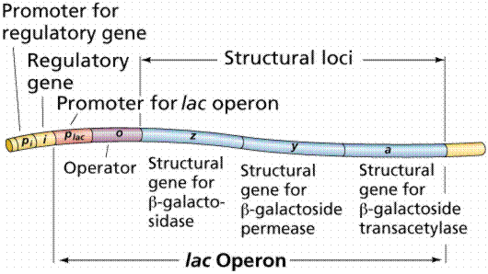
lac Operon
Notes:
An Operon is a functioning unit of genomic DNA containing a cluster of genes under the control a single promoter. Operon were thought to exist solely in prokaryotes, but since the discovery of the first operons in eukaryotes ( C. elegans) in 1993 by Spieth and their colleagues.

Slide 25
Operon(Gene cluster under control of single promoter)
Structural gene- gene that codes for a polypeptide
Promoter site- region where RNA polymerase bind to initiate transcription of the structural genes (STG).
Operator Site - region where the repressor attaches to control the access to STG
Regulatory gene- codes for repressor proteins
Notes:
An Operon is a functioning unit of genomic DNA containing a cluster of genes under the control a single promoter. Operon were thought to exist solely in prokaryotes, but since the discovery of the first operons in eukaryotes ( C. elegans) in 1993 by Spieth and their colleagues.

Slide 26
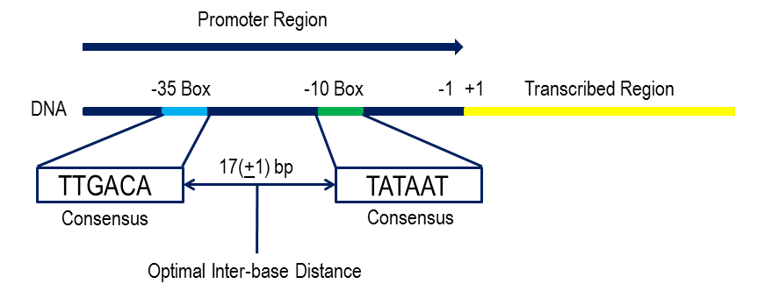
Bacterial Promoter
-35 box
-10 or Pribnow or TATA box
Notes:
In bacteria, the promoter contains two short sequence elements approximately -10 and -35 nucleotides upstream from the transcription start site.
The sequence at -10 (the -10 element) has the consensus sequence TATAAT.
The sequence at -35 (the -35 element) has the consensus sequence TTGACA.

Slide 27
ESSENTIAL FEATURES OF GENE
Determines the physical as well as physiological characters.
Situated in the chromosome.
Occupies a specific position known as Locus.

Slide 28
ESSENTIAL FEATURES OF GENE
Arranged in single linear order.
Occur in functional states called Alleles.
Some have more than 2 alleles known as Multiple Alleles.

Slide 29
ESSENTIAL FEATURES OF GENE
Some may undergo sudden and permanent change in expression called as Mutant Gene (Mutation).
May be transferred to its homologous (Cross-over) or non-homologous counterpart (Translocation).

Slide 30
ESSENTIAL FEATURES OF GENE
Can duplicate themselves very accurately (Replication).
Synthesizes a particular Protein.
Determines the sequence of amino acid in the polypeptide chain

Slide 31
ESSENTIAL FEATURES OF GENE
Average size of Prokaryotic gene is 1 kbp and have little diversity
Average size of Eukaryotic gene is 16 kbp and have great diversity

Slide 32
SOME TERMS RELATED TO GENE
RECON - It is the smallest unit of DNA capable of undergoing Crossing Over & Recombination.
MUTON - It is the smallest unit of DNA which can undergo Mutation.
Notes:
BENZA has coined new terms to denote the relationship between DNA molecule and genetic phenomenon.

Slide 33
SOME TERMS RELATED TO GENE
COMPLON - It is the unit of complementation.
CISTRON - The portion of DNA specifying a single polypeptide chain is termed as cistron.
Notes:
BENZA has coined new terms to denote the relationship between DNA molecule and genetic phenomenon.

Slide 34
Gene Cistron Relationship
  Prokaryotes : Genes and Cistrons are equivalent
  Eukaryotes : Cistron is equivalent to the exons

Slide 35
Genetic Recombination
Genetic recombination involves the exchange of genetic material (DNA):
- between multiple chromosomes
- between different regions of the same chromosome.
This process is generally mediated by:
- homology (homologous regions of chromosomes line up in preparation for exchange)
- some degree of sequence identity.
However, various cases of nonhomologous recombination do exist

Slide 36
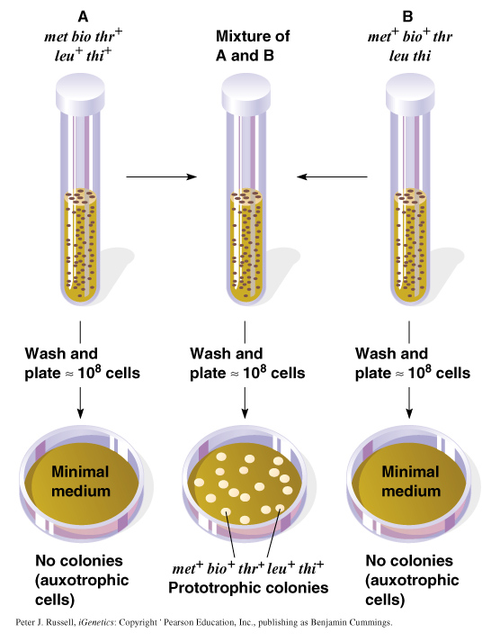
Lederberg-Tatum Experiment for Genetic Recombination
Strain A:
Grow if minimal medium supplemented with methionine and biotin.
Strain B:
Grow if minimal medium supplemented with threonine, leucine and thiamine.
Notes:
Lederberg and Tatum discovered conjugation (1946) using two E. coli auxotrophic mutant strains:
a. Strain A’s genotype was met bio thr⁺ leu⁺ thi⁺. It grows on minimal medium supplemented with methionine and biotin.
b. Strain B’s genotype was met⁺ bio⁺ thr leu thi. It grows on minimal medium supplemented with threonine, leucine and thiamine.
c. Strains A and B were mixed, and plated onto minimal medium. About 1/10⁶ cells produced colonies with the phenotype met⁺ bio⁺ thr⁺ leu⁺ thi⁺ (Figure 14.2).
d. Neither strain produced colonies when plated alone onto minimal medium, so the new phenotype resulted from recombination.

Slide 37
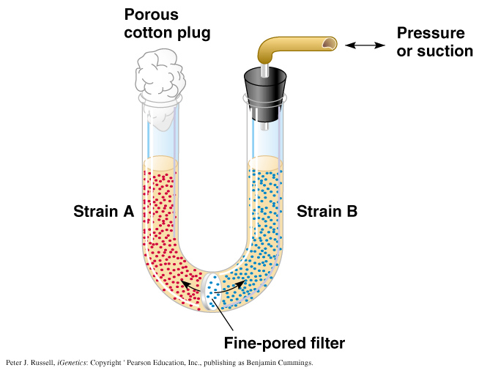
Davis’s U-tube experiment
Notes:
Davis tested whether cell-to-cell contact was required:
a. Strain A cells were placed on one side of a filter, and strain B on the other. Cells could not move through the filter but molecules moved freely, encouraged by alternating suction and pressure.
b. No prototrophic colonies appeared when the cells were plated on minimal medium. This indicates that cell-to-cell contact is required, and the genetic recombination results from

Slide 38
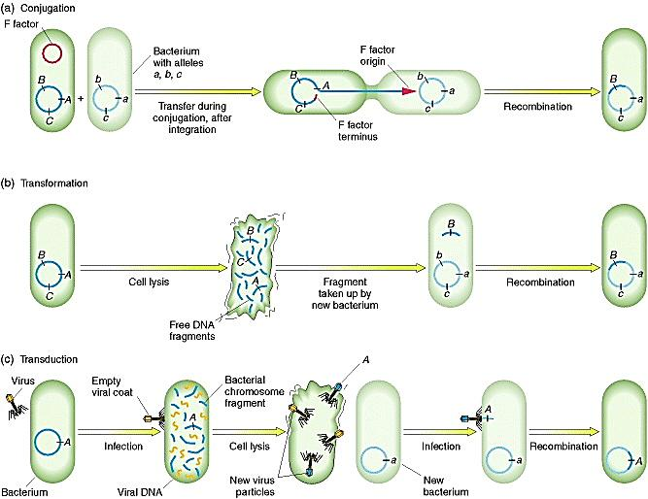
Ways of Genetic Recombination: Conjugation
Conjugation: The direct transfer of DNA (usually plasmid) from one bacterial cell to another bacterial cell. It require formation of a conjugation bridge between two bacterial cells

Slide 39
Ways of Genetic Recombination: Transformation
Transformation: The genetic alteration of a cell resulting from the direct uptake and incorporation of exogenous genetic material (exogenous DNA) from its surroundings through the cell membrane(s).

Slide 40
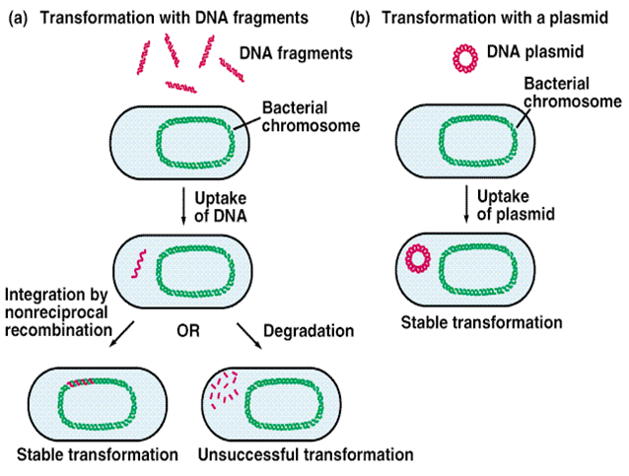
Ways of Transformation

Slide 41
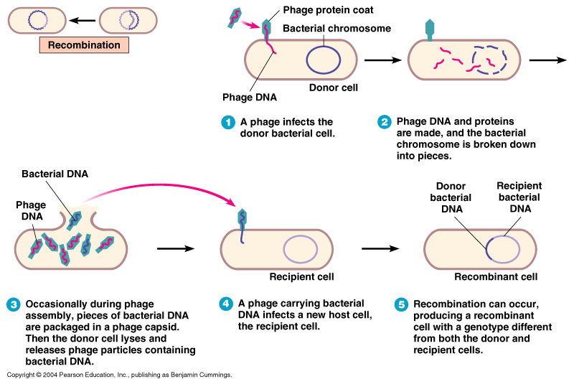
Ways of Genetic Recombination: Transduction
Transduction is the process by which genetic material, e.g. DNA or siRNA, is inserted into a cell by a virus.

Slide 42
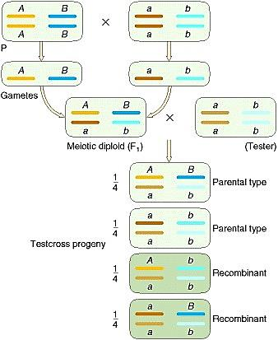
Ways of Genetic Recombination: independent assortment
Notes:
Independent assortment always produces a recombinant frequency of 50 percent. This diagram shows two chromosome pairs of a diploid organism with A and a on one pair and B and b on the other. Note that we could represent the haploid situation by removing the parental (P) cross and the testcross.

Slide 43
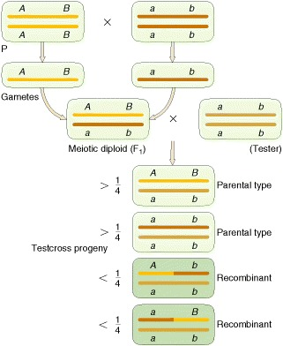
Ways of Genetic Recombination:
crossing-over
Notes:
Recombination from crossing-over. Notice that the frequencies of the recombinants add up to less than 50 percent.
MESSAGE
A recombinant frequency significantly less than 50 percent shows that the genes are linked. A recombinant frequency of 50 percent generally means that the genes are unlinked on separate chromosomes.

Slide 44
Complementation test
Occasionally, multiple mutations of a single wild type phenotype are observed.
The appropriate genetic question to ask is:
  whether any of the mutations are in a single gene, or
  whether each mutations represents one of the several genes (complementation group) necessary for a phenotype to be expressed.
The simplest test to distinguish between the two possibilities is the complementation test.
Notes:
Occasionally, multiple mutations of a single wild type phenotype are observed. The appropriate genetic question to ask is whether any of the mutations are in a single gene, or whether each mutations represents one of the several genes necessary for a phenotype to be expressed. The simplest test to distinguish between the two possibilities is the complementation test. The test is simple to perform --- two mutants are crossed, and the F1 is analyzed. If the F1 expresses the wild type phenotype, we conclude each mutation is in one of two possible genes necessary for the wild type phenotype. When it is shown that shown genetically that two (or more) genes control a phenotype, the genes are said to form a complementation group. Alternatively, if the F1 does not express the wild type phenotype, but rather a mutant phenotype, we conclude that both mutations occur in the same gene.
Eye color in Drosphila is a good model to demonstrate the complementation test. A wide array of spontaneous mutations have been studied. These experiments demonstrated that five genes (white, ruby, vermillion, garnet and carnation) controlling eye color reside within 60 cM of each other on the X chromosome. The dominant wild type allele for each gene produces the deep red eyes. The mutant alleles produce a different color. If mutants from any of these five genes are crossed, the F1 would express deep red eye color (wild type phenotype).

Slide 45
Complementation test
In complementation test, two mutants are crossed, and the F1 is analyzed.
If two mutants are crossed and F1 express wild type phenotype, the phenomenon by which F1 do this is known as Genetic complementation. It indicate that each mutation is in one of two possible genes necessary for the wild type phenotype.
Alternatively, if the F1 does not express the wild type phenotype, but rather a mutant phenotype, we conclude that both mutations occur in the same gene.
Notes:
Occasionally, multiple mutations of a single wild type phenotype are observed. The appropriate genetic question to ask is whether any of the mutations are in a single gene, or whether each mutations represents one of the several genes necessary for a phenotype to be expressed. The simplest test to distinguish between the two possibilities is the complementation test. The test is simple to perform --- two mutants are crossed, and the F1 is analyzed. If the F1 expresses the wild type phenotype, we conclude each mutation is in one of two possible genes necessary for the wild type phenotype. When it is shown that shown genetically that two (or more) genes control a phenotype, the genes are said to form a complementation group. Alternatively, if the F1 does not express the wild type phenotype, but rather a mutant phenotype, we conclude that both mutations occur in the same gene.
Eye color in Drosphila is a good model to demonstrate the complementation test. A wide array of spontaneous mutations have been studied. These experiments demonstrated that five genes (white, ruby, vermillion, garnet and carnation) controlling eye color reside within 60 cM of each other on the X chromosome. The dominant wild type allele for each gene produces the deep red eyes. The mutant alleles produce a different color. If mutants from any of these five genes are crossed, the F1 would express deep red eye color (wild type phenotype).

Slide 46
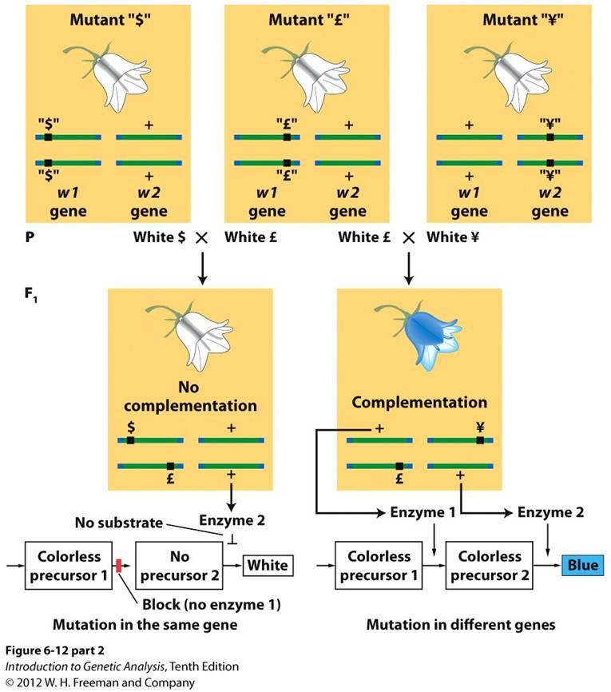
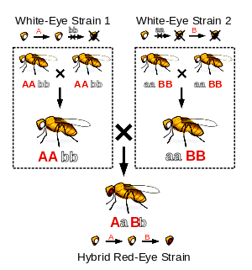
Complementation test
Notes:
Occasionally, multiple mutations of a single wild type phenotype are observed. The appropriate genetic question to ask is whether any of the mutations are in a single gene, or whether each mutations represents one of the several genes necessary for a phenotype to be expressed. The simplest test to distinguish between the two possibilities is the complementation test. The test is simple to perform --- two mutants are crossed, and the F1 is analyzed. If the F1 expresses the wild type phenotype, we conclude each mutation is in one of two possible genes necessary for the wild type phenotype. When it is shown that shown genetically that two (or more) genes control a phenotype, the genes are said to form a complementation group. Alternatively, if the F1 does not express the wild type phenotype, but rather a mutant phenotype, we conclude that both mutations occur in the same gene.
Eye color in Drosphila is a good model to demonstrate the complementation test. A wide array of spontaneous mutations have been studied. These experiments demonstrated that five genes (white, ruby, vermillion, garnet and carnation) controlling eye color reside within 60 cM of each other on the X chromosome. The dominant wild type allele for each gene produces the deep red eyes. The mutant alleles produce a different color. If mutants from any of these five genes are crossed, the F1 would express deep red eye color (wild type phenotype).

Slide 47
Cis and Trans position
Cis position: Genes in the cis position are on the same chromosome of a pair of homologous chromosomes.
Trans position: Genes in the trans position are on the different chromosomes of a pair of homologous chromosomes.

Slide 48
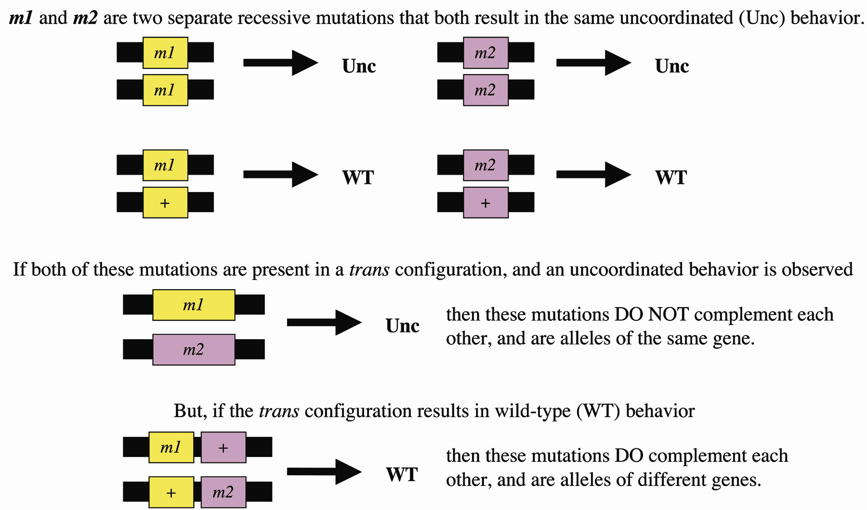
Notes:
Cis position: Genes in the cis position are on the same chromosome of a pair of homologous chromosomes.

Slide 49
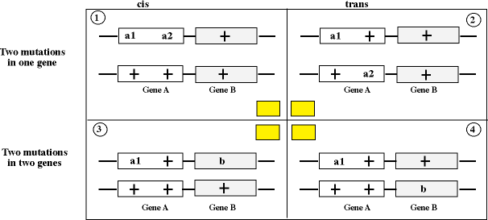
Wild type
Mutant type
Wild type
Wild type
Notes:
Cis position: Genes in the cis position are on the same chromosome of a pair of homologous chromosomes.
Trans position: Genes in the trans position are on the different chromosomes of a pair of homologous chromosomes.

Slide 50
T4 rII system
The T4 rII system is an experimental system developed in the 1950s by Seymour Benzer
It was developed for studying the substructure of the gene.
This experimental system is based on genetic crosses of different mutant strains of bacteriophage T4,
Bacteriophage T4 is a virus that infects the bacteria E. coli.

Slide 51
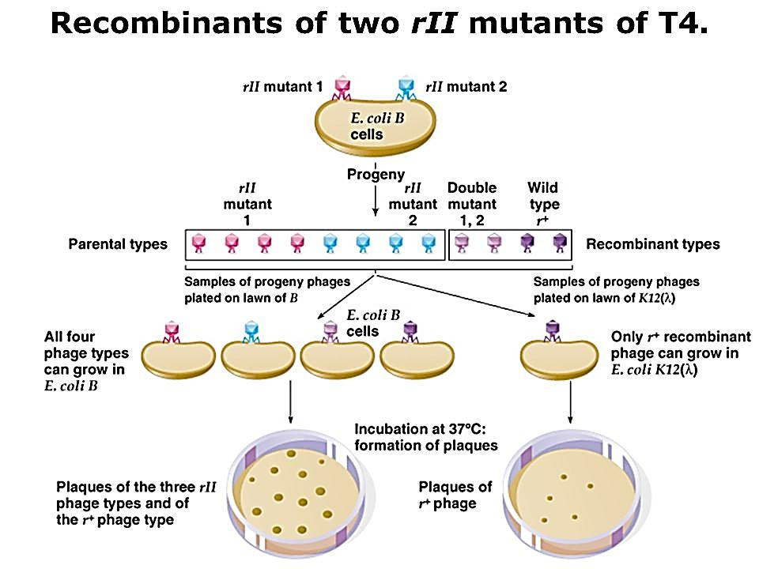
Notes:
One type of mutation in the T4 bacteriophage identified by researchers in Phage genetics by the 1950s was known as r (for rapid), which caused the phage to destroy bacteria more quickly than normal. These could be spotted easily because they would produce larger plaques rather than the smaller plaques characteristic of the wild type virus. Through genetic mapping, the researchers had identified specific regions in the T4 chromosome, called the rI, rII, and rIII loci, associated with the r mutants. In 1952, while performing experiments with rII mutants, Seymour Benzer found a strain that did not behave normally. By 1953, after the publication of Watson and Crick's proposed structure of DNA, Benzer hit on the idea that the apparently defective r mutants might have been the result of crossing two different rII mutants, each of which had part of the rII gene intact, so that the hybrid strain did not exhibit the r phenotype at all because it combined the intact parts of the rII gene.
From there, Benzer saw that it would be possible to generate many independent r mutants, and by measuring the recombination frequency between different r strains, he could map the substructure of a single gene. Although the chance of successful recombination for any given virus was very small, a single petri dish could be the basis for millions of trials at once. They could be screened easily by using a specific strain of E. coli, known as K12 (λ), that was susceptible to wild type T4 but not to r mutants.

Slide 52
Transposons (Jumping Genes)
Transposons or Jumping genes or Movable genes can be defined as small, mobile DNA sequences that:
    move around chromosomes with no regard for homology and
    insertion of these elements may produce deletions, inversions, chromosomal fusions and even more complicated rearrangements

Slide 53
Characteristics of Transposable Elements
They are found to be DNA sequences that code for enzymes which bring about the insertion of an identical copy of themselves into a new DNA site
Transposition events involves both recombination and replication process which frequently generates two daughter copies of the original transposable elements. One copy remains at the parent site while the other appears at the target site (on the host chromosome)

Slide 54
Characteristics of Transposable Elements (cont.)
3. The insertion of transposable elements invariably disrupts the integrity of their target genes.
4. Since transposable elements carry signals for the initiation of RNA synthesis, they sometimes activate previously dormant genes.
5. A transposable elements is not a replicon, thus, it can not replicate apart from the host chromosome, the way that plasmid and phage can.
6. No homology exists between the transposons and the target site for its insertion. Many transposons can insert at virtually any position in the host chromosome or into a plasmid.

Slide 55
Types of Transposable elements
Transposable elements can be classified into several types, but broadly two types:
Insertion sequence or simple transposons
Composite or complex transposons

Slide 56
Insertion sequence or simple transposons
An insertion sequence is a short DNA sequence that acts as a simple transposable element.
Insertion sequences have two major characteristics:
  they are small relative to other transposable elements (generally around 700 to 2500 bp in length) and
  only code for proteins implicated in the transposition activity
These proteins are usually the transposase which catalyses the enzymatic reaction allowing the IS to move, and also one regulatory protein which either stimulates or inhibits the transposition activity.
The coding region in an insertion sequence is usually flanked by inverted repeats.
In addition to occurring autonomously, insertion sequences may also occur as parts of composite transposons; in a composite transposon, two insertion sequences flank one or more accessory genes, such as an antibiotic resistance gene (e.g. Tn10, Tn5).

Slide 57
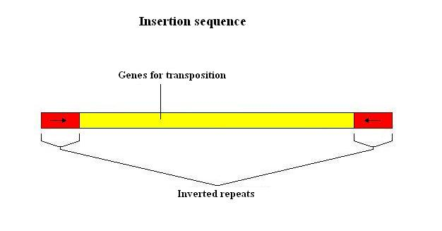
Insertion sequence or simple transposons
Notes:
An insertion sequence (also known as an IS, an insertion sequence element, or an IS element) is a short DNA sequence that acts as a simple transposable element. Insertion sequences have two major characteristics: they are small relative to other transposable elements (generally around 700 to 2500 bp in length) and only code for proteins implicated in the transposition activity (they are thus different from other transposons, which also carry accessory genes such as antibiotic resistance genes). These proteins are usually the transposase which catalyses the enzymatic reaction allowing the IS to move, and also one regulatory protein which either stimulates or inhibits the transposition activity. The coding region in an insertion sequence is usually flanked by inverted repeats.

Slide 58
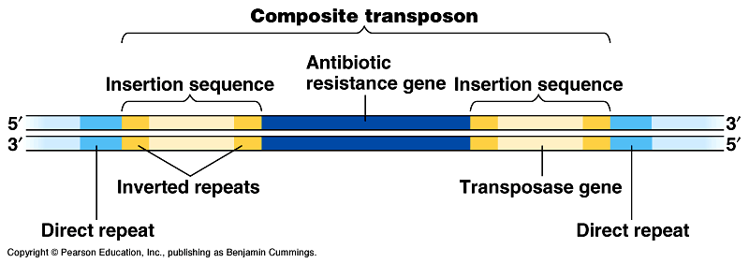
Composite or complex transposons
Composite transposons (complex transposons) include extra genes sandwiched between two insertion sequences.
Composite transposons may help bacteria adapt to new environments.
Repeated movements of resistance genes by composite transposition may concentrate several genes for antibiotic resistance onto a single R plasmid.
Nevertheless, there exist another sort of transposons, called unit transposons, that do not carry insertion sequences at their extremities (e.g. Tn7).

Slide 59
Genetic Code
The genetic code is a set of rules defining how the four-letter (A, T, G, C) code of DNA is translated into the 20-letter code of amino acids, which are the building blocks of proteins.
The genetic code is a collection of three-letter combinations of nucleotides called codons, each of which corresponds to a specific amino acid or to translational signal.

Slide 60
Genetic Code
The concept of codons was first described by Francis Crick and his colleagues in 1961.
Any altered codon (triplet of DNA nucleotides) that encodes an incorrect amino acid or stop signal, resulting in an altered or non-functioning peptide or protein product is known as missense codon.

Slide 61
Basis for Cryptoanalys
Cryptoanalys is the analysis a secrete code language.
Genetic information is written in DNA.
DNA molecule consists of:
  Deoxyribose sugar
  (One type; Arrangement diversity not possible)
  Phophate
  (One type; Arrangement diversity not possible)
  Nitrogenous bases
  (Four types: A, T, G, C; Arrangement diversity possible)

Slide 62
Size of Codon
How 4 letters-language of DNA is translated into 20-letters language of protein?
Explained by George Gamov (1954) by logical reasoning
Singlet codon ?
(Maximum 4 types of codon for amino acids; Not sufficient for 20 amino acids)
Doublet codon ?
(Maximum 16 types of codon for amino acids; Not sufficient for 20 amino acids)
Triplet codon ?
(Maximum 64 types of codon for amino acids; Sufficient for 20 amino acids)

Slide 63
Size of Codon
How 4 letters-language of DNA is translated into 20-letters language of protein?
Singlet codon ?
(Maximum 4 types of codon for amino acids; Not sufficient for 20 amino acids)
Doublet codon ?
(Maximum 16 types of codon for amino acids; Not sufficient for 20 amino acids)
Triplet codon ?
(Maximum 64 types of codon for amino acids; Sufficient for 20 amino acids)

Slide 64
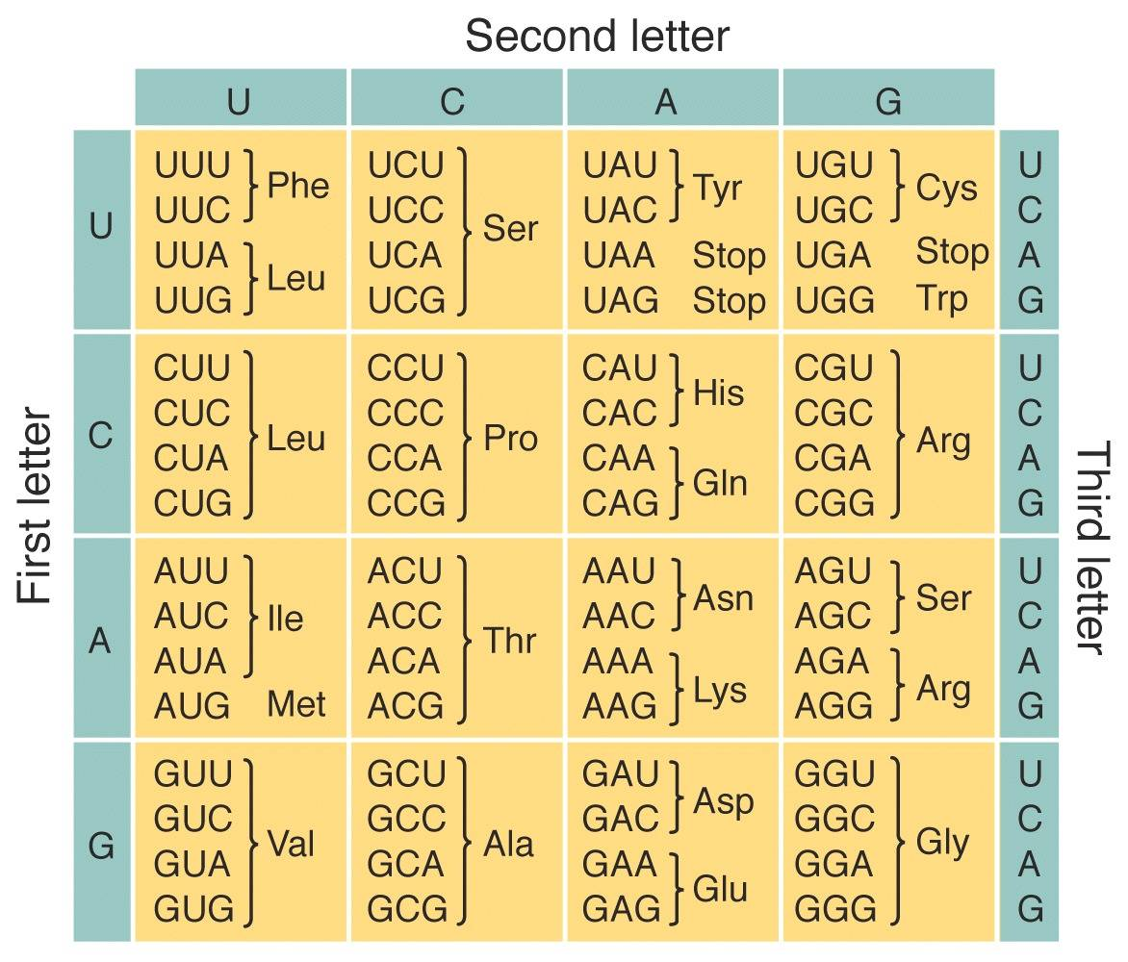
Genetic code

Slide 65
Characters of genetic code
The code is triplet: Each codon consists of three bases (triplet). There are 64 codons. 61 codons code for amino acids.
There is one start codon (initiation codon): AUG acts as start codon. AUG code for methionine. Protein synthesis begins with methionine (Met) in eukaryotes, and formylmethionine (fmet) in prokaryotes.
Some codons acts as stop codons: These three (UAA, UGA, UAG) are stop codons (or nonsense codons) that terminate translation.
The code is unambiguous: Each codon specifies no more than one amino acid.
The code has polarity: They are all written in the 5' to 3' direction.

Slide 66
Characters of genetic code
The code is degenerate: More than one codon can specify a single amino acid.
All amino acids, except Met and tryptophan (Trp), have more than one codon.
For those amino acids having more than one codon, the first two bases in the codon are usually the same. The base in the third position often varies (Wobble hypothesis).
The code is almost universal: (the same in all organisms). Some minor exceptions to this occur in mitochondria and some organisms.
The code is commaless (contiguous): There are no spacers or "commas" between codons on an mRNA.
The code is non-overlapping: Neighboring codons on a message are non-overlapping.

Slide 67
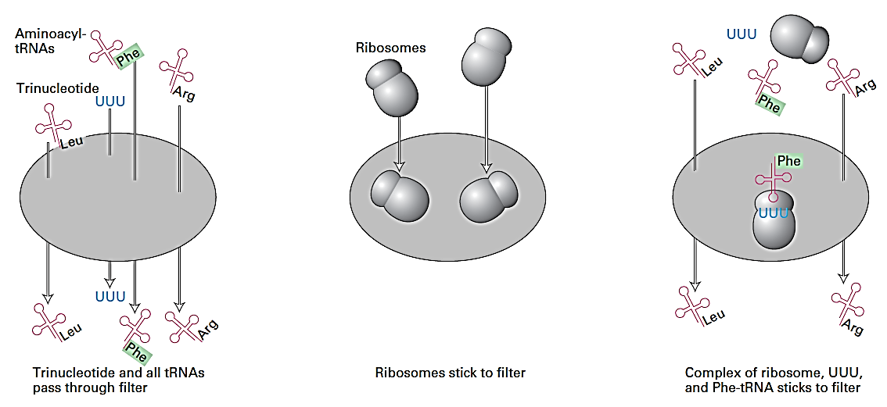
Decoding genetic code by using mini-messenger in filter binding
Notes:
Assay developed by Marshall Nirenberg and his collaborators for deciphering the genetic code. They prepared 20 E. coli extracts containing all the aminoacyl-tRNAs (tRNAs with amino acid attached). In each extract sample, a different amino acid was radioactively Labeled (green); the other 19 amino acids were present on tRNAs but remained unlabeled. Aminoacyl-tRNAs and trinucleotides passed through a nylon filter without binding ( left panel ); ribosomes, however, bind to the filter (center panel). Each of the 64 possible trinucleotides was tested separately for its ability to attract a specific tRNA by adding it with ribosomes to different extract samples. Each sample was then filtered. If the added trinucleotide causes the radiolabeled aminoacyl-tRNA to bind to the ribosome, then radioactivity is detected on the filter; otherwise, the label passes through the filter (right panel). By synthesizing and testing all possible trinucleotides, the researchers were able to match all 20 amino acids with one or more codons (e.g., phenyalanine with UUU as shown here).

Slide 68
Exception of Universality of Code
Codon | Mammalian Mitochondria Code | Yeast Mitochondria Code | Universal Code
UGA | Tryptophan | Tryptophan | Stop
AUA | Methionine | Methionine | Isoleucine
CUA | Leucine | Threonine | Leucine
AGA AGG | Stop | Arginine | Arginine

Slide 69
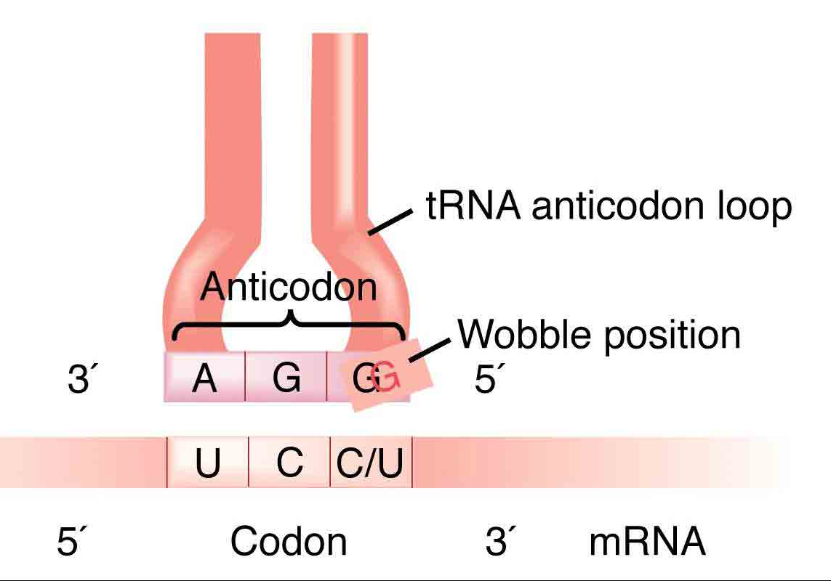
Differences between “Codon” and “Anticodon”
Codon:
It is found in DNA and mRNA.
2. Codon is complementary to a triplet of template strand.
3. It determines the position of an amino acid in a polypeptide.
Anticodon
1. It occurs in tRNA.
2. It is complementary to a codon.
3. It helps in bringing a particular amino acid at its proper position during translation.

Slide 70
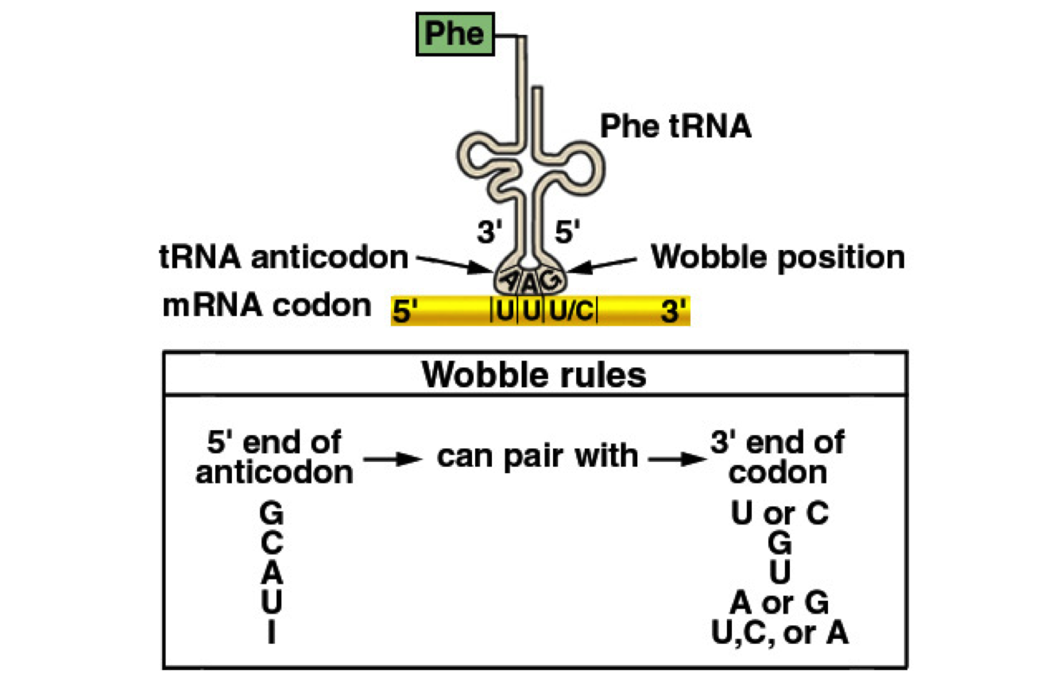
Wobble hypothesis

Slide 71
Regulation of Gene Action
The synthesis of particular gene products is controlled by mechanisms collectively called regulation of gene action.
Synthesis of gene products can be controlled at the level of-
- Genome (DNA) (usually in eukaryotes)
- Transcription
- Post-transcription (usually in eukaryotes)
- Translation
- Post-translation

Slide 72
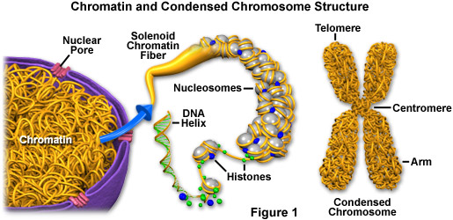
Regulation of Gene Action at the Level of Genome
At the level of genome, the following five modes of regulation are operative:
Situation of total genetic shutdown. Example:
(a) During mitotic phase of the cell cycle, chromatin is highly condensed to form chromosome resulting in suspension of transcriptional activity of all genes.
(b) In mammalian female, one of the two X chromosomes present in somatic cells undergoes condensation in early embryonic stages to become Barr body resulting in inactivation of all genes of that chromosome (Dosage compensation).

Slide 73
Regulation of Gene Action at the Level of Genome
2. Evidences for constitutive expression of some genes.
Example- Housekeeping genes:
In molecular biology, housekeeping genes are typically constitutive genes that are required for the maintenance of basic cellular function, and are expressed in all cells of an organism under normal and patho-physiological conditions. Example: gene for B-actin.

Slide 74
Regulation of Gene Action at the Level of Genome
3. Many genes are expressed only in certain tissue.
Example- Smart genes or Luxury genes:
These genes are tissue-specific or organ-specific, which means they are not expressed in all cells. They are expressed only in certain type of cell or tissue. They are not constantly expressed, they express only when their function is needed. Examples of luxury genes are genes coding for heat-shock proteins.

Slide 75
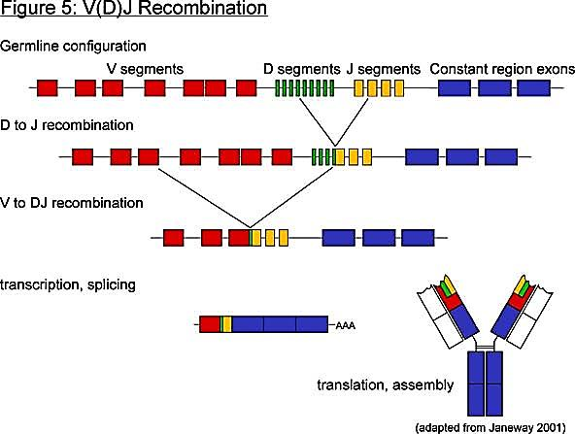
Regulation of Gene Action at the Level of Genome
4. Some DNA is never transcribed in any cell.
Example- Centromere of chromosome
5. Some DNA is spliced to cause gene rearrangement.
Example- Such a mechanism occurs during expression of immunoglobulin (Ig) genes.

Slide 76
Regulation of Gene Action
at the Level of Transcription

Slide 77
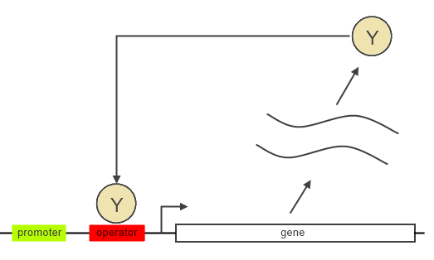

Autoregulation
mRNA
mRNA
Autoregulation of gene action occurs, when the product of a gene activates or repress its own production. Two types: Positive autoregulation (the product of a gene activates its own production) and Negative autoregulation (the product of a gene represses its own production)

Slide 78
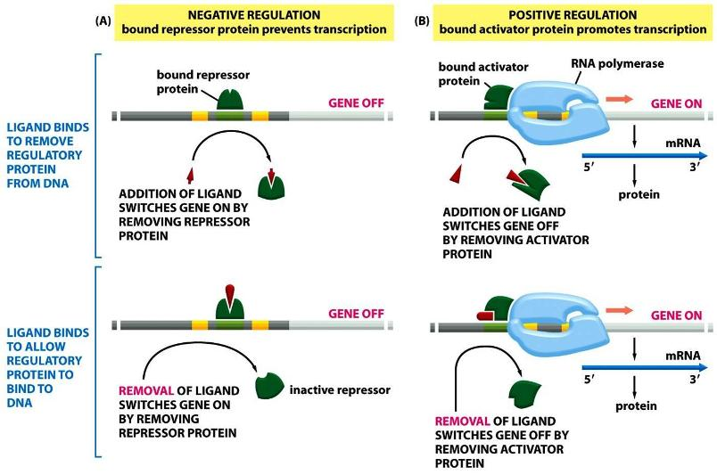
Positive and Negative Regulation of gene expression

Slide 79
Negative Regulation:
Inducible System (Lac Operon)
BPs +/- 111 - 35 -26 0 3063 800 800
Regulator
Promoter
Operator
Lac Z
Lac Y
Lac A
Peptide
Amino acid 360 1021 275 275
MW (Da) 3800 1,25,000 30,000 30,000
Active
Protein Tetramer Tetramer Monomer Dimer
Function Repressor β- Galactosidase β- Galactoside β- Galactoside
Permease Trans acetylase

Slide 80
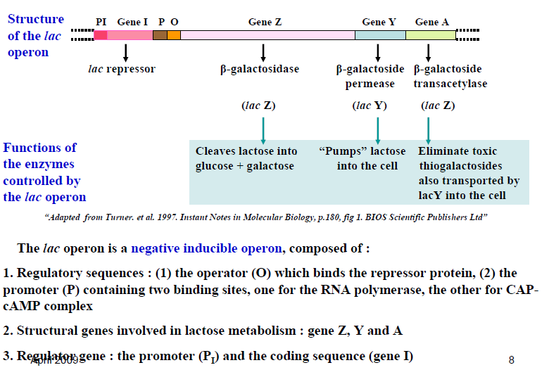
Regulatory gene:
Notes:
CAP= Catabolic Activator Protein

Slide 81
Negative Regulation: Repressible System
A repressible system in Salmonella typhimurium
Regulatory gene
Utilized by the cell
(Excess)
Histidine
Corepressor
Aporepressor
Repressor
Enzymes
Genes
e10
g10
10
Metabolites
e9
g9
9
.
.
.
e1 to e8
g1 to g8
1

Slide 82
Positive Regulation: (Lac Operon)
BPs +/- 111 - 35 -26 0 3063 800 800
Regulator
Promoter
Operator
Lac Z
Lac Y
Lac A
RNA-Pol
Rp
cAMP
CAP
β- Galactosidase
β- Galactoside Permease
β- Galactoside Trans acetylase
RNA-Pol
Rp
Lac
Lac
cAMP
CAP
Lac
CAP
cAMP
Glucose + Galactose
Indirectly inhibit synthesis
CAP= Catabolic activator Protein
cAMP= Cyclic Adenosine Mono Phosphate

Slide 83
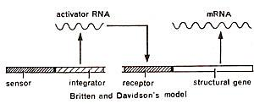
Britten-Davidson model
Notes:
The Britten-Davidson model, also known as the gene-battery model, is a hypothesis for the regulation of protein synthesis in eukaryotes. Proposed by R. J. Britten and E. H. Davidson in 1969, the model postulates four classes of DNA sequence: an integrator gene, a producer gene, a receptor site, and a sensor site. The sensor site regulates the integrator gene, responsible for synthesis of activator RNA. The integrator gene cannot synthesize activator RNA unless the sensor site is activated. Activation and deactivation of the sensor site is done by external stimuli, such as hormones. The activator RNA then binds with a nearby receptor site, which stimulates the synthesis of mRNA at the structural gene.
This theory would explain how several different integrators could be synthesized at the same time. In addition, this theory would explain the pattern of repetitive DNA sequences followed by a unique DNA sequence that exists in genes.

Slide 84
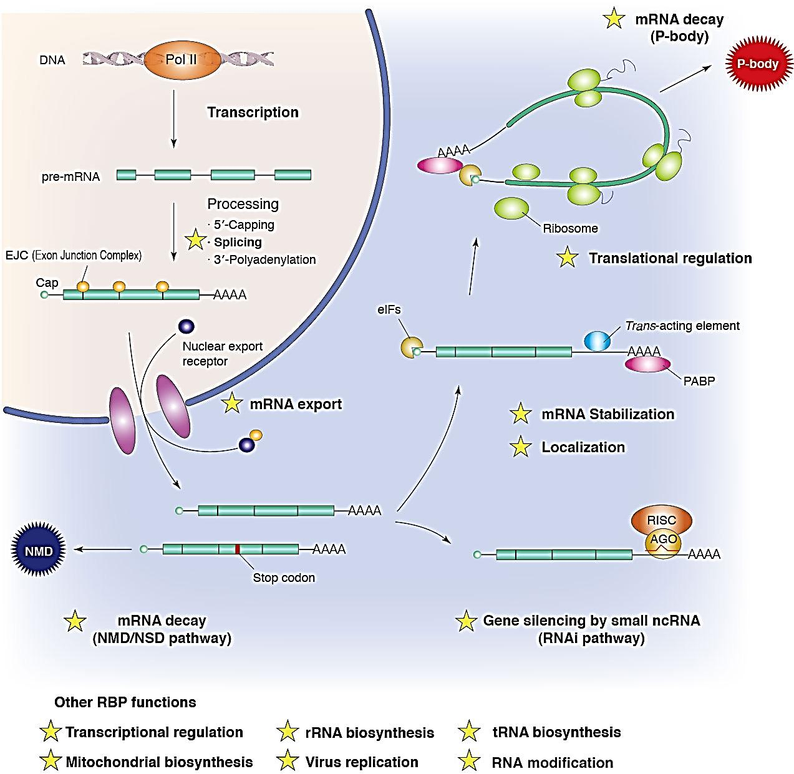
Regulation of Gene Action at Post-transcription level (in eukaryotes)
Expression of a gene can be regulated in post-transcription level in following ways:
By controlling mRNA processing mechanisms such as Capping, Splicing and 3’-polyadenylation. Only 25% of pre-mRNA can be selected for processing.
By controlling the mRNA export from nucleus.
By RNA editing
By modifying mRNA stability

Slide 85
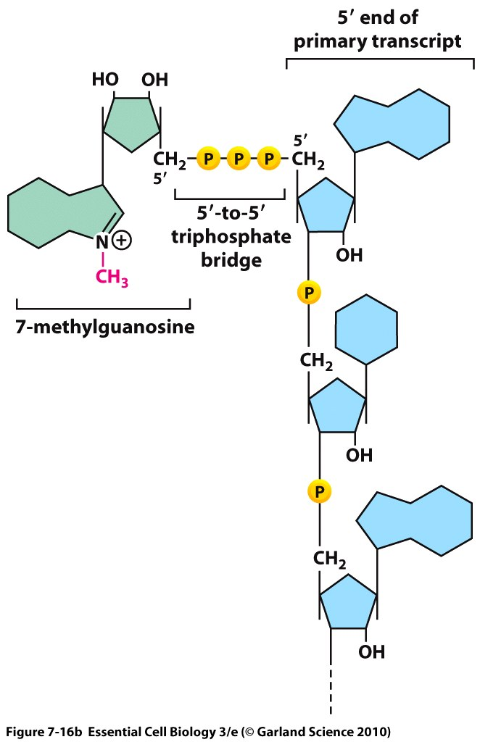
Regulation of Gene Action at Post-transcription level (in eukaryotes)
1. a) Capping: Capping changes the five prime end of the mRNA to a three prime end by 5'-5' linkage, which protects the mRNA from 5' exonuclease, which degrades foreign RNA. The cap also helps in ribosomal binding.

Slide 86
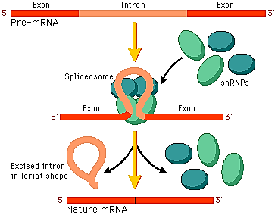
Regulation of Gene Action at Post-transcription level (in eukaryotes)
1. b) Splicing:
Splicing removes the introns, noncoding regions that are transcribed into RNA, in order to make the mRNA able to create proteins. Cells do this by spliceosomes (composed of small nuclear ribonucleoproteins, snPNPs) binding on either side of an intron, looping the intron into a circle and then cleaving it off. The two ends of the exons are then joined together.

Slide 87
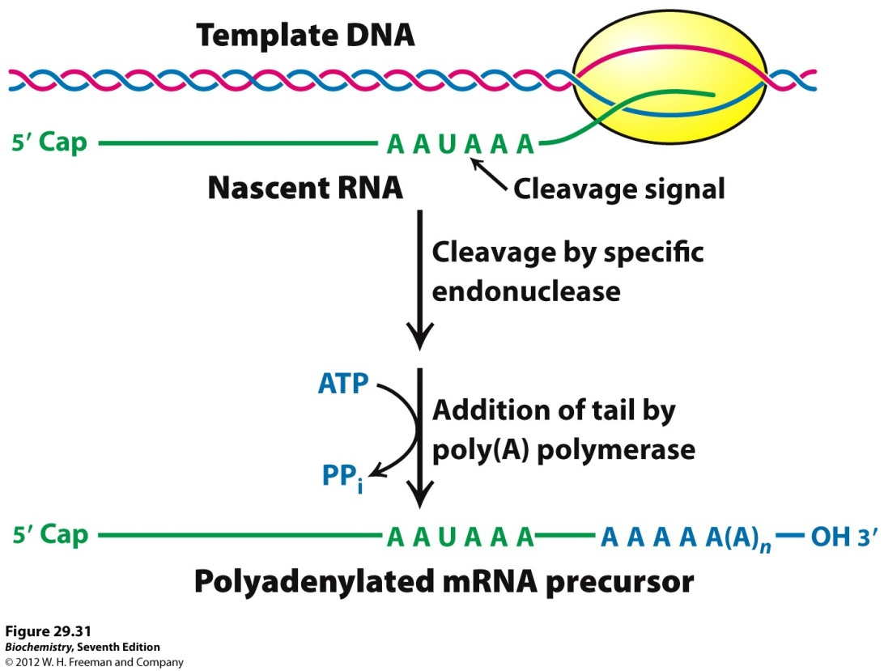
Regulation of Gene Action at Post-transcription level (in eukaryotes)
1. c) 3’ Polyadenylation:
By Polyadenylation , a stretch of RNA that is made solely of adenine bases is added to the 3' end, and acts as a buffer to the 3' exonuclease in order to increase the half life of mRNA.

Slide 88
Regulation of Gene Action at Post-transcription level (in eukaryotes)
2. By controlling the mRNA export from nucleus:
After processing mRNA export from nucleus to cytoplasm which is mediated by certain proteins, factors and receptors.
The RNA export from nucleus to cytoplasm is strictly regulated.
Only 5% of heterogeneous nuclear RNA (hnRNA) can be exported from nucleus to cytoplasm.

Slide 89
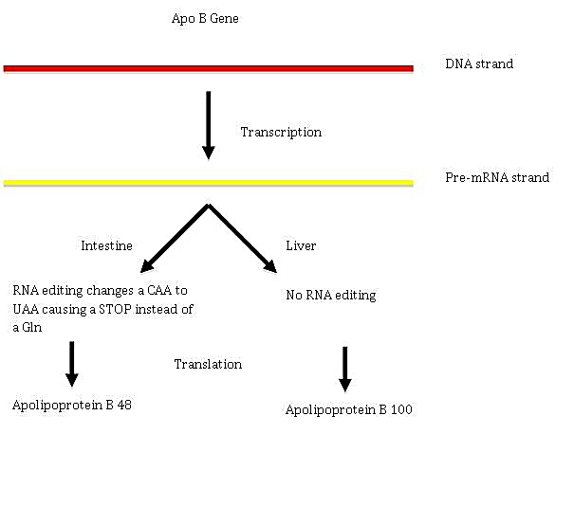
Regulation of Gene Action at Post-transcription level (in eukaryotes)
3. By RNA editing : RNA editing is a molecular process through which some cells can make discrete changes to specific nucleotide sequences within a RNA molecule after it has been generated by RNA polymerase. RNA editing in mRNAs effectively alters the amino acid sequence of the encoded protein so that it differs from that predicted by the genomic DNA sequence. Exception: It can be found in eukaryotes and their viruses, and prokaryotes.

Slide 90
Regulation of Gene Action at Post-transcription level (in eukaryotes)
4. By modifying mRNA stability:
mRNA Stability can be manipulated in order to control its half-life.
Stable mRNA can have a half life of up to a day or more which allows for the production of more protein products.
Capping, the poly(A) tail has some effect on this stability, as previously stated.

Slide 91
Regulation of Gene Action at Translation level
In prokaryote:
Life-time of mRNA is genetically predetermined. But, the life time is correlated with number free ribosomes available at a given moment. Hence, bacteria can modify their protein synthesis by altering their ribosomal contents.
Protein synthesis is determined by the location of a gene in a polycistronic mRNA (polarity gradient). eg. lac Z, lac Y and lac A protein synthesis rate is 1 : 0.5 : 0.2 respectively.
In eukaryotes:
Extension of life-time of mRNA: Life-time of mRNA can be increased by masking it with protein particles. eg. Informosomes or masked mRNA.
Regulation of rate of protein synthesis with recruitment factors which apparently interferes with formation of the ribosomes-mRNA complex.

Slide 92
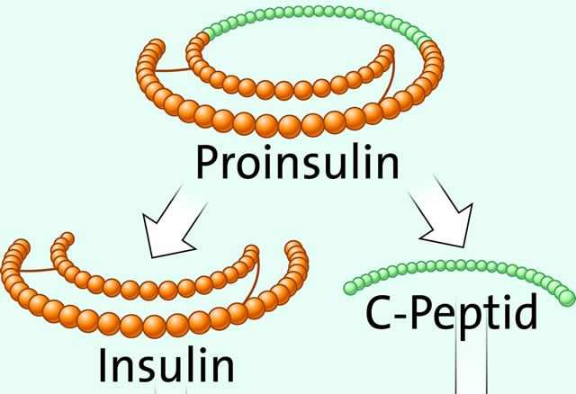
Regulation of Gene Action at Post-translation level
Some proteins are altered after synthesis, usually by partial degradation or trimming, to form active form of protein.
For example, central section of the proinsulin molecules is removed by the enzymatic action to yield the active protein, insulin.

