Slide 1
Research methodology
Dr. Md Fazlul Haque
Associate Professor
Dept. of Zoology
Rajshahi University

Slide 2
Experiments
An experiment is defined as manipulating an independent variable to see how it affects a dependent variable while also controlling the effects of additional extraneous/ controlled variables.

Slide 3
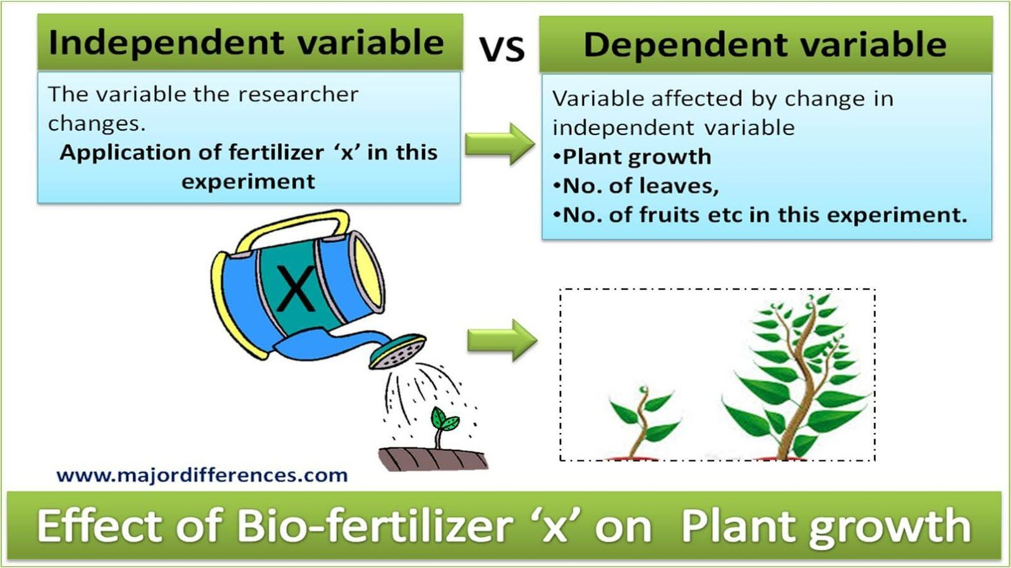
Independent Variable
Independent variables are those variables that the researcher has control over and wishes to manipulate or change.
Examples: amount and types of food; treatment of different types of drug, psychological treatment, level of temperature, humidity, photoperiod etc.

Slide 4
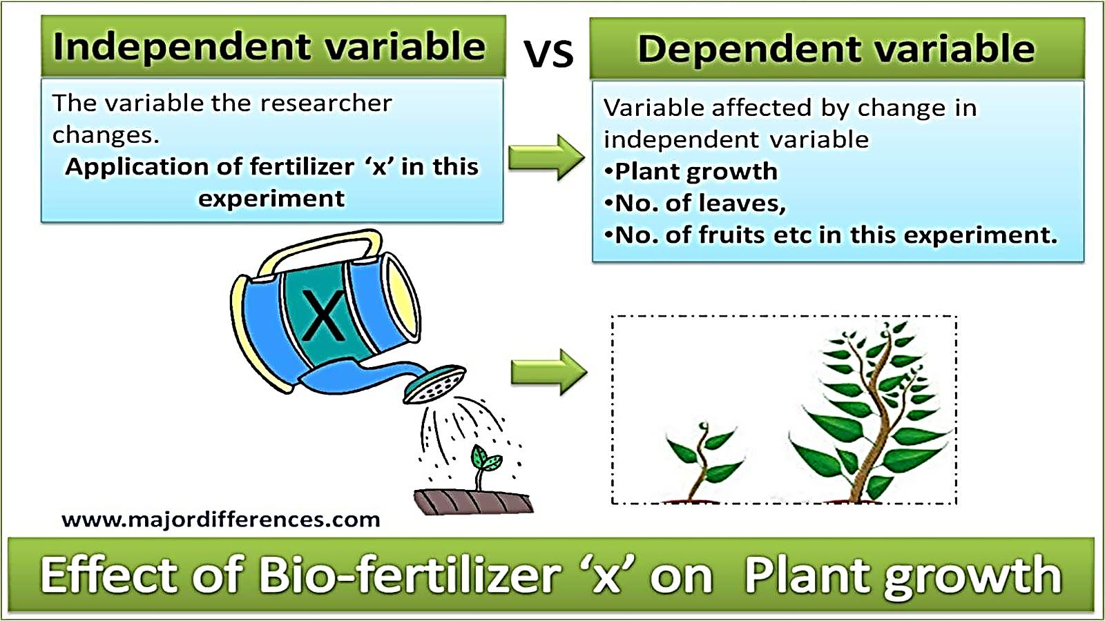
Dependent Variables
The variable that depends on other factors (variables) is called Dependent variable.
Dependent variables are expected to change as a result of an experimental manipulation or change of the independent variables. It is the presumed effect.
Researchers have no direct control over the dependent variables but have a strong interest in changing.

Slide 5
Extraneous/ Constant/ Controlled Variables
Extraneous/ Constant/ Controlled variables are all variables, which are not the independent variable, but could affect the results of the experiment.
Hence, all the other variables that could affect the dependent variable to change must be controlled. These other variables are called extraneous or controlled variables.

Slide 6
Experimental Design
Experimental design is a procedure for planning an experimental setting such that a change in a dependent variable may be attributed solely to the change in an independent variable.
Three important steps in good experimental design:
Define the objectives: Record precisely what you want to test in an experiment.
Plan a strategy: Record precisely how you can achieve the objective. This includes thinking about the size and structure of the experiment: how many treatments? how many replicates? how will the results be analyzed?
Set down all the operational details: How will the experiment be performed in practice?

Slide 7
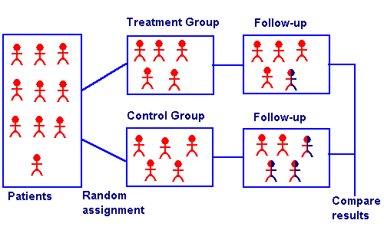
Symbols of Experimental Design
O = observation, or measurement, of a dependent variable
X = manipulation, or change, of an independent variable
R = random assignment of subjects to experimental/treatment and control groups
E = experimental effect (change in the dependent variable due to the independent variable)
Notes:
Don – is this information required? Not emphasized in text

Slide 8
Control and Experimental group
Control group: control of extraneous variables typically achieved by the use of a second group of subjects
Experimental group: the group that has been exposed to a change in the independent variable
Notes:
Add definition for Quasi-Experimental Design; change title; Add definition for Experimental group

Slide 9
types of experimental design
The three main types of scientific experimental design are
A “true” experimental design: isolates the effects of the independent variable on the dependent variable while controlling for the effects of any extraneous variables.
Quasi-experimental design: ones that do not properly control for the effects of extraneous variables on our dependent variable.
Observational/non-experimental: one that lacks the manipulation of an independent variable, control of extraneous variables through random assignment, or both

Slide 10
Terms related to Experimental Design
Pretest refers to the measurement of the dependent variable taken prior to changing the independent variable.
Posttest refers to measuring the dependent variable after changing the independent variable.
Field experiments are those in which the independent variables are manipulated and the measurements of the dependent variable are made on test units in their natural setting.
Laboratory experiments are those in which the independent variable is manipulated and measures of the dependent variable are taken in a unnatural, artificial setting for the purpose of controlling the many possible extraneous variables that may affect the dependent variable.

Slide 11
How Valid Are Experiments?
An experiment is valid if the following are true:
The observed change in the dependent variable is due to the independent variable.
The results of the experiment apply to the “real world” outside the experimental setting.
Two forms of validity are used to assess the validity of an experiment:
Internal validity is concerned with the extent to which the change in the dependent variable is actually due to the change in the independent variable.
External validity refers to the extent that the relationship observed between the independent and dependent variables during the experiment is generalizable to the “real world.”

