Slide 1
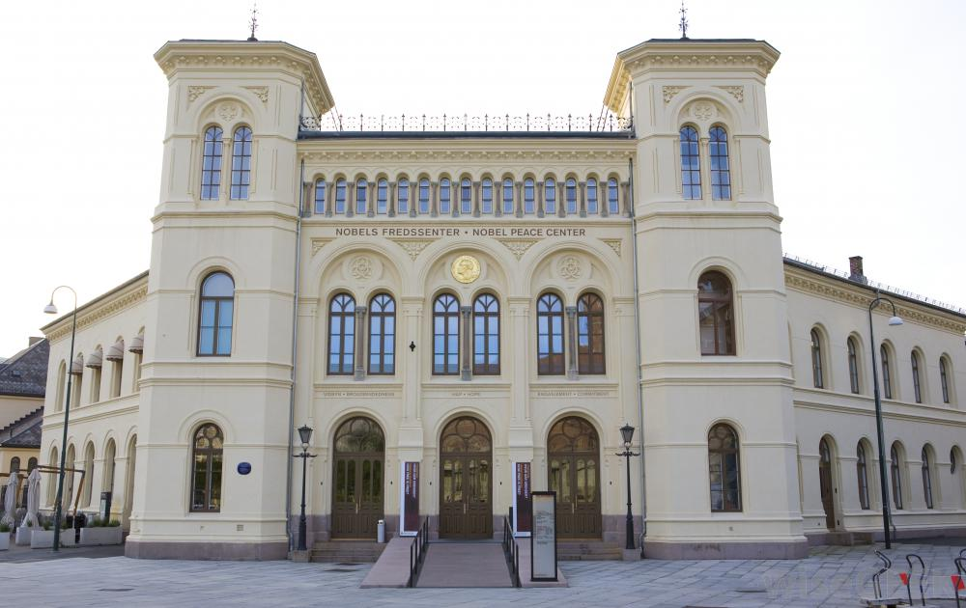

Slide 2
W. Waldeyer ( 1856-1921)

Slide 3
CHROMOSOME
Ananda Kumar Saha
Department of Zoology
University of Rajshahi

Slide 4
Chromosome
Chromosome (Gr. Chroma, Colour; soma, body) are the most Significant component of the cell, particularly during mitosis and meiosis.
They are capable of self reproduction and play a vital role in heredity, mutation, variation and evolution any development of the species.

Slide 5
Chromosome
Chromosome is the highly condensed
form of DNA
Wrapped into nucleosomes
Wrapped into chromatin

Slide 6
Chromosome

Slide 7
Chromosome

Slide 8
Chromosome

Slide 9
Chromosome

Slide 10
Historical Background
W. Flemming (1879): Described the splitting of Chromosomes and Coined the term Chromatin for sustainable material of the nucleus.
W. Roux (1883): Involvement of the Chromosome in the mechanism of inheritance.
Benden and Bovery (1887) : Number of Chromosomes for each species was constant.

Slide 11
Historical Background
W. Waldeyer (1888): The present name chromosome was coined by Waldeyer.
W.S. Sutton and T. Boveri (1902). Chromosomes which acted as messengers of heredity.
Morgan(1933): Transmission of heredity.

Slide 12
Haploid and Diploid
The number and set of the Chromosomes of the gametic cells such as sperms and ova is known as the gametic, reduced or haploid sets of chromosomes. The haploid set of the chromosomes is also known as the Genome.
The somatic or body cells of most organisms contain two haploids set or genomes and are known as the diploid cells.
The diploid cells achieve the diploid set of the chromosomes by the union of the haploid male and female gametes in the sexual reproduction.

Slide 13
Chromosome
Number: The number of chromosomes is constant for a particular species. These are of great importance in the determination of the phylogeny and taxonomy of the species.
Lowest number of Chromosome: Two (Ascaris megalocephalus univalens)

Slide 14
Morphology
The size of the chromosomes varies from species to species and relatively constant for a particular species.
Length: 0.2----50µ
Diameter: 0.2----20µ
Human Chromosome 6µ in length

Slide 15
Chromosome Types
There are four types of chromosomes:
1. Telocentric
2. Acrocentric
3. Submetacentric
4. Metacentric
Divided based on the position of the centromere

Slide 16
Chromosome Types:
1.Telocentric : no p arm; centromere is on end
2.Acrocentric : very small p arm; centromere is very near end
3.Submetacentric : p arm just a little smaller than q arm; centromere in middle
4.Metacentric : p and q arms are exactly the same length; centromere in exact middle of chromosome

Slide 17
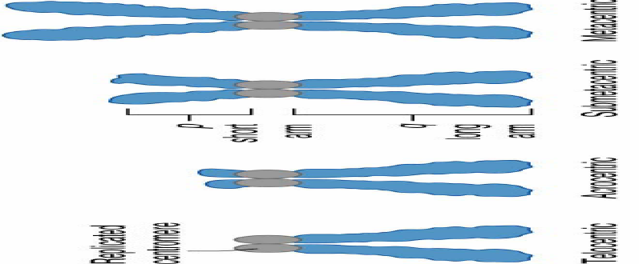
Chromosome Types

Slide 18
Karyotype and Idiogram
The characters by which a set of the chromosomes of a species is identified, are known as their karyotypes.
When the karyotypes of a species are represented by a diagram then such diagram is called idiogram.

Slide 19
Chromomeres
Chromomeres: The thick or bead like structures of the chromonema are known as the chromomeres.
The cytologist have given various interpretations about the chromomeres. Some consider chromeres as condensed nucleoprotein material,
while other postulated that the chromeres are regions of the super – imposed coils.
For long time most geneticists considered these chromsomes as gene, i.e. the unit of heredity.

Slide 20
Paranemic and Plectonemic coils

Slide 22
Heterochromatin
Constitutive Heterchromtin: Regions that are always heterochomatic, called heterochromatin.
Fecultative Heterochromatin: Regions of euchromatin are converted to a heterochromatic state.

Slide 23
Chromosome Structure

Slide 24
Chromosome Structure

Slide 25
Chromosome Structure
Secondary Constriction: The chromosome besides having the primary constriction or the centromere possess secondary constriction at any point of the chromosome.
Certain secondary constrictions play a vital role in the formation of the nucleus, therefore, known as nucleolar zone or nuclear organizer.

Slide 26
Chromosome Structure
Telomere: Each extrimity of the chromosomes has a polarity and therefore, it prevents other chromosomal segments to be fused with it. The chromosomal ends are known as the telomeres.
Satelite: Sometimes the chromosomes bear round elongated or knob-like appendages known as satellites. The chromosomes with the satelite are designated as the sat chromosomes.

Slide 27
Structure of Chromosome

Slide 28
Sat Chromosome

Slide 29
B-Chromosome or Super Neumerary chromosome
B-Chromosome: Many plants (Maize, etc.) and animals (such as Insects and small mammals), besides having autosomes (A-chromosomes) and Sex-chromosomes possess a special category of chromosomes called B-Chromosomes without obvious genetic function.
About 600 species of flowering plants and more than 100 animal species are now known to carry such B-chromosome (Jones, 1975).

Slide 30
B-Chromosome
B-chromosomes have negative consequences for the organism, as they have deleterious effects because of abnormal nuclear divisions of the gametophytes plants. In animals, B-chromosomes occur more frequently in females and the basis is non-disjunctions.

Slide 31
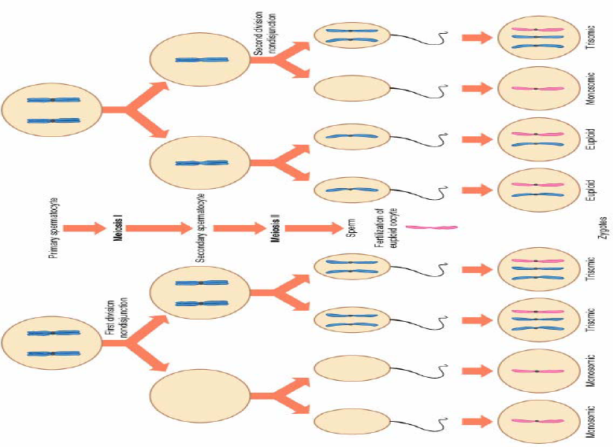
Non-disjunction

Slide 32
Holokinetic Chromosome
Holokinetic Chromosome: The chromosmes of most plants and animals have centromere that are situated as one specific position in each chromosomes.
In a number of animals, especially in insects of the order Hemiptera, the kinetic activity is distributed over the entire chromosome and such chromosomes are called holokinetic chromosomes (Sybenga, 1972).

Slide 33
Holokinetic Chromosome

Slide 34
Molecular Compounds of Chromosome
Chemically the Chromosomes of most Prokaryotes and Eukaryotes are composed of mainly DNA which may or may not be wrapped in histone and non-histone proteins.
The DNA of bacteria, viruses and cellular organelles may have some protein associated with it but this protein is not intimately associated with the nucleic acid.

Slide 35
Chromosome and Histone Protein

Slide 36
Molecular compounds of Chromosome
DNA of the eukaryotic nucleus associates with specific nuclear proteins the histone and non-histone or acidic proteins, to form a stable nucleo protein complex, the chromatin.
Besides the proteins a number of enzymes (DNA and RNA polymerase) intimately associated with chromatin.

Slide 37
Functions of Chromosome
The Chromosome are the most significant components of the cell. They control most of the cell biological and genetical activities of a species.
They contain the genetical material, the DNA which ultimately influences all the biological phenomena at molecular, physiological and gross morphological levels.

Slide 38
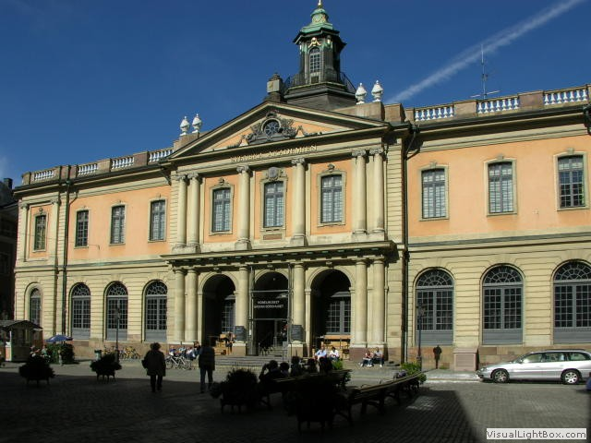
THANK YOU

