Slide 1
Cell Division
Ananda Kumar Saha
Professor
Department of Zoology
Rajshahi University

Slide 2
Cell Division
One of the most important characteristics of the living cells is their power to grow and divide. The cell division is a process by which the cell duplicates itself for growth and reproduction of organisms.

Slide 3
Cell Cycle

Slide 4
Types of Cell Division
Two basic types of cell divisions are recognized according to the behavior of the chromosomes.
The daughter cells finish up containing exactly the same number of chromosomes as the parent cell (Mitosis).
The daughter cells finish up with half the total number of chromosomes present in the parent cell (Meiosis).

Slide 5
Initiation of cell division
Some workers suggested that when the ratio of cytoplasm to nucleus is upset then the cell division is occurs.
Gaulden and Prey (1958) have suggested the possibility that the nucleolus has a vital role in the initiating cell division.
The chromosomes and other organelles produce a specific substance which induces the division of a cell.
Initiation of division in the doubling of DNA of the cell.

Slide 6
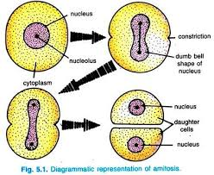
Amitosis
Diagrammatic representation of Amitosis

Slide 7
Amitosis

Slide 8
INTERPHASE
Interphase: The resting phase between two mitotic divisions is known as the intermitotic phase or interphase (L. inter- between, phasis- appearance).
In interphase no division occours but in the nucleus and cytoplasm active metabolic activities occur and also increase in the volume of the cytoplasmic and nuclear substances take place.

Slide 9
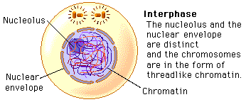
Interphase

Slide 10
INTERPHASE
Following events occur:
The nuclear envelop remains intact
The chromosome occurs in the form of diffused, long, coiled and indistinctly visible chromatin fiber.
The DNA amounts become double
The centriole is surrounded by a clear and dense zone
The centriole divides into two centrioles.

Slide 11
Prophase
The prophase (gr., pro-before, phasis-appearance) is the actual first phase of the mitosis.
The disintegration of nuclear envelop starts
Both chromatids remain connected with each other by centromere
The chromatids become shortened and thickened
The nucleolus starts to disappear
The centrioles separate and migrate towards the opposite poles of the cell.

Slide 12
Prometaphase
Promataphase: (Gr., Pro-before, meta –after, phasis-appearance) following changes usually occur in the cell.
The nuclear membrane completely disintegrates
The Chromosome move towards the equator

Slide 13
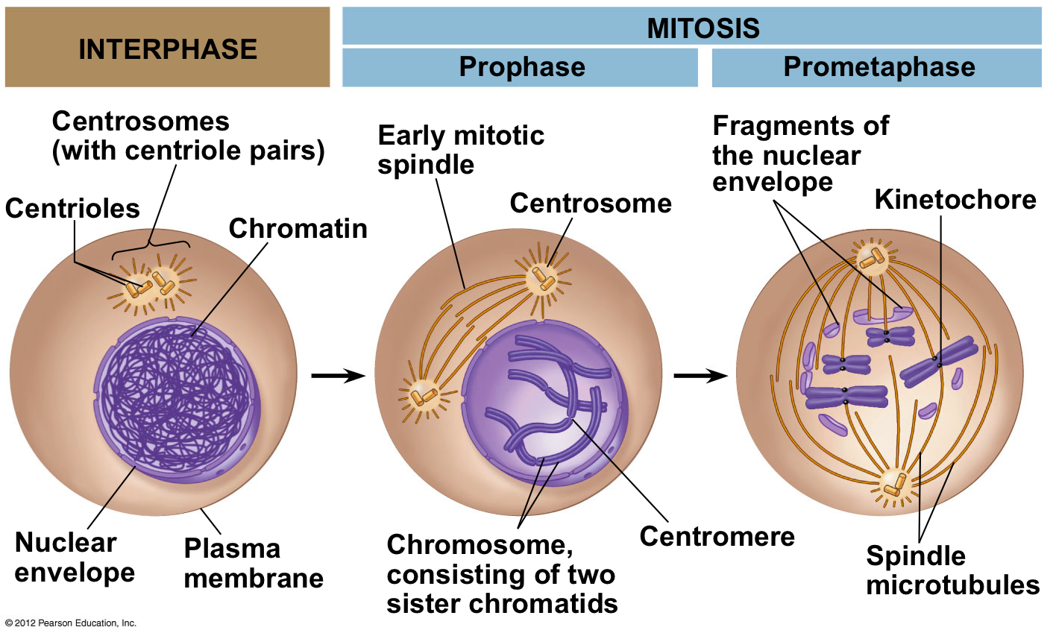
Cell Division

Slide 14
Metaphase
Metaphase: (Gr., meta-after, phasis-appearance)
Each chromosome reaches to the equator and all arrange themselves readily at the periphery of the spindle.
The smaller chromosomes usually remain towards the interior, while the larger chromosomes remain at the periphery.
Some of the fibres or microtubules of the spindle attach with the centromere of each chromosomes and are known as the chromosomal fibre.
Some of the fibres or microtubules of the spindle remain attached from one end to the other end with the centrioles and are known as continuous fibre.

Slide 15
Anaphase
Anaphase : ( gr., ana-up, phasis-appearance)
The centromere of the each chromosome divides into two.
The chromatids of the each chromosomes are separated and form two chromosomes.
The chromosomes become shorter and thicker and migrates towards the opposite poles of the cell.
The migration of the daughter chromosomes towards the opposite poles is achieved by the contraction of chromosomal fibres and the stretching of interchromosomal or interzonal fibres. The interzonal fibres push the daughter chromosomes towards the opposite poles.

Slide 16
Telophase
The chromosomes which reach at the opposite poles of the cell now elongate, the coils of DNA protein fibers loosen and the chromosomes become thread like.
The nucleolus reappear
The endoplasmic reticulum forms the new nuclear envelope around the chromosomes and the nucleolus.
The microtubules of the aster and mitotic spindle rearrange and disappear.
Thus, after the telophase two daughter nuclei are formed due to the cytokinesis. The karyokinesisis followed by the cytokinesis.

Slide 17
Mitosis

Slide 18
Cell Division Mitosis

Slide 19
Significance of Mitosis
The mitosis helps the in maintaining proper size.
It helps in the maintenance of equilibrium in the amount of DNA and RNA in the cell.
The mitosis provides the opportunity for the growth and development to organs and the body of the organisms.
The old decaying and dead cells of the body are replaced by the help of mitosis.
The gonads and the sex cells depend on the mitosis for the increase in number.

Slide 20
Thank You

