Slide 1
Cell Biology

Slide 2
Cytology or Cell Biology
The cytology or cell biology (Gr., Kytos-hollow vessel or cell, logos- to discourse) is a biological science which deals with the study of cells from morphological, biochemical, physiological, developmental, genetical, pathological and evolutionary point of views.
Modern Cell Biology is attempting to interpret and explain the phenomenon of metabolism, biosynthesis, heredity, sex, variation, mutation, and evolution of living organisms in terms of molecules or macromolecules such as proteins, ribonucleic acids (RNAs) and deoxyribonucleic acid (DNA)

Slide 3
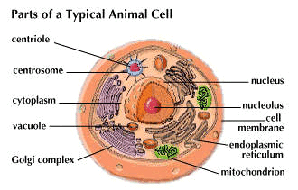
CELL
Loewy and Siekevitz (1963) have defined that
“a unit of biological activity delimited by a selective permeable membrane and capable of self reproducing in a medium free of other living system”.

Slide 4
Comparison of Prokaryotes and Eukaryotes
Characteristics | Prokaryotes | Eukaryotes
Nucleus | Absent | Present with nuclear membrane
Organelles | Absent | Present in a variety of forms
DNA structure | Single closed loop | Multiple chromosomes
Chlorophyll | When present, dissolved in cytoplasm | When present, contained in chloroplast
Ribosomes | Smaller than eukaryotic ribosomes Free in cytoplasm | Larger than prokaryotic ribosomes Bound to membrane
Cell Wall | Generally present Complex chemical composition | Present in some types, absent in others Simple chemical composition
Reproduction | Usually by fission No evidence of mitosis Sexual reproduction unusual | By mitosis Sexual reproduction usual
Examples | Bacteria, Rickettsiae, Chlamydiae | Fungi, Protozoa, Plants, Animals, Humans etc

Slide 5
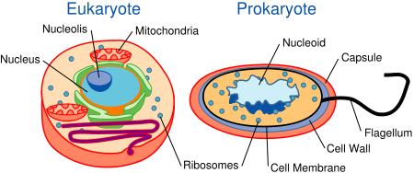
Eukaryotes vs. Prokaryotes

Slide 7
CELL THEORY
The cell theory holds that all living matter, from the simplest of unicellular organism to very complex higher plants and animals, is composed of cells and that each cell can not act independently but functions as integral part of the complete organisms.

Slide 8
Year | Scientist | Contribution
1595 | Zacharias Jensen | Creates the first compound microscope
1655 | Robert Hooke | Hooke, using the microscope that he devised, viewed the cell walls of cork for the first time. He coined the term ‘Cell’
1670 | Antonie Van Leeuwenhoek | Observes the first living cells in pond water using lenses that he created for his microscope
1833 | Robert Brown | Discovers the nucleus in plant cells
1838 | Matthias Jakob Schleiden | Proposed that all plant tissues are composed of cells
1839 | Theodor Schwann | Concludes that not just plant tissue, but animal tissues, as well , are composed of one or more cells. He also states that the cell is the basic unit for all organism.
1845 | Carl Heinrich Braun | Re states the second part of the cell theory proposing that cells are the basic unit of life
1855 | Rudolf Virchow | Add the last part of the cell theory stating that cells only come from other living cells.

Slide 9
Objections to cell theory
Schawan believed that cell could be spontaneously generated by a process analogous to crystal formation. But studies of developing embryos showed that during growth, cells duplicated themselves by cell division.
These observation were summarized by Rudolf Virchow in 1858 and he stated “where a cell exists there must have been a pre-existing cell, just as the animal arises only from an animal and the plant only from a plant”.

Slide 10
Exception to cell theory
Various cytological investigations have shown that all living organisms are not cellular as considered by the cell theory and some organisms are without any true cell or acellular.
A true cell has been defined as mass of protoplasm having a distinct nucleus and limited by plasma membrane; but most viruses have no protoplasm and nucleus but only DNA or RNA as the genetic material.

Slide 11
Exception to cell theory
The bacteria and blue green algae have no true cell and in them the nuclear material does not remain bounded by the nuclear membranous and have direct contact with that of cytoplasm.
Moreover, certain algae such as Vaucheria and certain fungi, such as Rhizopus are unexplainable according to the cell theory because their bodies are made up of the undivided mass of protoplasm in which many nuclei remain scattered. These are the examples from the exceptions to cell theory.

Slide 12
Protoplasm Theory
In the middle of the 19th century, various biologist started to recognize the importance of Juicy or Slimy contents of the cells. Purkinje (1839) gave the name protoplasm (Gr., Protos- primitive or first, plasma- substance) to the contents of the cells.
This theory states that “the cell is an accumulation of living substance or protoplasm, definitely limited in space and possessing a nucleus and a cell membrane”.

Slide 13
References
1. Cytology by P. S. Verma and V. K. Agarwal
2. The World of the Cell by Wayne M. Beeker, Jeff Hardin and Lewis J. Kleinsmith
3. Molecular Biology of the Cell by Bruce Alberts, Dennis
Bray, Julian Lewis, Martin Raff, Keith Roberts .
4. Molecular Cell Biology by Harvey Lodish, D. Baltimore
5. Cell Biology by De Robertes
6. Cell Biology by S. C. Rastogi

