Slide 1
Application of Biotechnology in the Field of Agriculture
Prof. Ananda Kumar Saha
Dept. of Zoology
Rajshahi University

Slide 2
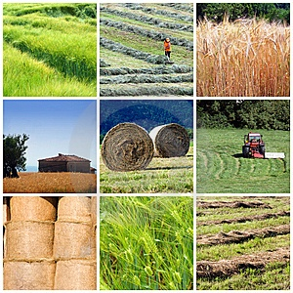
Agricultural Biotechnology
Agricultural biotechnology includes a range of tools that scientists employ to understand and manipulate the genetic make-up of organisms for use in the production or processing of agricultural products.

Slide 4
What are the new products of agricultural biotechnology?
Herbicide tolerant crops, e.g., Roundup Ready soybeans and corn and Liberty Link corn
Virus resistant Plants

Slide 5
What are the new products of agricultural biotechnology?
Insect resistant crops commercially available, e.g., Bt corn, cotton, and potatoes
Corn rootworm resistance in 2001?

Slide 6
What are the new products of agricultural biotechnology?
Animal growth hormones, e.g., bST

Slide 7
What are the new products of agricultural biotechnology?
Identity-preserved or specific-attribute crops (vaccines, higher oil or starch content, additional amino acids)

Slide 8
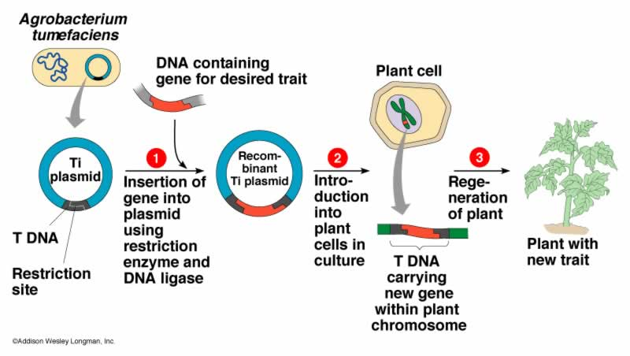
Transgenic Plant Development: Agrobacterium mediated transformation

Slide 9
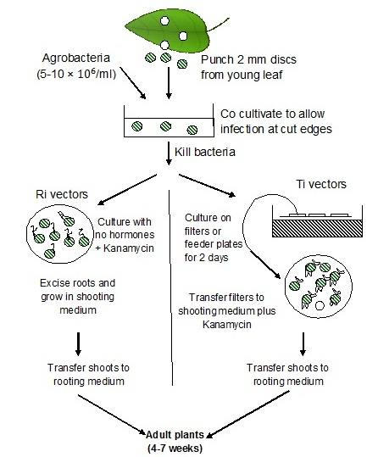
Transgenic Plant Development: Leaf disc transformation

Slide 10
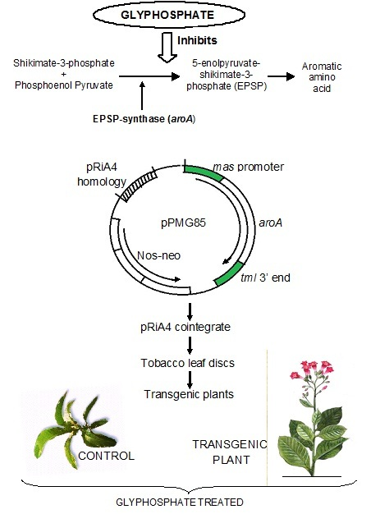
Herbicide resistant transgenic plant

Slide 12
Insect Resistant Plant Bt Mode Action

Slide 13
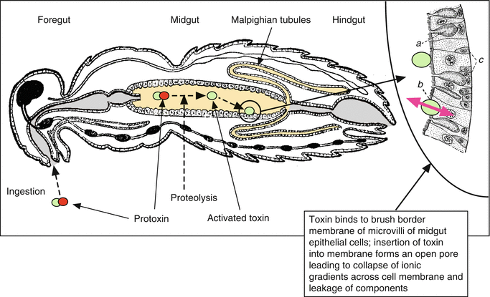
Bt Mode Action on Insect

Slide 14
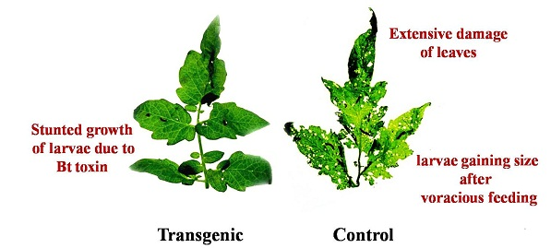
Insect Resistant Plant

Slide 15
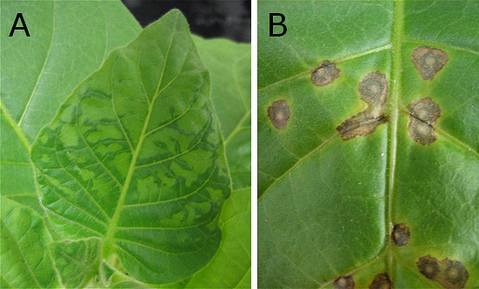
Virus Resistant Plant
Tobacco Mosaic Virus Resistant Plant
Wild Plant infected with Tobacco Mosaic Virus

