Slide 1

Welcome to Writing Proposal on
“Academic Transformation Fund”
(Session 3)
Md. Enayet Hossain
(PhD, Curtin University, Australia)
Professor, Department Tourism and Hospitality Management
E-mail: mehossain@yahoo.com
Tel: 01711461460, 01746583853

Slide 2
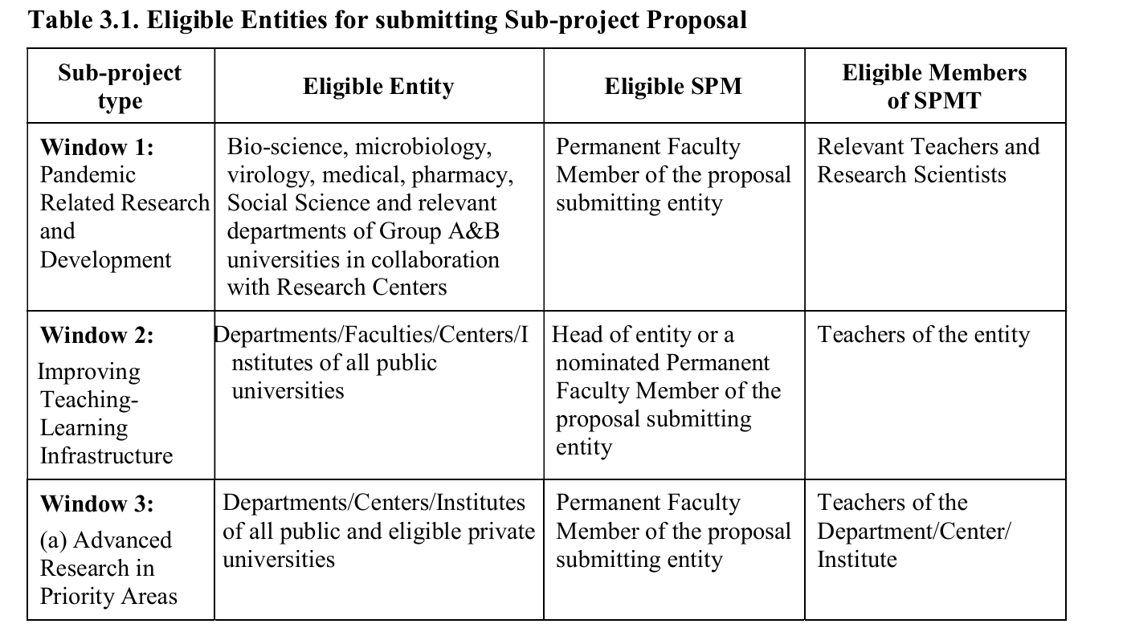
Eligible Entities for submitting Sub-project Proposal

Slide 3
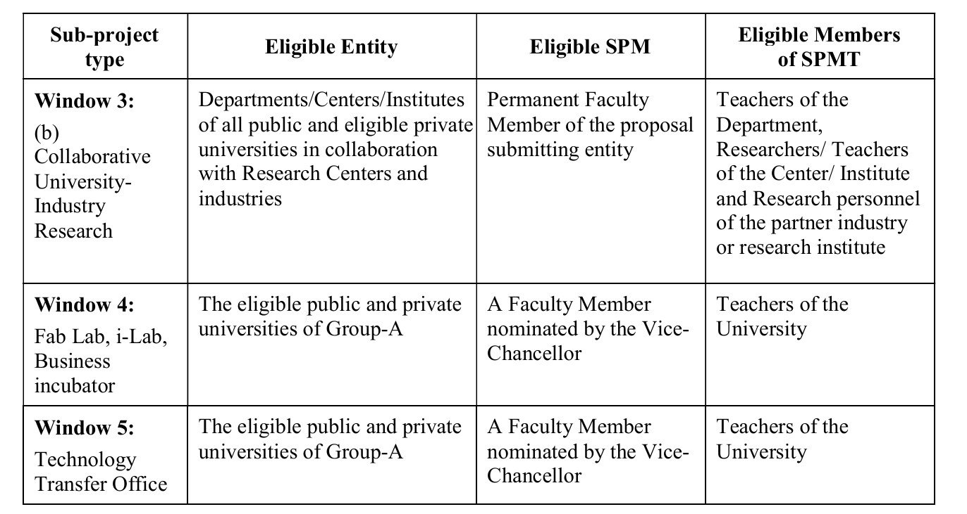
Eligible Entities for submitting Sub-project Proposal

Slide 4
Window 2
Every sub-project will require a SPMT, consisting of a Sub-project Manager (SPM), one or two Associate Sub-project Managers (ASPM), and if required, one or two members. However, the total number of members should not exceed 4 including the SPM. The SPMT will prepare the proposal, and both the SPMT as well as the proposal will require the formal approval of the academic committee of the entity, which will own the proposal and submit it after obtaining VC’s approval. The SPM and ASPMs shall be selected from the regular/permanent teaching staff of the proposal submitting entity.
It is expected that the Dean of a Faculty, the Chairperson/Head of a Department or the Director of an Institute will be the SPM of a Window 2 sub-project. In the event the entity is awarded more than one sub-project or the Dean of a Faculty, the Chairperson/Head of a Department or the Director of an Institute unable to become the SPM, a senior faculty may be nominated as SPM by the Faculty/Academic Committee or the Governing Body as the case may be. The Same committee shall form the SPM team to prepare the SPP and place it before the Faculty/Academic Committee (AC) or the Governing Body as the case may be, and upon approval, submit it to the UATFS for obtaining endorsement of the Vice-Chancellor and onward transmission to ATF unit of HEAT PMU.

Slide 5
Window 3 (a) Sub-projects
Sub-project proposals may be initiated by an individual academic in consultation with a group of colleagues in the same entity or a partner entity, which may be a neighboring entity, or even an entity in another university. The objective of the proposal is to establish facilities for carrying out cutting-edge research in a priority area relevant to needs of the country. The initiator of the proposal is expected to be selected by the entity as the SPM, the ASPMs and team members who will be academics having full time positions in the entity. The SPMT will prepare the SPP and submit it to the Department/Center/Institute for approval by the Academic Committee/Board of Governors and forward it to the UATFS for obtaining VC’s approval.

Slide 6
Window 3 (b) Sub-projects:
First, an individual teacher or a group of teachers of a department or Institute may have developed certain technology which they think, have commercial value, or may have ideas for developing a marketable technology out of their own research findings or existing knowledge available in literature. The proposed technology should be innovative, in the sense that it should be based on “doing something differently” than how it is done currently. They should have proven research experience relevant to the technology, and basic research facilities at their disposal.
Second, this group will undertake a survey of the industries (small, medium or big) and identify the enterprise that produces and markets products/processes/technologies in relevant technology fields and would be the appropriate partner for jointly developing and marketing the technology and products that would fulfill the purpose of the innovative research planned by the academician-researcher. The names of such appropriate enterprises shall be listed and then each of them will be individually contacted by the proposal writer academician. Discussion with the enterprise owner/manager will be initiated to make him/her interested to involve in the collaborative research.
The faculty will choose an industry partner who would be interested in adopting the technology for commercial benefits and investing in the development of the technology through collaborative research with the assistance of experienced researchers including Postdoctoral Fellows and PhD students.

Slide 7
Window 3 (b) Sub-projects:
Third, once the two parties agree in principle to start the collaborative venture, the terms and conditions of collaboration shall be worked out through negotiation and presented in a draft Memorandum of Understanding (MoU).
Fourth, the draft MoU shall be submitted to the VC of the university for obtaining approval.
Fifth, the entity will form a Sub-project Management Team (SPMT) headed by the SMP including one or two Associate SPM (ASPM) and one or two members, one of the ASPM/Member will be a representative of the industry partner. The SPMT will formulate the proposal and submit it to the Academic Committee/Governing Body, as the case may be for approval and necessary further action.

Slide 8
For Research (Window 1 and Window 3) sub-projects:
a. Financial support to candidates enrolled for Master’s and PhD:
A particular Master’s and PhD student may be paid allowances at the monthly rate of Taka 30,000 and Taka 50,000 respectively for a maximum period of 18 months for Master’s and 36 months for PhD student. A maximum of four Master’s and four PhD students may be engaged in a sub-project. The number of Master’s students must not exceed four in any given academic session. Tuition fees and other mandatory fees of all registered research students will be paid from the sub-project.

Slide 9
For Research (Window 1 and Window 3) sub-projects..
b. Research stay allowances for Master’s/PhD students
A researcher’s stay of up to six months for Master’s and twelve months for PhD students in a foreign university/institute is permissible for collaborative research; they will be entitled to most economic return air fare and allowances at the following rates:
Category-A: Tk:120,000/month (US, Canada, Australia, Europe, New Zealand, Japan, Singapore)
Category-B: Tk:100,000/month (The Union of Soviet Socialist Republics (USSR), Hong Kong, South Korea),
Category-C: Tk:70,000/month (India, China, Malaysia, Thailand, Indonesia, Phillippines, Turkey)
For any other counties, decision of UGCBATF will be the final.

Slide 10
For Research (Window 1 and Window 3) sub-projects..
c. Host institute charges for research stay
An amount up to BDT 500000/- may be paid to the host institution for extending research facilities for collaborative research as per sub-project design, and an incentive up to US$ 5000.00 (equivalent BDT) to the host research supervisor per Master’s/PhD student. Provided that the cost is included in the budget and financing plan of the sub-project.

Slide 11
Administrative Structure of ATF
The HEATPMU will have a designated unit for ATF with an academic/official not below the rank of Grade 3. (Professor) S/he will work under the project director who will lead the PMU and the implementation of all activities of the project including of ATF. PD will be directly accountable to the Chairman, UGC.

Slide 12
Annexes in SPP
SPP Annex 1: Milestones, Performance Indicators and Logical Framework
SPP Annex 2: Work/Activities Plan (excel spread sheet) SPP Annex 3: Financing Plan (excel spread sheet)
SPP Annex 4: Procurement Plan Summary (Table A, Table B, Table C,
Table D and Table E) excel spread sheet SPP Annex 5: Training visit/ Study Tour Plan
SPP Annex 6: Details of estimated Budget (Excel spread sheet) SPP Annex 7: Environment and Safety Check List for Research and Innovation SPP Annex 8: Attachment A: Environmental Monitoring and Mitigation Plan SPP Annex 9: Social Screening Form
SPP Annex 10: Indicative Organogram of the Sub-project Management Office
SPP Annex 11: Sub-project Management Team and Resume Attachment: Resume of SPM, ASPM and SPMT Members. Upload: CV of SPM, ASPM and SPMT members online.
SPP Annex 12: Proposal Endorsement by University Management
13. Collaboration MoU, for collaboration SPP

Slide 13
Sub Project Evaluation Criteria
EVALUATION CRITERIA | W-1 & W-3a | W-3b | W-2, | W-4 | W-5
1. Clarity and Quality of Strategic Analysis and Proposal Design | 20.0 | 20.0 | 20.0 | 20.0 | 20.0
2. Quality and Clarity of the Milestones and Performance Indicators | 10.0 | 10.0 | 10.0 | 10.0 | 10.0
3. Access to Higher Education and Research | 10.0 | 10.0 | 15.0 | 15.0 | 15.0
4. Justification of the Budget | 10.0 | 10.0 | 10.0 | 10.0 | 10.0
5. Quality of the Management Plan | 10.0 | 10.0 | 10.0 | 10.0 | 10.0
6. Experience of SPMT | 20.0 | 20.0 | 10.0 | 10.0 | 10.0
7. Clarity of Impact Analysis | 10.0 | 10.0 | 10.0 | 10.0 | 10.0
8. Sustainability | 10.0 | 10.0 | 15.0 | 15.0 | 15.0
Total Mark | 100 | 100 | 100 | 100 | 100
EVALUATION QUESTIONNAIRE
1. Clarity and quality of the strategic analysis, objectives and expected results and innovative nature of the proposal | 20.0 | 20.0 | 20.0 | 20.0 | 20.0
2. Quality and clarity of the milestones and performance indicators to measure progress, results and impact | 10.0 | 10.0 | 10.0 | 10.0 | 10.0
3. Access to Higher Education and Research | 10.0 | 10.0 | 15.0 | 15.0 | 15.0
4. Clarity and justification of the proposal budget | 10.0 | 20.0 | 10.0 | 10.0 | 10.0
5. Quality and clarity of the proposed work, financing and procurement plans | 10.0 | 10.0 | 10.0 | 10.0 | 10.0
6. Experience of SPMT | 20.0 | 20.0 | 10.0 | 10.0 | 10.0
7. Impact the sub-project will have on environment/eco-system, gender inequality, employment, poverty reduction, academic programs, human development, research, food security, production innovation, governance and disaster management | 10.0 | 10.0 | 10.0 | 10.0 | 10.0
8. Academic and financial sustainability of the implementation after the ATF support has ended | 10.0 | 10.0 | 10.0 | 10.0 | 10.0
Total Marks | 100 | 100 | 100 | 100 | 100

Slide 14




Questions ???
Comments !!!
63

