Slide 1
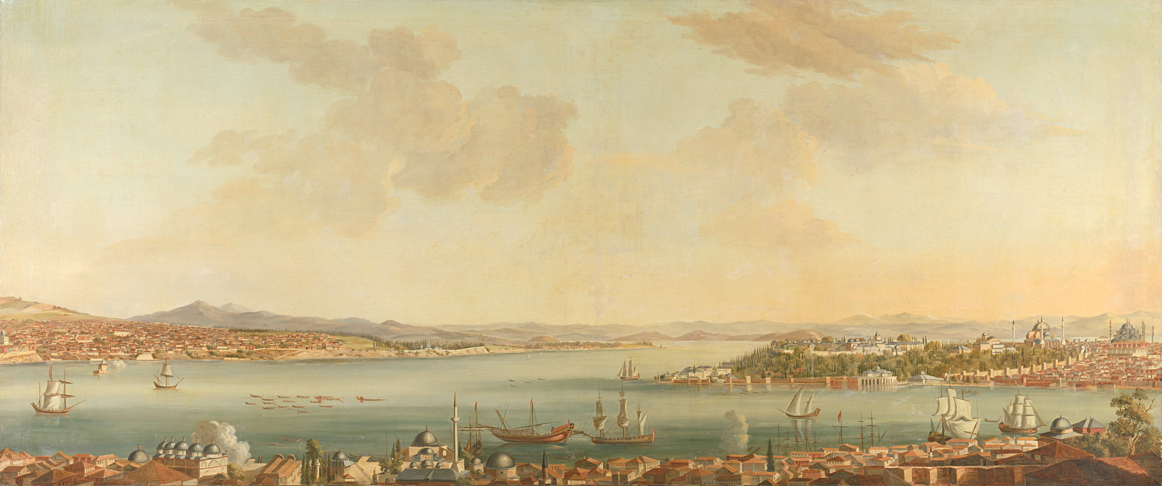
Welcome to Writing Proposal on
“Academic Transformation Fund”
(Session 2)
Md. Enayet Hossain
(PhD, Curtin University, Australia)
Professor, Department Tourism and Hospitality Management
E-mail: mehossain@yahoo.com
Tel: 01711461460, 01746583853

Slide 2
Components for Proposal Writing
1. Proposal title
2. Implementation Period
3. Total cost: BDT & US$
4. General objectives
5. Specific objectives
6. Sub-project summary
7. Strategic Analysis
8. Background Data Substantiating the Strategic Analysis
9. Description of proposed field of research

Slide 3
Proposal Components
10. Table of Milestones (Annex-1) Table Performance Indicators (Annex-1) Table of Logical Framework (Annex-1)
11. Relevance
12. Benefits (Qualitative and Quantitative)
13. Operation & Maintenance of Equipment/ Instrument
14. Summary of Estimated Budget
15. Work/Activities Plan (Annex-2)
16. Financing Plan (Annex-3)
17. Procurement Plan (Annex-4: Tables A-E)
18. Training Plan (Annex-5)

Slide 4
Proposal Components
19. Detail Budget (Annex-6)
20. Technical assistance/consulting
21. Linkages/collaboration
22. Effect/impact of the sub-project
23. Sustainability
24. Environment Safety Checklist & Mitigation Plan (Annex-7)
25. Social Screening Form (Annex-8)
26. Experience in similar project

Slide 5
Proposal Title
Informative, not creative
Brief, precise, direct & comprehensive
Reflect objectives
Should include all known “keywords”
Institutional and project responsibilities should be well established
Complete “at the end of writing”
EXAMPLE
“Capacity Building of Hospitality Graduates in Bangladesh to Promote Youth Employment Through industry and Universities Partnership”
Alternative:
“Empowering Tourism and Hospitality Graduates in Bangladesh: Bridging Academia and Industry for Employment”
Or
“Development of Employability Skills of Hospitality Students through Academia and Industries Partnership”

Slide 6
Window 3b: Collaborative Research with Industries and Research Institutes
Activities:
University-industry collaborative research targeting patenting and commercialization of research products.
Eligible Entities:
Departments/Institutes of all eligible Universities
Budget Limit:
:BDT. 200-1000 Lac
24
24

Slide 7
Implementation Period (EXAMPLE)
i. Implementation Period: 03, Years)
ii. Commencement: January 2025
iii. Completion: December 2027 Ex. June 2028
Total cost: BDT & US$
(i) BDT: 600 lack or 6 corer)
(ii) US$500000(@ 120 BDT as on Jan 1, 2025)

Slide 8
General objective/s
Should reflect the title; Repeat keywords if possible
Should be commensurate with vision, mission, goal of the University, entity
State main problem addressed by the proposal
State objectives referred to medium-term results and impact that the institution would like to achieve
Single Sentence

Slide 9
Example
General Objective
The general objective of the study is to empower tourism and hospitality graduates in Bangladesh by bridging the gap between academia and industry, ensuring they are equipped with the skills, knowledge, and experiences necessary for successful employment in the local and global markets.

Slide 10
Specific objectives
Should support the General Objectives
Several specific objectives against one General objective
Identified and numbered
Clear and Specific
Measurable, not necessarily quantified
Achievable during lifetime of the project but outreach beyond
Relevant in the local context
Should allow periodic M&E

Slide 11
Example
Industry Collaboration: To establish strong partnerships with tourism and hospitality organizations for internships, mentorship, and job placement opportunities.
Global Competency: To prepare graduates for international markets by integrating global best practices, foreign language training, and international certifications/recognition.
Entrepreneurship Development: To foster entrepreneurial skills among students, enabling them to create innovative tourism and hospitality businesses in Bangladesh.
Research and Innovation: To promote research and innovation in tourism and hospitality, addressing both local and global challenges and contributing to industry advancements.

Slide 12
Institutional information
Information should be based on the importance of the Department/institute. It would be wise to emphasize the relevance of the project (implied)

Slide 13
Example
The tourism industry is considered as one of the largest and the most diverse industries in the world. It has been drawing attention as a modern service industry and the device to create connectivity among nations and various people across the world. This industry has the most potential in the world. Every 1 in 10 jobs; generating 10% of global GDP and 9 % of the world’s jobs are part of this industry. Currently there are more than 5 million jobs available in the world; and roughly 0.5 million jobs are in Bangladesh. It is expected that by 2022 more than 2.5 million jobs will be created in Bangladesh in this field. The estimated statistics indicate that there are many possibilities and potentials existing in our country as well as abroaod. Unfortunately, due to the lack of strategic attention, tourism industry has not shown considerable progress.

Slide 14
Example only
The economy of the country is growing at over 7%; the government has set a target of over 8% economic growth in the next fiscal year and employment generation will be 15 million within next five years. Obviously, tourism industry will play significant role for fulfill these targets.
The Department is also committed to achieve quality and to establish an effective system that helps in elevating the educational process, in reaching the department to leadership. It wants see itself as iconic department through an even balance between theoretical and practical expertise, while also keeping aligned with the labor market to promote tourism industry in a way that goes with the Bangladesh status regionally and globally.

Slide 15
Proposal Summary
250 words for SPP
A first concise view of the proposal
Follow logical framework approach
  Goal & Purpose
    General Objectives
  Purpose & Output
    Specific Objective
    Expected Result
    Outcome
  Output & Input
    Activities, Methods etc.
Item-wise paragrapgh captions

Slide 16
PROPOSAL SUMMARY (EXAMPLE)
Tourism and hospitality are rapidly growing sectors with significant economic potential. However, a gap between academic teaching and industry needs hinders graduates’ success. This project aims to bridge this gap by aligning curricula with industry requirements, incorporating practical skills, and fostering global competencies. The project emphasizes hands-on training, industry-led internships, and strong academia-industry partnerships, both locally and internationally. Key areas include global acceptance, language training, international exposure, sustainability, ethical practices, and entrepreneurship. The goal is to enhance graduate employability, support economic growth, and position Bangladesh as a competitive destination in the global tourism and hospitality market.

Slide 17
Strategic Analysis
- Basically, SWOT analysis
- Should clearly indicate that all categories of
stakeholders participated in the exercise
- Both internal (strength & weaknesses) and external (opportunities & threats) factors should be analyzed & highlighted
Link SWOT results with:
  objective, activity,
  outcome, performance indicator

Slide 18
Internal
Strategic Analysis (SWOT)
Strength
Weakness
Opportunities
Threat
External

Slide 19
Strength Analysis EXAMPLE
Bangladesh's tourism and hospitality industry is expanding, offering significant job opportunities for skilled graduates. A large and dynamic young workforce eager to contribute to the sector. Several universities and training centers offer tourism and hospitality programs, providing a foundation for skill development. In Bangladesh there are around 42 universities are offering this program. Bangladesh Government also recognizes tourism as a key sector for economic growth, ensuring policy support for workforce development. Thus, this sector have a lot potentially in home and abroad. However, in the flowing sections partially a brief description is given focusing SWOT.

Slide 20
Strength Analysis EXAMPLE
Growing Tourism Sector: Bangladesh's tourism and hospitality industry is expanding, offering significant job opportunities for skilled graduates.
Youth Demographics: A large and dynamic young workforce eager to contribute to the sector.
Established Academic Institutions: Several universities and training centers offer tourism and hospitality programs, providing a foundation for skill development.
Government Focus on Tourism: The government recognizes tourism as a key sector for economic growth, ensuring policy support for workforce development.
Untapped Potential in Sustainable Tourism: Opportunities in ecotourism, cultural tourism, and heritage tourism that graduates can capitalize on.

Slide 21
WEAKNESS Analysis EXAMPLE
Skill Mismatch: A gap between academic training and the practical skills required by the industry.
Limited Industry-Academia Collaboration: Inadequate partnerships between universities and industry stakeholders for internships, training, and curriculum development.
Outdated Curriculum: Course content may not keep pace with evolving industry trends and global standards.
Lack of Soft Skills Development: Deficiencies in communication, leadership, and customer service skills among graduates.
Employment Challenges: High underemployment rates due to limited job opportunities aligned with graduates' qualifications.

Slide 22
OPPORTUNITY Analysis EXAMPLE
Global Trends in Hospitality: Increasing international interest in Bangladesh's tourism sector opens doors for innovative and global-standard training programs.
Technology Integration: Leveraging digital tools and online platforms for both education and industry engagement.
Policy Interventions: Government policies and incentives can stimulate industry-academia collaboration and investment in training programs.
Public-Private Partnerships: Collaborative ventures between academia, industry, and policymakers to bridge the employment gap.
Regional and Cultural Strengths: Rich cultural heritage and natural attractions provide a unique advantage for specialized training and niche tourism markets.

Slide 23
THREAT Analysis (EXAMPLE)
Political Uncertainty: It could be raised on the way of implementation of the project that may make delay.
Economic Uncertainty: Fluctuations in economic stability can impact the demand for tourism and hospitality services.
Global Competition: Competing with well-established tourism markets in the region for skilled jobs and investment from the wider.
Lack of Awareness: Limited understanding among stakeholders about the importance of aligning education with industry needs.
Brain Drain: Skilled graduates may seek opportunities abroad due to better pay and prospects, leading to a talent gap locally.

Slide 24
Background Data
Should link the background data with SWOT (S & W part)
Should generate extra relevant information along with the given questions
Data should relate to the sub-project issues
Some quantitative facts about the entity
Some important items not to be omitted: Basic academic indicators (input, output, outcomes); physical facilities, institutional tendencies
Note: SWOT analysis & background data
should be related

Slide 25
(Example)
According to the World Travel & Tourism Council (WTTC), the tourism sector in Bangladesh contributed BDT 1.02 trillion (USD 9.5 billion) to the country’s GDP in 2023, accounting for 3% of the total employment in Bangladesh, with 2.14 million jobs.
A Bangladesh Bureau of Educational Information and Statistics (BANBEIS) survey shows that only 40% of tourism and hospitality graduates find jobs within six months, with employers citing a lack of practical skills and industry exposure as major barriers.
United Nations World Tourism Organization (UNWTO) highlights the global shift toward sustainable and digital tourism, which demands proficiency in areas such as technology integration, sustainability practices, and cross-cultural communication.

Slide 26
(Example)
A 2021 study by the Bangladesh Institute of Development Studies (BIDS) found that less than 30% of academic institutions have active partnerships with industry stakeholders, resulting in limited opportunities for internships, on-the-job training, and industry-aligned recognitions.
Furthermore, the lack of entrepreneurship development programs within academic institutions restricts graduates’ potential to create innovative tourism ventures. This is critical in a market where micro, small, and medium enterprises (MSMEs) drive local tourism growth.

Slide 27
Description of proposed field of research (EXAMPLE)
There are multiple career opportunities in this industry like managing hotels, resorts, restaurants, public houses; conference hall, accommodations, catering services, customer services, and management access a range of industries. Jobs are also available in airlines, cruises, hospitals, transportation services, spa, beauty-parlor destination planning, designing and development .The leisure industry also covers sport and entertainment as additional avenues of employment in sport and fitness centers, cinemas, and theatres as well as other leisure venues such as bowling alleys and theme parks. Other service-focused roles in retailing, human resources management and events management also could be of interest areas. Many become on entrepreneur in the services industry like tour entrepreneur, club, travel, event, restaurant, hotel owner and several others.
While we are committed to achieve global excellence in tourism and hospitality education, we continue to forge strong relationship between the industry and students, academic and non-academic staffs, partnerships through industry collaboration and effective teaching and research.

Slide 28
Description of proposed field of research (EXAMPLE)
1. Academia-Industry Gap: Curricula often fail to address the real-world challenges and practical requirements of the industry.
2. Skill Deficiency: Employers frequently report a lack of soft skills, technical expertise, and leadership qualities among graduates.
3. Limited Industry Collaboration: A lack of partnerships between educational institutions and industry stakeholders restricts students’ opportunities for internships, apprenticeships, and hands-on learning.
4. Underutilization of Educated Human Resources: The mismatch between the skills acquired by graduates and the needs of the industry leads to underemployment and unemployment.

Slide 29
Project Indicators
Level 1. Milestones
  Describe progress in sub-project implementation
  Expressed in terms of critical activities/outcome
Level 2. Performance indicators
  key variables that affect beneficiaries
Refer to Annex-2 of ATFOM
Logical Framework
Essential for M&E, measurement of achievement of results, effectivness in resource’s use and improvement of project design.

Slide 30
Milestones (Level 1)
Achievement of critical activities / Results
Only critical activities & critical results
Activity-Result relation should be well visible and self explanatory
Should indicate a new level in implementation
Must be objectively verifyable
Relate to Work plan, Procurement plan, Financing plan

Slide 31
Milestones (Level 1) EXAMPLE
To prepare graduates for employment in Bangladesh and the global tourism and hospitality industry, a structured approach with clearly defined milestones is essential. Below are key milestones and specific activities to achieve them are given in briefly:
Area 1. Curriculum Modernization and Industry Alignment
Milestone: Develop a curriculum that aligns with both national and international industry standards.
Activities:
Conduct a needs assessment by consulting industry stakeholders, alumni, and employers.
Integrate practical modules such as event planning, tourism marketing, hotel operations, and travel technology.
Offer specialized courses in emerging areas like sustainable tourism, eco-tourism, and digital marketing.
Align the program with global certifications like the World Tourism Organization’s TedQual accreditation.
31

Slide 32
Milestones (Level 1) EXAMPLE
Area 2: Skill Development through Practical Training
Milestone: Equip students with industry-relevant technical and soft skills.
Activities:
Establish state-of-the-art laboratories such as mock hotel rooms, kitchens, and reservation systems and house keeping services.
Partner with local and international organizations to provide internships and apprenticeships.
Organize workshops and seminars on communication, customer service, cultural sensitivity, and problem-solving skills.
32

Slide 33
Table of Milestones (Example from HEAT)
Milestone | Specific Objective | Critical activities | Verification method | Assumption
ATFOM published | Teaching – learning, research | Manuscript printing contract | Physical, Record | Sufficient no. of tenders
ATF started | -Do- | Proposal call evaluation contract sign | List of sub- projects | All time schedule maintained
BDREN first phase | High speed Internet | Design Fiber laying NOC creation | Physical | No administrative hindrance Univ. coop-n

Slide 34
Performance Indicators (level 2)
Relation between milestones & performance indicators, log frame
Log-frame: Input →Output → Purpose →Goal
Performance Indicator Milestone
May be within the SPP period, some may go beyond
May be quantitative and qualitative (but verifiable)
Assumptions should be realistic
Verification methods clear, operational
Refer to general objective, specific objectives, benefits, University characteristics etc.

Slide 35
Table of PI (Example from HEAT)
Indica -tor | Specific objective | Cal. meth od | Assump- tion | Verif. method | Cal. base value | Base value 2024 | Desire d value 2026
Devt. of new curricul um | Teaching- learning | % | Academic Council Approval | M&E report | % | **** | ****
Student access to Internet | High speed Internet | % | Sufficient internal connec- tivity | Survey | % | **** | ****

Slide 36
Relevance
Explicit:
University & Entity relevance
(eg. Agri Univ. projects should be agri related)
Regional relevance
National relevance
Relate to sub-project activities, specific objective, SWOT results

Slide 37
Relevance (EXAMPLE)
Employment Challenges for Graduates: Tourism and hospitality graduates in Bangladesh face difficulties in securing jobs that match their qualifications due to a lack of industry-specific skills and practical experience.
Sectoral Growth and Economic Contributions: Tourism and hospitality contribute significantly to Bangladesh’s GDP and provide direct and indirect employment opportunities.
Meeting Industry Demands: The rapid growth of sustainable tourism, digital technologies, and globalized markets demands a workforce with diverse skills, including technology integration, sustainability practices, and cultural adaptability.

Slide 38
Benefits (qualitative and quantitative)
Be imaginative but objective
Direct and indirect benefit
Relate to general objective, specific objective
Relate to performance indicators
Some examples
  Better R&D infrastructure and capacity
  Wider PhD disciplinary coverage, enrolment and graduation
  Higher research outputs, productivity and international linkages

Slide 39
Qualitative Benefits (EXAMPLE)
1. Enhanced Employability of Graduates: By aligning academic training with industry requirements, graduates will possess the relevant skills and practical experience needed to meet employer expectations. This will boost their confidence and readiness for the workforce, allowing them to transition smoothly from education to employment.
2. Strengthened Academia-Industry Relationships: Establishing partnerships between educational institutions and tourism and hospitality businesses fosters mutual learning and collaboration. These relationships ensure that the curriculum stays relevant and responsive to industry demands, benefiting both students and employers in the long term.

Slide 40
Quantitative Benefits (EXAMPLE)
1. Increased Graduate Employment Rate: By bridging the gap between academia and industry, graduate employment rates are likely to increase. For example, the percentage of graduates securing employment within six months of graduation can rise from the current 40% to 70% or higher, reducing unemployment in the sector.
2. Higher Salary and Job Placement Rates: Graduates equipped with industry-relevant skills and experience are more likely to command higher salaries. This can result in increased average salaries for tourism and hospitality graduates, with potential increases in salaries by 15-30% as they fill key positions in industry-leading organizations.

Slide 41
Proposal Sustainability
Continuation after the contract can be foreseen and is realistic
Capitalisation on previous experiences
Medium/long term impact can be expected
Long-lasting effect on institutions/target groups
Environmental, safety hazard protection and risk mitigation have been considered
Institutional commitments on implementation and sustainability are clear and convincing

Slide 42
Proposal Sustainability (EXAMPLE)
1. Establishing Long-Term Academia-Industry Partnerships
• Action: Build continuous and strategic partnerships with key industry stakeholders, including hotels, airlines, travel agencies, and government tourism bodies.
• Sustainability Mechanism: Forming advisory boards consisting of industry leaders who actively participate in curriculum development, internship programs, and job placements. Regular review meetings and partnership contracts will ensure that both academia and industry stay aligned with evolving market trends.
• Outcome: Ongoing collaboration between institutions and employers will ensure that industry requirements are continuously reflected in academic programs, while providing students with continuous access to internship, industrial attachment and employment opportunities.

Slide 43
Proposal Sustainability (EXAMPLE)..
2. Curriculum Flexibility and Global Integration
• Action: Continuously revise the curriculum to reflect global trends, digitalization, and sustainability while also maintaining flexibility to adapt to emerging industry needs.
• Sustainability Mechanism: Develop strong collaborations with international academic institutions, ensuring that curricula remain globally competitive. Offer exchange programs and online learning platforms to allow students to engage with global trends.
• Outcome: The curriculum will be continuously updated to keep pace with industry demands, ensuring that graduates are always prepared for global job markets. International exposure and certifications will further increase the employability and competitiveness of graduates.

Slide 44
Operation and Maintenance
of equipment and instruments
Institutional capacity in operation and maintenance of equipment and instruments that will be used in the project:
In-house preventive maintenance
In-house servicing
Repair parts (if any)
Externaly procured servicing

Slide 45
Summary of Estimated Budget (Aggregate and Detail)
Detail and aggregate are structurally related
Detail first and Aggregate will follow
Employ New Economic Code (7-digit; SPP Annex-3)
Prepare in Excel Sheet
Comply ceiling and rates e.g.
  SPM team incentive, Consultant hire, Renovation, etc.
  Ph.D., MPhil scholarship, Training, Collaboration, Foreign visit, etc.

Slide 46
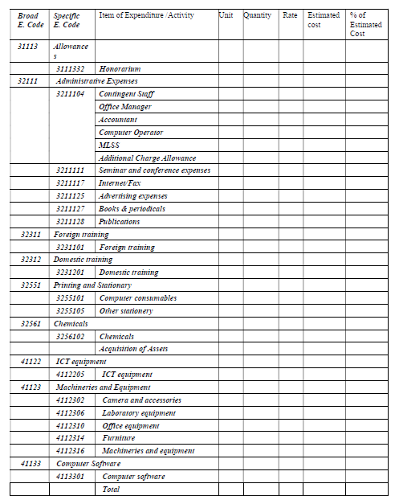
EXAMPLE

Slide 47
Workplan: Actions in time chart (Gantt chart)
Work plan should be progressive and realistic
Activities should be logically sequenced
Where, when and who questions should be answered
Clear milestones should be set
Duration of preparation versus implementation should be realistic

Slide 48
Workplan: Actions in time chart (Gantt chart) EXAMPLE
Activities | Year 1 |  |  |  |  |  |  |  |  |  |  |  | Year 2 |  |  |  |  |  |  |  |  |  |  |  | Year 3
 | 1 | 2 | 3 | 4 | 5 | 6 | 7 | 8 | 9 | 10 | 11 | 12 | 1 | 2 | 3 | 4 | 5 | 6 | 7 | 8 | 9 | 10 | 11 | 12 | 1 | 2 | 3 | 4 | 5 | 6 | 7 | 8 | 9 | 10 | 11 | 12
ATF’s Office Setup ( Renovation, Furniture, office staff appointment) | x | x | x | x
Procurement of Computer and accessories |  | x | x | x | x
Procurement of Electric Equipment |  | x | x | x | x
Website Development |  |  |  |  |  | x | x | x |  |  |  |  | x | x | x
Publication on Research Findings |  |  |  |  |  |  |  |  |  |  |  |  | x | x | x |  |  |  |  |  | x | x | x |  |  |  |  |  |  | x | x | x
Training (Non-AC) | x | x | x |  |  |  |  |  |  |  |  |  | x | x | x |  |  |  |  |  |  |  |  |  | x | x |  | x | x
Training (AC) |  |  |  |  | x | x |  |  |  |  |  |  | x | x |  |  |  |  |  |  |  |  |  |  | x | x
Training (Foreign) |  |  |  |  |  |  |  |  |  |  |  |  |  | x | x |  |  |  |  |  |  |  |  |  | x | x | x
Seminar |  |  |  | x |  |  |  |  |  |  |  |  | x |  |  |  |  |  |  |  |  |  |  |  | x
Workshops |  |  |  |  | x |  |  |  |  |  |  |  |  | x |  |  |  |  |  |  |  |  |  |  |  | x
Study Tour at Home |  |  |  |  |  |  |  |  |  |  |  |  |  |  | x |  |  |  |  |  |  |  |  |  |  |  | x |  |  | x
ATF (phase-1) |  |  |  | x | x | x | x | x | x | x | x | x | x | x | x
Self Assessment (phase-2) |  |  |  |  |  |  |  |  |  |  |  |  | x | x | x | x | x | x | x | x | x | x | x | x
Self Assessment (phase-3 |  |  |  |  |  |  |  |  |  |  |  |  |  |  |  |  |  |  |  |  |  | x | x | x | x | x | x | x | x | x | x | x | x
Reporting |  |  | x | x | x | x | x | x | x | x | x | x | x | x | x | x | x | x | x | x | x | x | x | x | x | x | x | x | x | x | x | x | x | x | x | x

Slide 49
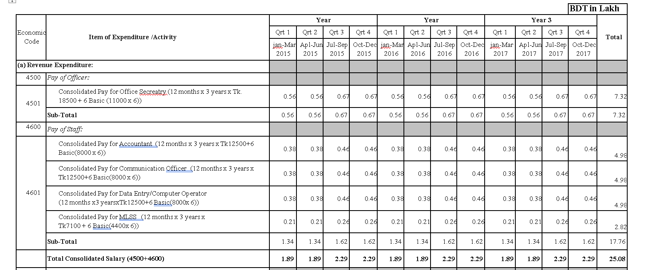
Workplan: Actions in time chart (Gantt chart) EXAMPLE

Slide 50
Training/Workshop Plan
Training for Human Resource Development of the Entity
Types: Training, Workshops Location: Local & Foreign
Should be logically sequenced
Academic staff upgrading
Academic staff development. Post-graduate degrees, local and abroad. New qualified staff
Support/ management staff, Technicians

Slide 51
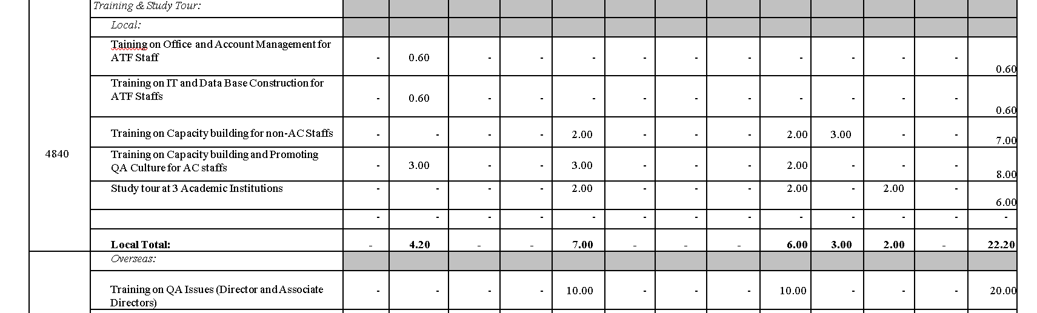
Training/Workshop Plan

Slide 52
Procurement Plan
Goods, Works, Consultant Service and Non- Consultant Services separately
Use format given in ATFOM SPP Annex-4
Useful management tool for project activity planning and implementation of purchases
Links to budget and work plan (Coherence)
On time adjustments for delays and contingencies will allow on time updates of work-plan and efficiency improvements
Careful management of procurement will normally produce project savings that can be used to support other project purposes
It is a LIVING DOCUMENT
53

Slide 53
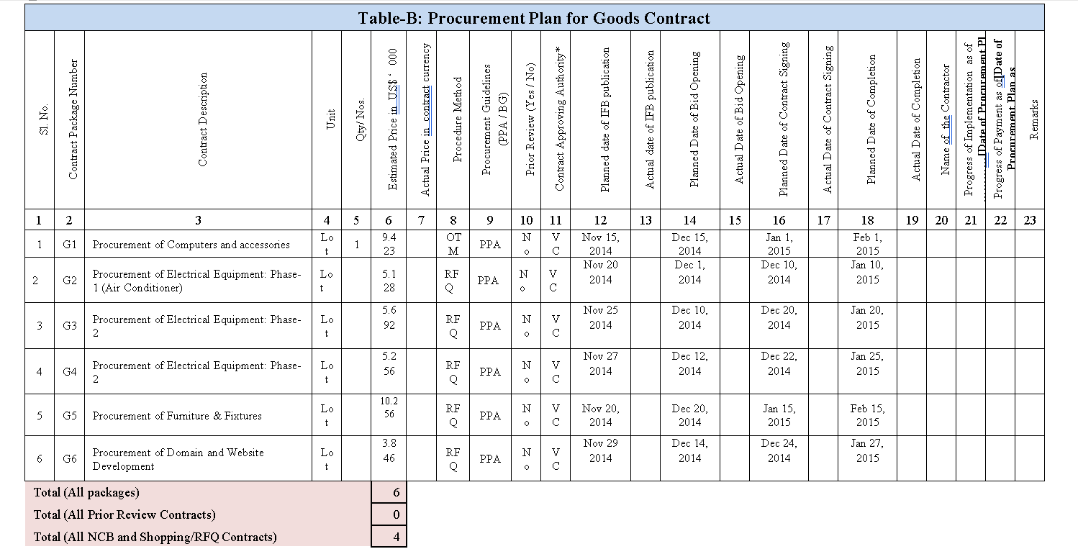
Procurement Plan (EXAMPLE)
53

Slide 54
Eligible and Non-Eligible Expenditure
A. Indicative Eligible Expenditure (Art-2.7)
Training of permanent academic staff (all Windows)
Teaching aids-materials (W-2)
Equipment/ stationeries (all Windows)
Local conference/seminar/workshops (all Windows)
Research support to Masters/MPhil./PhD (W-3)
Financial support to research students (W-3)
Research stay abroad (Fellows & host) (W-3)
Academic collaboration visit (all Windows)

Slide 55
Eligible and Non-Eligible Expenditure
B. Ineligible Expenditure (Art.-2.7.7)
Salary and allowances for permanent staff
Any establishment/recurring/revenue expenditures of the entities
Large civil works (Not exceeding 10% of total sub project cost)
Expenditure not included in the sub project work/financing/procurement plans and budget

Slide 56

Special Attention
A faculty in more than one SPP not allowed
Faculty engaged in other research costing above 100 lac are not allowed to submit ATF sub-project
All paragraphs/items should be organized & filled
Justification of budget asked for major items (>15%)..
Budget & all plans should be given in xls format
Foreign visit restricted & needs UGC permission
SPP hardcopy binding should be properly done
SPP submission needs both online and Hardcopy
Endorsement by university authority
UGCBATF may apply complementary selection criteria
………

Slide 57

Don’t Cross the Boundary
Total budget of SPP (4 Basics for SPM, 2 Basics ASPM and 1 Basic for each Member)
SPM team incentives
Number of MPhil/PhD fellowship
Research stay abroad (Student/Faculty)
Number of foreign training (Faculty)
Collaboration visit abroad (# Faculty)
Total remuneration for consultants (<10%)
Renovation works (<10%)
Operational costs (<2%)

Slide 58
Sub-project Management Team
Sub-project Management Team includes SPM, ASPM & Member of SPMT (total <=4)
Human resources behind a project
Responsibilities and challenges
Institutional role
Academic role
Project organization
Technical committee

Slide 59
Indicative Organogram of the Sub-project Management Office
Sub-project Manager (Faculty)
Associate SPMs (1-2) (Faculty)
Member (1-2) (Faculty)
Member (1-2) (Industry)
Procurement/ Accounts/ Finance Officer
Office Secretary
/ Administrative officer
Data Entry
/Computer Operator
Office Sohayok

Slide 60
Status of Team Members
The SPM would be the same person proposed in the approved subproject proposal and will be assisted by Associate SPM (ASPM), another faculty of the same entity. There will be a Sub-project Management Team (SPMT) consisting of the SPM, ASPMs and members who will normally be academics of the entity. In the case of WINDOW-3b sub-projects, a scientist from the industry partner will be a member of the SPMT. In the case of WINDOW 3, 4 and 5 sub-projects, an officer of the university may be included in the SPMT. SPM will recruit office staff, i.e., Secretary/Office Manager,
Accountant/Finance Officer, Data Entry Technician, and support staff, i.e., Janitor/MLSS etc., (with consolidated salary or as additional duty/part-time contract basis) provisionally in line with approved sub-project proposal to work in SPMO. (Page 23 ATF OM)

Slide 61
Fund allocation
All sub-projects will require fund for renovation and refurbishing of class rooms, lecture theaters, women’s facilities renovation, labs, procurement of scientific equipment for labs, computers, communication and teaching-learning devices, office equipment, stationary, soft-ware, renovation work of classrooms and labs, etc. Sub-project budget will also cover expenses for other activities included in the work and financing plans, e.g., training, travel allowances, remuneration to MPhil, Master’s, PhD and Post-doc fellows, etc., and salary for contractual staff of the sub-project. However, Pandemic Research and Development sub-projects and those of the STAGE/ STEM disciplines would require modern state-of-the-art lab equipment for conducting advanced research.
Most of these scientific lab equipment are very expensive.

Slide 62
Institutional linkages
Links with other improvement programs in the institution
Links with other universities.
Links with other organizations; example: industry
If possible, consider their participation in the first design stages
Other institutions
University-1
Development Plan
University-2
Development Plan
Other institutions
Proposal
Proposal
Proposal
Proposal

Slide 63
Effects and Impacts
Environment
Women and children
Employment and poverty reduction
Institutional performance
Academic program
Entity
Research
Human development
Food security
Productive innovation
Academic innovation
Quality Assurance Program (if any)
Governance
Management practices
Disaster management
Any other (please specify)

Slide 64
Annexes in SPP
SPP Annex 1: Milestones, Performance Indicators and Logical Framework
SPP Annex 2: Work/Activities Plan (excel spread sheet) SPP Annex 3: Financing Plan (excel spread sheet)
SPP Annex 4: Procurement Plan Summary (Table A, Table B, Table C,
Table D and Table E) excel spread sheet SPP Annex 5: Training visit/ Study Tour Plan
SPP Annex 6: Details of estimated Budget (Excel spread sheet) SPP Annex 7: Environment and Safety Check List for Research and Innovation SPP Annex 8: Attachment A: Environmental Monitoring and Mitigation Plan SPP Annex 9: Social Screening Form
SPP Annex 10: Indicative Organogram of the Sub-project Management Office
SPP Annex 11: Sub-project Management Team and Resume Attachment: Resume of SPM, ASPM and SPMT Members. Upload: CV of SPM, ASPM and SPMT members online.
SPP Annex 12: Proposal Endorsement by University Management
13. Collaboration MoU, for collaboration SPP

Slide 65
Sub-project Proposal Evaluation Criteria
1. Clarity & quality of the SWOT analysis, objectives & expected results & innovative nature of the proposal |  | 20
2. Quality and clarity of the milestones and performance indicators to measure progress, results and impact |  | 10
3. Access to Higher Education and Research |  | 10
4. Clarity and Justification of the proposed budget |  | 10
5. Quality and clarity of the proposed work, financing and procurement plans |  | 10
6. Experience of SPMT: Research & Publication |  | 20
7. Impact the Sub-project |  | 10
8. Sustainability |  | 10
Total |  | 100
Excellent=5, Good=4, Fair=3, Weak=2, Deficient=1 and Incomplete=0
62

Slide 66
Environment Safety Checklist & Mitigation Plan (Annex-7)

Slide 67
Social Screening Form (Annex-8)

Slide 68
Experience in similar project

Slide 69




Questions ???
Comments !!!
63

