Slide 1











Proposal Writing
Prof. Dr. Md. Mozahar Ali
ATF Management Specialist HEAT Project, UGC, SHED Bangladesh Cell: 01711-391190
Email: atfms.heat@ugc.gov.bd
1

Slide 2
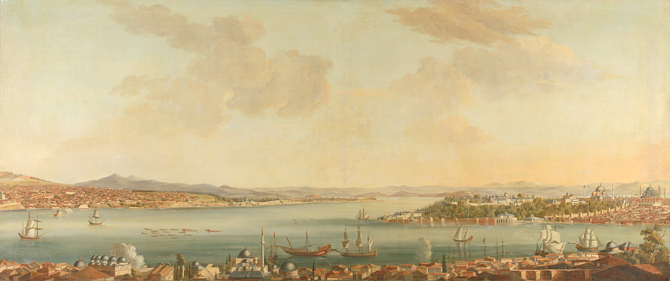
Welcome to Writing Proposal on
“Academic Transformation Fund”
Md. Enayet Hossain
(PhD, Curtin University, Australia)
Professor, Department Tourism and Hospitality Management
E-mail: mehossain@yahoo.com
Tel: 01711461460, 01746583853

Slide 3



Outline of Presentation
HEAT Project (Higher Education Acceleration and Transformation Project)
ATF fund (Acceleration Transformation Fund)
Eligible Universities and Entities
Proposal Wings for US
Three Parts of the Project (Up to completion) I) Conceptual Part ii) Implementation Part iii) Monitoring Part
SWOT Analysis and Measure Value in Relation to Project Objective/s
Identification of Milestone
Identification of Activities
Budgeting based on activities
Monitoring Performance Indicator

Slide 4
Objectives of this Workshop
Share information about How to write Project Proposal on
  ATF Sub-project Proposal Writing

Slide 5
HEAT: Project Overview
Project Title
  Higher Education Acceleration and Transformation(HEAT) Project
Sponsoring Ministry/Division
  Secondary and Higher Education Division
Implementing Agency
  University Grants Commission (UGC) of Bangladesh
Project Implementation Period
Date of Commencement
Date of Completion
IDA Credit Closing
Estimated Cost: 401,657
: July 2023
: June 2028
: December 2027

Slide 6
HEAT: Main Components
Main Component and Sub-component Name
Component 1: Strengthening Regional and Global Partnerships in Higher Education
Sub-Component 1.1: Institutionalization of Regional Mechanisms, Systemic Resilience/Flexibility, and Digital Connectivity
Sub-Component 1.2: Regional Network of Women’s Higher Education Institutions

Slide 7
HEAT: Main Components
Component 2: Transforming Higher Education In Bangladesh
Sub-Component 2.1: Business Continuity under Covid-19
Sub-Component 2.2: Strengthening the Market Relevance of HE Programs in Bangladesh
Sub-Component 2.3: Improving the Governance and Quality of the HE Sector
Component 3: Project Management, Results Monitoring, Communication and contingency

Slide 8
Major Activities
Component 1:
Strengthening Regional and Global Partnerships in Higher Education
International Partnership and Collaboration
Student Exchange Programs
Collaboration with NRENs through BdREN
Development of an academic center at AUW (Asian University for Women)
Establish a network of women’s universities and colleges in Bangladesh

Slide 9
HEAT: Major Activities
Component 2:
Transforming Higher Education In Bangladesh
Improving digital connectivity and infrastructure
  Develop National Learning Management Infrastructure (LMI)
  Upgrade the Bangladesh Research and Education Network (BdREN)
Faculty Professional Development (FPD)
  Establish UTTA at rental premises and Train 5000 faculty members

Slide 10
Cont.
Competitive Grants
  Research grants to promoting advanced research, innovation and entrepreneurship skills
  Project grants to improve teaching learning facilities
Quality assurance and Accreditation
  Support the full operationalization of BAC
  Strengthening the operation of IQACs
  Performance based budgeting

Slide 11
Windows and Eligible University and Entity
W i n d o w s: |  | Entity & University Group
Win-1 | Pandemic Research | Bio-science, Pharmacy and Social Science Depts. of Group A & B Universities
Win-2 | Teaching-Learning Infrastructure | All Departments/Institutes of eligible public Universities
Win-3a | Advanced Research: Priority Areas | Departments/Institutes of all eligible Universities
Win-3b | Advanced Research: Industry Collaboration | Departments/Institutes of all eligible Universities
Win-4 | Establishing Fab Lab | Group A Universities
Win-5 | Establishing TTO | Group A Universities

Slide 12
Duration of ATF Sub-Projects
Maximum duration:
Window 1
Window 2
Window 3
Window 4
Window 5
: 3 years
: 2 years
: 3 years
: 2 years
: 2 years
In extreme circumstances, SP duration may be extended, but should be completed 06 months before the closing date of HEAT project.

Slide 13
ATF Allocations to Five Windows
W i n d o w | Allocation for the window (Tk. Lac) | Allocation for this type | Allocation to individual SPP (lower ceiling) | Allocation to individual SPP (upper ceiling)
W-1 Pandemic Res & Dev | 6000 | 6000 | 100 | 500
W-2: TL infrastructure | 24200 | 24200 | 50 | 500
W-3a: Adv. Research | 62960
3ai:STEM (Science, Technology, Engineering Mathematics) |  | 38960 | 200 | 600
3ai : AHSBL (Arts, Humanities, Social Science, Business and Law) |  | 10000 | 50 | 100
3aii: Jun Res |  | 10000 | Same as 3ai
3aiii: Climate Res |  | 4000
W-3b: U-I Collab. Res | 20000 | 20000 | 200 | 1000
W-4: Fab Lab. I Lab, Bus. Incubator) | 5740 | 5500 | 200 | 600
FL Network |  | 240 | 20 | 100
W-5: TTO | 3500 | 3500 | 20 | 100 11

Slide 14
Group of Universities
Group | Number of Universities | Name of Universities
A | 30 | 1. DU, RU, BAU, BUET, CU, JU, SUST, JnU, NSU, DIU, KU, BRACU, IU, KUET, AIUB, BSMRSTU, HSTU, ….. 30. Independent University, Bangladesh
B | 30 | 1. IIUC, IUBAT, UIU, PUST, BSMRSTU, UAP, BRU, JKKNIU, CVASU, ULAB, ………. 30. KYAU
C | 102 | 1. BSMRSTU Pirojpur, BSMRMU, BAUST Saidpur, BSMRAAU, DIU, EU, BIU, EDU, AUB, …….. 102. Queens University

Slide 15
Proposal Format Selection (6)
W i n d o w s: |  | SPP Format
Win-1 | COVID R&D-1: Biochemical/Virological COVID R&D-2: Medical/Pharmaceutical Social adaptation and Institutional readiness during/after pandemic | SPP Anx-1
Win-2 | Improvement of Teaching-Learning Infrastructure | SPP Anx-2
Win-3a | Advanced Research Grants: Priority Areas | SPP Anx-3a
Win-3b | Advanced Research Grants: Industry Collaboration | SPP Anx-3b
Win-4 | Establishing Innovation Support Facilities | SPP Anx-4
Win-5 | Establishing Technology Transfer Office | SPP Anx-5 14

Slide 16


Structure of ATF Sub-Project Proposal
1. Conceptual part
Analysis of present status → Identifying area and extent of Capacity Building →Conceptualizing in terms of Objective (s) Activities, Outputs, and
Outcome
SWOT Analysis, Logframe
Implementation part
Identifying major items of Expenditure → Work Plan→Training Plan → Procurement Plan → Budget
→ Financing Plan
Monitoring and Evaluation (M&E) Part
Milestones, Performance Indicators & Logframe

Slide 17
Characteristics of Development Proposals
An objectively analyzed need assessment: SWOT
Formulation of realistic objective(s)
Identifying major activities and inputs
A realistic Budget
An unambiguous, time-bound Implementation plan
Identifying Monitoring Instruments
Identifying probable Risks and their management plan

Slide 18
Cluster of disciplines for sub-projects: (Disciplines which are not mentioned here, are also eligible, just align with anyone of the following)
AHSS: (Arts, Humanities, Social Sciences))
CCDM: (Climate Change and Disaster Management)
PCMSI: (Physics, Chemistry, Biology, Mathematics, Statistics, ICT)
ETTCLW: (Engineering, Technology, Textiles, Ceramic, Leather, Wood)
MBPPHNS: (Medical, Biochemical, Medical Physics, Pharmaceutical, Public Health and Nutritional Sciences)
6. AG:
(Agriculture including Crops, Fisheries, Livestock, Veterinary, Poultry & Horticulture)
(Business and Law)
7. BL:

Slide 19
Window 1: Pandemic Readiness Related
Research and Development
Indicative Activities:
Biochemical/Virological aspects of the virus, such as, genomics, origin, and mutation in human bodies, immune system,
Medical and pharmaceutical research on pandemic causing viruses, antibodies, vaccines, drugs, etc.
Social adaptation and Institutional readiness during/after pandemic.
Eligible Entities:
Bio-science, Pharmacy and Social Science Depts. of Group A & B Universities
Budget Limit:
:BDT. 100-500 Lac

Slide 20
Window 2: Improvement of Teaching-Learning Infrastructure
Improving Infrastructure for Teaching-Learning: The funds from this window will finance:
Modern ICT systems for teaching and learning;
Upgrading of STEM labs;
Updating/modernizing curricula and teaching- learning materials; and
Upgradation/renovation of childcare facilities
and ensuring campus safety for women.
Eligible Entities
All Depts./Institutes of eligible public Universities
Budget Limit: BDT. 50-500 Lac
20
20

Slide 21
Window 3a(i): Advanced Research in Priority Areas
STAGE/(Science, Technology, Agriculture, Engineering)
STEM (Science, Technology, Engineering, Mathematica) disciplines:
Smart agriculture, food safety, sustainable agriculture, smart textiles, computational biology, bio-medicines, biotechnology, poultry, fisheries and livestock, Veterinary, nanotechnologies and engineering, artificial intelligence, sustainable materials, ceramic, jute fabrics, biodegradable polymer, wood, metallurgy, and leather technologies, ship recycling, carbon emission, robotics and automation, etc.
Eligible Entities: Departments/Institutes of all eligible Universities. Budget Limit
:BDT. 200-600 Lac
21
21

Slide 22
Window 3a(i): Advanced Research in Priority Areas
AHSBL disciplines: (Arts, Humanities, Social Sciences, Business and Law)
Economic, anthropological, sociological studies, globalization, production systems, livelihood pattern changes, rural and urban social transformation, ecosystem degradation impact on communities, migration, capital market, judicial and legal system, etc.
Eligible Entities:
Departments/Institutes of all eligible Universities
Budget Limit. 50-100 Lac
22
22

Slide 23
Window 3a: Advanced Research in Priority Areas
Activities: (Same as 3a(i))
Research Projects lead by Junior Researchers
Climate change
Eligible Entities:
Departments/Institutes of all eligible Universities
Budget Limit for STAGE/STEM
Budget Limit for AHSBL: 50-100 Lac
:BDT. 200-600 Lac
23
23

Slide 24
Window 3b: Collaborative Research with Industries and Research Institutes
Activities:
University-industry collaborative research targeting patenting and commercialization of research products.
Eligible Entities:
Departments/Institutes of all eligible Universities
Budget Limit:
:BDT. 200-1000 Lac
24
24

Slide 25
Window 4: Establishing Innovation Support Facilities
SPP Type-1:
Fab Labs, i-labs, Business incubators
Activities:
Establish new Fab Labs, i-labs, upgrading existing Fab labs, Business Incubation Centers tagged with Fab labs and i-Labs
Eligible Entities:
Group A universities
Budget Limit: :BDT. 200-600 Lac
25

Slide 26
Window 4: Establishing Innovation Support Facilities
SPP Type-2:
Networking with other Fab Labs
Activities:
Establish Fab Lab Bangladesh Network`, become member of Fab Lab Asia Network and Fab Foundation
Eligible Entities: Budget Limit:
Group A universities
:BDT. 20-100 Lac

Slide 27
Window 5: Establishing Technology Transfer Office
Activities:
Establishing new Technology Transfer Offices
Eligible Entities: Budget Limit:
Group A universities BDT. 20-100 Lac

