Slide 1
Introduction to
Outcome Based Education (OBE)
Md. Mashihur Rahman
Additional Director
IQAC, RU

Slide 2
What is Outcome Based Education (OBE)
A system/teaching and learning methodology where parts and aspects (i.e. course design, delivery, assessment) of education are organized around a set of goals (outcomes).
Students should achieve their goal by the end of the educational process.
Maps and measures students’ performance at every step.
Aims to maximize student learning outcomes by developing their knowledge & skills.
Also referred to as standard based education, helping institutions measure their learning outcomes and enabling students to develop to stand out with their global counterparts.

Slide 3
OBE involves the restructuring of curriculum, assessment, and reporting practices in education to reflect the achievement of high-order learning and mastery rather than the accumulation of course credits.
It requires students to demonstrate the knowledge and skills they have learnt and achieved.
Outcome-based education means starting with a clear picture of what is important for students to be able to do, then organizing the curriculum, instruction, and assessment to make sure that this learning ultimately happens. (Spady, 1994).
Spady, W.D. (1994) Outcome-Based Education: Critical Issues and Answers. American Association of School Administrators, Arlington.

Slide 4
OBE addresses the following key questions:
What do you want the students to have or able to do? [Knowledge, Skills, ability to solve problems etc.]
How can you best help students achieve it? [Student Centered Learning]
How will you know whether they have achieved it? [Through various assessment schemes]
HOW do we close the loop for further improvement [Continuous Quality Improvement (CQI)

Slide 5
Some important aspects/components of the Outcome Based Education
Vision: futuristic statement that the institution would like to achieve over a long period of time.
Mission: the means by which it propose to move toward the stated vision.
Programme
defined as the specialization or discipline of a Degree.
interconnected arrangement of courses, co-curricular and extracurricular activities to accomplish predetermined objectives leading to the awarding of a degree.

Slide 6
Programme Learning Outcomes (PLOs)
narrower statements that describe what students are expected to be able to do or attain by the time of graduation.
relate to the skills, knowledge and behaviour that students acquire through the completion.
expected to be aligned closely with Graduate Attributes.
Program Educational Objectives (PEOs)
the statements that describe the expected achievements of graduates in their career, and also in particular, what the graduates are expected to perform and achieve during the first few years after graduation.

Slide 7
Course: defined as a theory, practical or theory cum practical subject studied in a semester.
Course Learning Outcome (CLO): statements that describe significant and essential learning that learners have achieved, and can reliably demonstrate at the end of a course.
Mapping/Alignment: aligning objectives with outcomes (programme, course-level, contents). OBE tends to map at different levels by aligning itself to Bloom’s Taxonomy’s cognitive, affective, and psychomotor domains.

Slide 8
Rationale: a short description that makes clear the purpose and necessity of the course. It also describes the basis and context to understand how this course supports student learning and how it fits in the wider curriculum.
Graduate Attributes (GA): attributes that are expected in a graduate from a programme.

Slide 9
Major Benefits
Makes the programme student-centric
Better tracking the learning in students
Engaging with students in a better way
More directed curriculum, reviewing and revising
Better assessment
Meeting accreditation requirements

Slide 10
Bangladesh Accreditation Council (BAC) Standards for
Accreditation of Academic Program
1: Governance
2: Leadership, Responsibility and Autonomy
3: Institutional Integrity and Transparency
4: Curriculum
5: Teaching-Learning & Assessment
6: Student Admission & Support Services
7: Faculty & Professional Staff
8: Facilities & Resources
9: Research & Scholarly Activities
10: Monitoring, Evaluation & Continual Improvement

Slide 11
Bloom's Taxonomy of Learning
A set of three hierarchical models used for the classification of educational learning objectives into levels of complexity and specificity.
The model is named after Benjamin Bloom.
During the 1990s, a new group of cognitive psychologists, led by Lorin Anderson (a former student of Bloom), updated the taxonomy reflecting relevance to 21st century perspective.
Bloom, B. S. (1956). Taxonomy of educational objectives: The classification of educational goals (1st ed.). Longman Group.
Anderson, L. W., Krathwohl, D. R., & Bloom, B. S. (2001). A taxonomy for learning, teaching, and assessing: A revision of Bloom’s taxonomy of educational objectives. New York: Longman.

Slide 12
The three lists cover the learning objectives in cognitive, affective and psychomotor domains.

Slide 13
Use of Bloom’s Taxonomy
Defining the Learning Outcomes (LOs) & Educational Objectives
Selecting teaching methods/strategies
Selecting teaching aids-materials
Preparation of assessment tools
Development & review of curriculum

Slide 14
Cognitive | Affective | Psychomotor
Learners' ability to process information in a meaningful way Learners demonstrate knowledge and comprehension of the subject matter and the ability to apply it to real life situations. (Mental skills, Knowledge, Comprehension, Critical thinking) | Learners' attitudes and feeling that are a result of the learning process. involves the demonstration of feelings, attitudes, or sensitiveness toward other people, ideas or things. includes the manner in which we deal with things emotionally, such as feelings, values, appreciation, enthusiasms, motivations, and attitudes. (Attitudes, Emotional reaction, Awareness) | Learners' ability to use motor skills to learn measures the skills performance of the learner, therefore, the performance required will involve the manipulation of objects, tools, supplies, or equipment. includes physical movement, coordination, and use of the motor-skill areas. Development of these skills requires practice and is measured in terms of speed, precision, distance, procedures, or techniques in execution. (Manual or physical skills)

Slide 15
Cognitive | Affective | Psychomotor
Categories Knowledge Comprehension Application Analysis Synthesis Evaluation Revised ones Remember Understand Apply Analyze Evaluate Create | Categories - Receiving Responding Valuing Organizing Characterizing | Categories Perception Set Guided Response Mechanism Complex over response Adaptation Origination

Slide 16
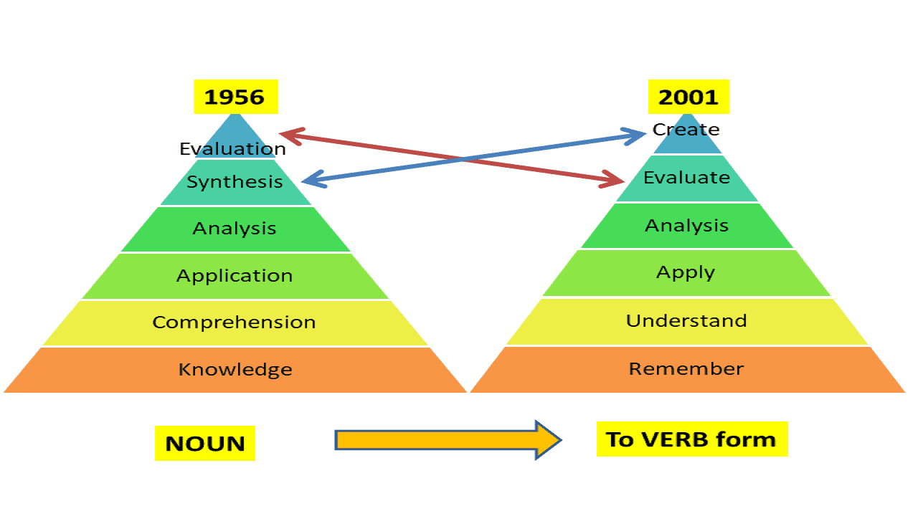

Slide 17
The hierarchy of the cognitive domain of Bloom's Taxonomy (1956).

Slide 18
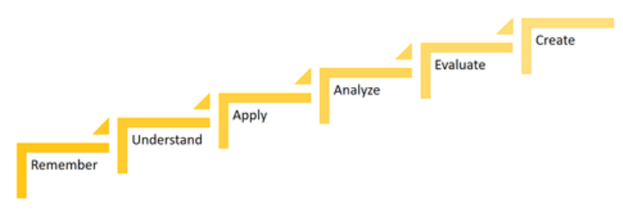
Revision to Bloom's cognitive hierarchy (2001)

Slide 19
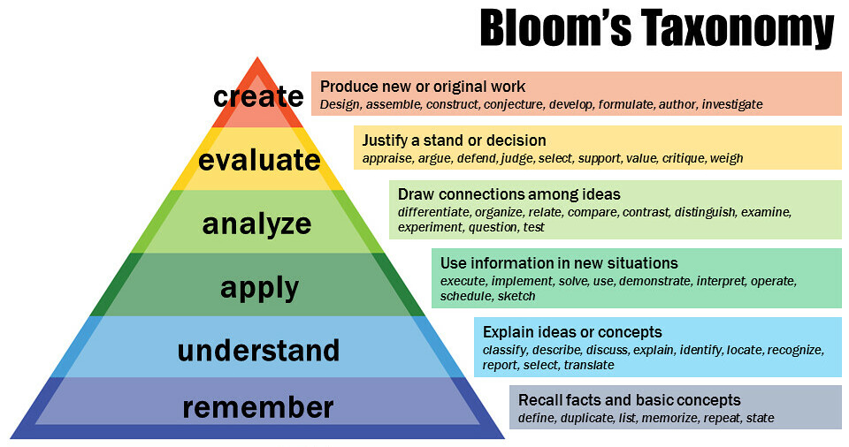

Slide 20
Action Verbs by Domains
Action Verbs by Domains 1

Slide 21
Selection of Teaching Methods: Cognitive Domain
Sub-levels of Cognitive Domain | Teaching Methods
Remember | Lecture, discussion, demonstration, cooperative learning, study tour, question-answer etc.
Understand | Suggested reading, practices, home assignment, case study, role play
Apply | Practice, problem solving, assignment etc
Analyze | Problem based learning, assignment, case study,brain storming, inquiry based learning
Evaluate | Assignment, discussion, review work,
Create | Debate, assignment, group work, competition

Slide 22
Selection of Teaching Methods: Affective Domain
Sub-levels of Affective Domain | Teaching Methods
Receiving | Lecture, directing reading, group discussion, demonstration,cooperative learning, study tour, question-answer etc
Responding | Lecture, group discussion, cooperative learning, field trip, question-answer etc
Valuing | Suggested reading, lecture, discussion etc
Organizing | Field trip, discussion, video, Role- playing
Characterization | Assignment, discussion, review work, practice

Slide 23
Selection of Teaching Methods: Psychomotor Domain
Sub-levels of Psychomotor Domain | Teaching Methods
Imitation | Observation, Practice, demonstration, video
Manipulation | Practice, Do it by yourself, exercise
Precision | Practice & practice, feedback, exercise
Articulation | Practice, observation, exercise
Naturalization | Practice under adverse condition

