Slide 1
Course File
by
Dr. Md. Abdur Rashid Sarker
Additional Director, IQAC
&
Professor of Economics, The University of Rajshahi

Slide 2
Course File
1. Course Outline
An outline for the course/courses a teacher teaches at the program; bachelor or masters.
2. Lecture Materials/Notes
Handout, Slides, Books
3. Attendance sheet
Whole sheet, Number of classes, total class attended, and percentages, Marks (if any)

Slide 3
Course File
4. Assignment
Copies of best, mediocre and poor for all assignments
5. Class test/quiz /mid-term test etc.
Preserve copies of best, mediocre and poor
6. Copies of question papers/assessment tools
All types of questions: Class test, Quiz, Assignment/group discussions/internships/ and
Final questions at the end of the year/semester
Notes:
Formative assessments take place during a course.
Formative assessments are evaluations of someone’s learning progress in a classroom. Common formative assessments include:
Quizzes
Projects
Presentations
Group activities
Summative assessments are the final evaluations at the course’s end. Summative assessments are evaluations of what someone has learned throughout a course.
Common summative assessments include:
Tests
Final exams
Reports
Papers
End-of-class projects

Slide 4
Course File
7. Rubrics
A rubric is a coherent set of criteria for students’ work that includes descriptions of levels of performance quality on the criteria.
Type of rubric: Analytic (problem-solving) and holistic (no single correct answer)
Notes:
Rubrics are important because they clarify for students the qualities their work should have.
How many criteria are there?
What are the names of each criterion?
Standards and criteria for marking assignment and presentation

Slide 5
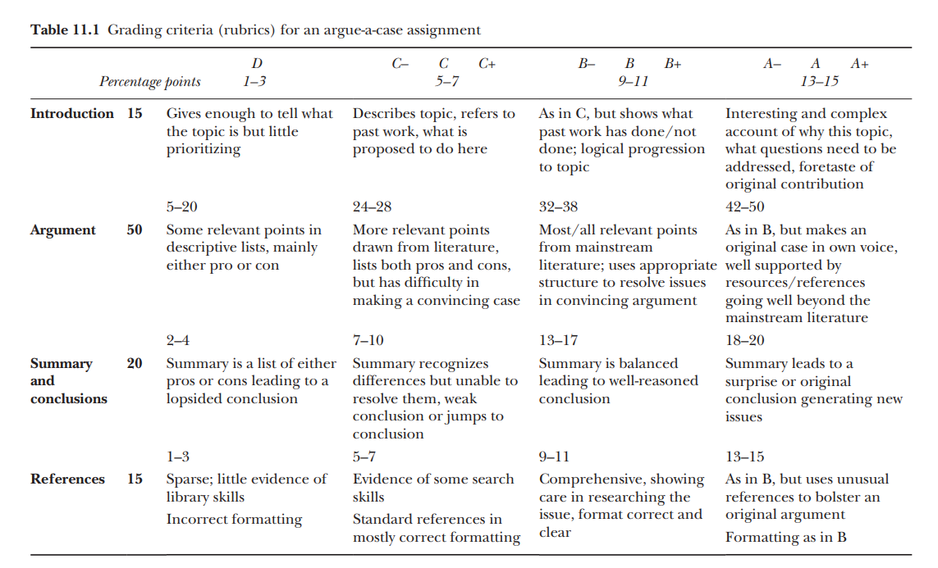
A Sample Rubric
Notes:
Biggs and Tang (2011) Teaching for Quality Learning at University , Mc Graw Hill

Slide 6
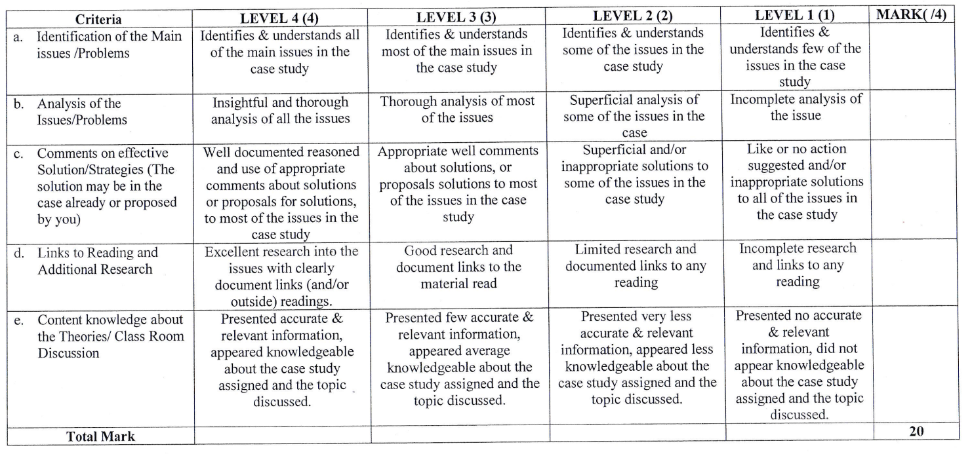
Rubrics for Group/Individual Case Study
Notes:
UGC Template

Slide 7
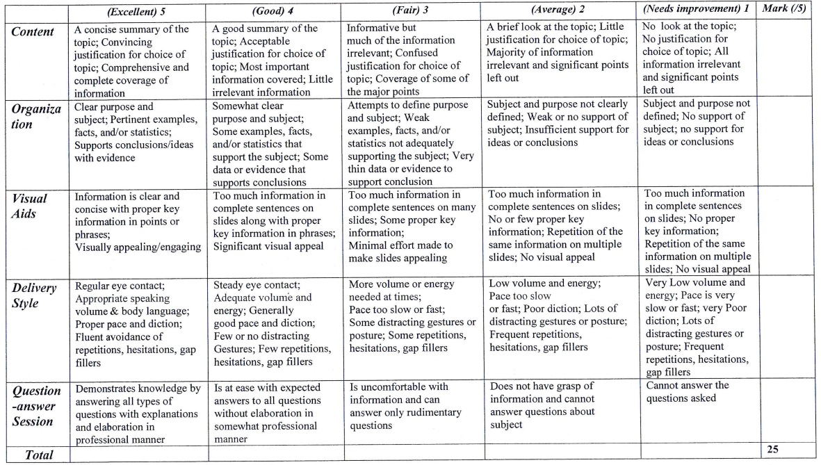
Rubrics for Individual Presentation
Notes:
UGC Template

Slide 8
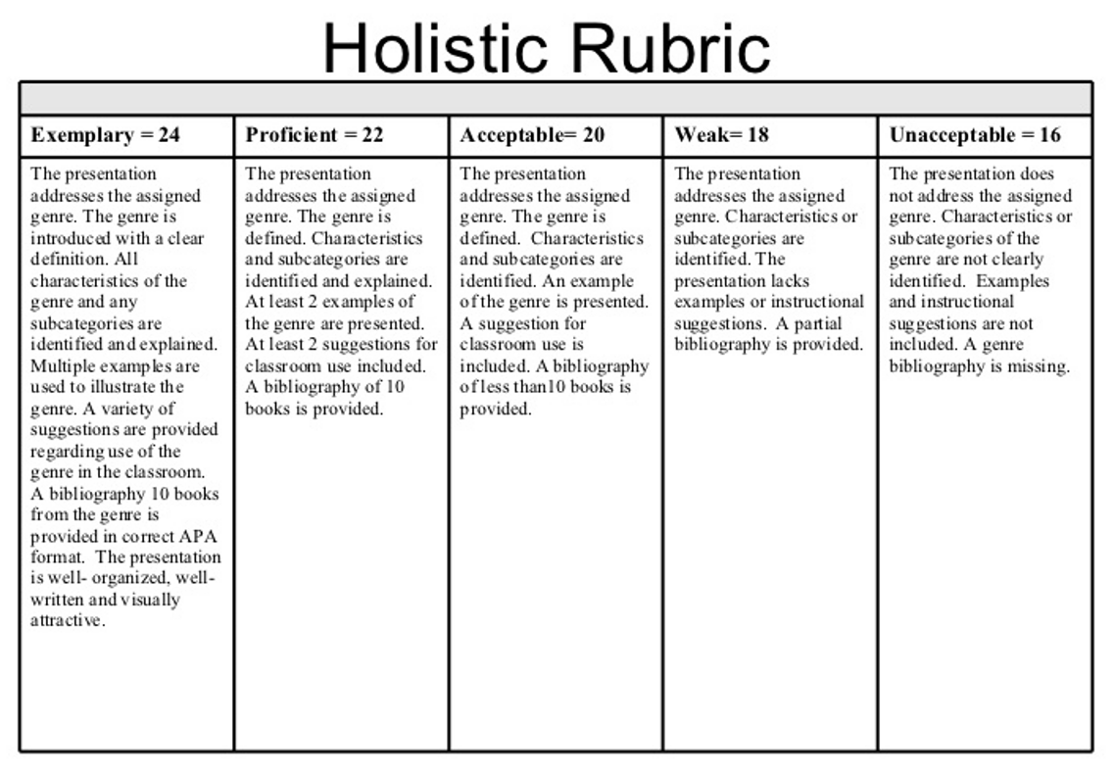
https://courses.dcs.wisc.edu/design-teaching/FacilitationManagement_Spring2016/facilitation-module/5_Course_Management_Strategies/images/holistic.jpg

Slide 9
Course File
8. Course evaluation by course teacher considering feedback from the students
9. Feedback from the students on the course
10. Peer review: Done / not Done
Notes:
A peer review assignment enables students to provide feedback on another student's assignment
Allows communication between students
Help students master the concepts of a course and learn from each other

Slide 10
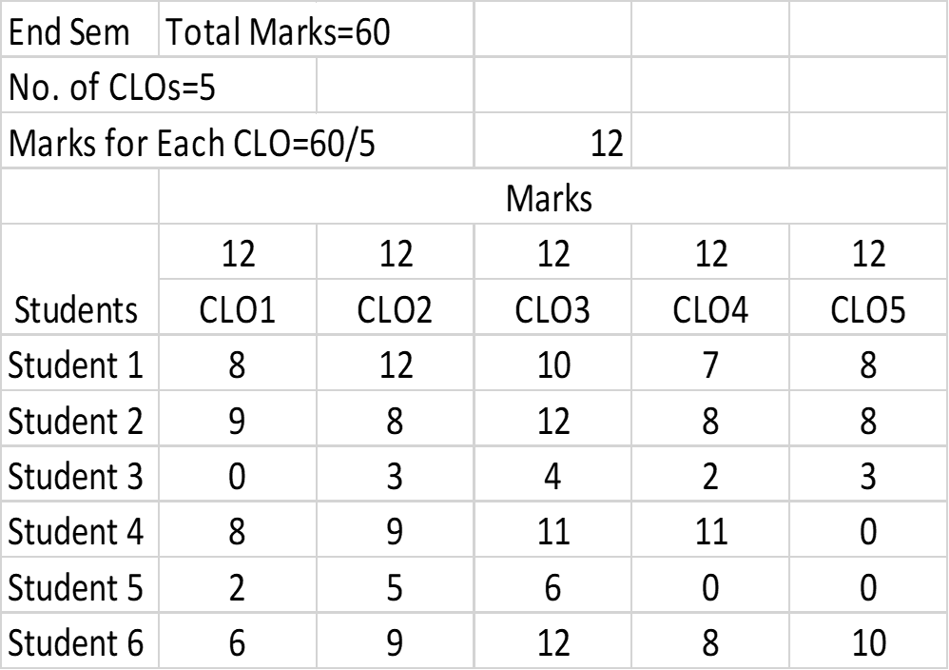
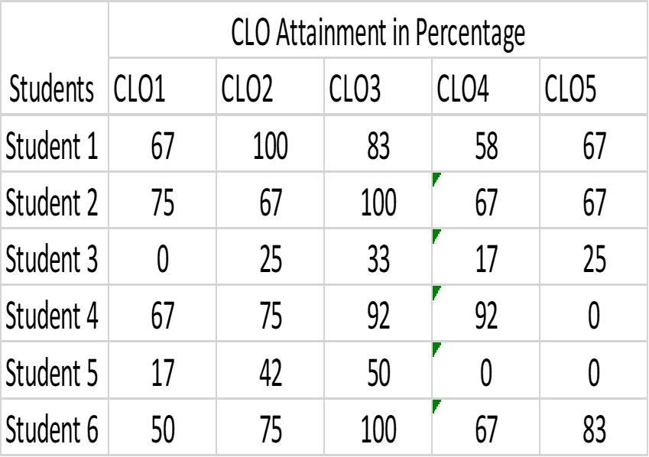
11. CLO attainment
Notes:
A peer review assignment enables students to provide feedback on another student's assignment
Allows communication between students
Help students master the concepts of a course and learn from each other

Slide 11
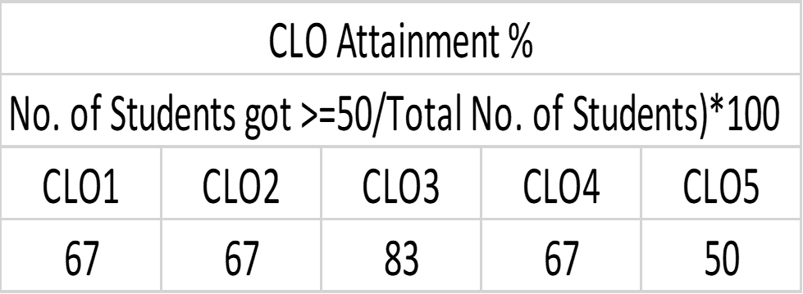
11. CLO attainment
Notes:
A peer review assignment enables students to provide feedback on another student's assignment
Allows communication between students
Help students master the concepts of a course and learn from each other

Slide 12
11. CLO attainment
Notes:
A peer review assignment enables students to provide feedback on another student's assignment
Allows communication between students
Help students master the concepts of a course and learn from each other

Slide 13
11. CLO attainment

Slide 14
Course File
12. Improvement plan for better attainment of CLOs
Here in this example, CLO2 and CLO5 need further improvement plan.

Slide 15
Thank you

