Slide 1
Revised OBE Curriculum Development
by
Dr. Md. Abdur Rashid Sarker
Professor, Department of Economics
The University of Rajshahi
&
Additional Director, IQAC,RU

Slide 2
Organization of this Presentation
Vision, mission, PEOs, PLOs, Graduate Attributes
Mapping/alignment
Structure of the Curriculum ( following BNQF and Faculty Ordinances)

Slide 3
How is OBE different from Traditional Educational Approach?
Criterion | Old Transmission Model | OBE model
The Learner | Passive Learners | Active Learners
Assessment | Graded Exam-driven | Continuous assessment; learners are assessed on an ongoing basis
Role of teacher | Teacher-centered Textbook bound | Learner-centered Teacher as facilitator Group work and teamwork
Curriculum Framework | Syllabus seen as rigid | Allow teachers to be innovative and creative in designing programmes
Source: Jansen, J. D., & Christie, P. (1999). Changing curriculum: Studies on outcomes-based education in South Africa. Juta and Company Ltd.
Notes:
A basic premise of OBE as "having all students learn well, not just the fastest, the brightest, or the most advantaged.“ (William Spady, 1994)
Treating learners as empty vessels which have to be filled with knowledge.
Outcomes are clear learning results that we want students to demonstrate at the end of significant learning experiences. They are not values, beliefs, attitudes, or psychological states of mind. Instead, outcomes are what learners can actually do with what they know and have learned they are the tangible application of what has been learned.
Outcomes are actions and performances . Possible outcome “ explain the major causes of inflation”

Slide 4
Part –A of the Revised Template
Title of the academic programme
Name of the University
3. Vision of the University
“To pursue enlightenment and creativity for producing world-class human resources to cater for the needs of changing time”
Notes:
Accreditation usually applies only to programs, not to departments or faculties
Undertaken only at the invitation of the HEI and with the consent of the appropriate regulator.

Slide 5
Part –A of the Revised Template
4. Mission of the University
M1:To ensure a world-class curriculum with talented academicians and conducive academic and research environment for generation and dissemination of knowledge.
M2: To maintain international standards in education with focus on both knowledge and skills, and humanitarian and ethical values to meet the needs of the society and state.
M3: To develop strategic partnerships with leading national and international universities, and organizations for academic as well as research collaborations.
Mission should be numbered, not bulleted

Slide 6
Part –A of the Revised Template
Notes:
Vision of History Department of Shivaji University: The History Department aims to make the students aware of the past and its legacies through teaching, research and extension activities in Indian history in the context of world history. We believe that only a critical understanding of the past will enable the students to understand the present and help them look towards the future.
Mission
M1 Transform the students into citizens who are critically informed about the past and its consequences for the present
M2 Promote studies in history, society and culture of Maharashtra in general and Maratha history in particular
M3 Empower students to cope with the challenges of globalization by instilling in them a life-long passion for learning about the past. The knowledge about the interconnections between the global, national, regional and local history will equip the students to face the challenges with confidence.
Objectives
M4 To acquaint students with the past and present of India and the World.

Slide 7
Part –A of the Revised Template
11. Graduate Attributes
What are Graduate Attributes?
“Graduate attributes are generally understood as ‘the qualities, skills and understandings a university community agrees its students would desirably develop during their time at the institution” (Bowden et al., 2000, p. 3)
Other terms: graduate outcomes, graduate skills, graduate qualities and graduate capabilities

Slide 8
Part –A of the Revised Template
11. Graduate Attributes
What are Graduate Attributes?
“For students, graduate attributes are meant to indicate the range of skills and
qualities that they should develop by graduation, regardless of their degree discipline”
(Barrie, 2004),

Slide 9
Part –A of the Revised Template
11. Graduate Attributes
Why Are Graduate Attributes Important?
Link between graduate attributes and employability
Increasing evidence of demand from business and employer organizations for graduates to possess generic attributes
Recent economic and technological developments
Ongoing long-term shift to a service economy where information and social skills are increasingly important
Shift to a knowledge-based economy that demand highly-skilled labour
Notes:
R&D is making differences Covid Vaccine/ Windows
Indian people are working in our garments industry
Computer literacy and Statistics knowledge are needed almost everywhere
Outsourcing

Slide 10
Part –A of the Revised Template
11. Graduate Attributes
Why Are Graduate Attributes Important?
There are sound educational arguments for the increased focus on generic attributes.
Initiatives to improve teaching and learning
Course development-interdisciplinary courses
Course delivery and assessment
Quality assurance
Notes:
Within the life of the university teachers and students are driven by a single motive, man’s basic quest for knowledge.

Slide 11
Part –A of the Revised Template
11. Graduate Attributes-Types
“The most popular attributes are communication, teamwork, problem-solving, technological skills, creativity, interpersonal skills, leadership skills, self-management and flexibility/adaptability” (Osmani et al. (2015)

Slide 12
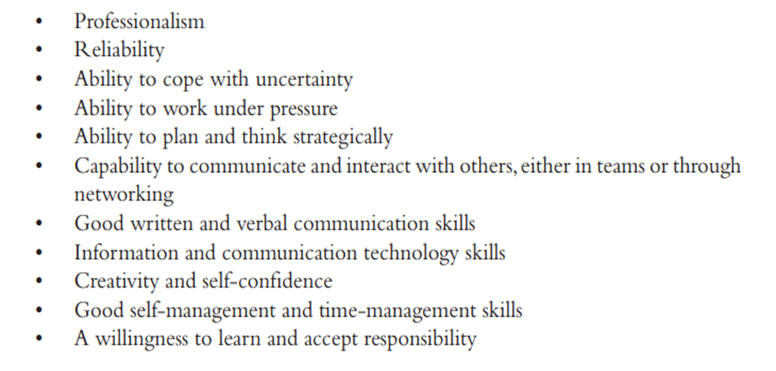
Part –A of the Revised Template
11. Graduate Attributes
Source: Andrews and Higdon (2008)

Slide 13
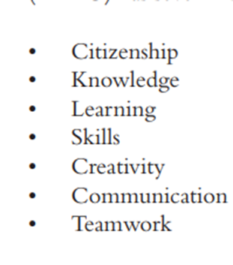
Part –A of the Revised Template
11. Graduate Attributes
Source: HKBU

Slide 14
Part –A of the Revised Template
11. Graduate Attributes
subject specialists, with in‐depth knowledge, understanding, research and other skills associated with their discipline(s)
innovative and creative in their approach to positive change
socially intelligent and proactively inclusive, able to effectively navigate complex relationships with others from any background or culture
digitally literate and
responsible for their own behaviour, their future and their wellbeing
(Source: https://www.stir.ac.uk/student-life/careers/careers-advice-for-students/graduate-attributes/)

Slide 15
Part –A of the Revised Template
11. Graduate Attributes- discipline specific
“the application of graduate attributes across five disciplines (economics, history, law, medicine and physics) and found that discipline-specific interpretations and meanings for the same attribute (e.g., ‘critical thinking’) are not always the same” (Jones ,2009a and 2009b)
Notes:
Staff have found it difficult to translate these ‘top-down’ policies on graduate attributes into the context of their own discipline, since the learning and teaching of graduate attributes are, after all, situated within disciplines, despite the aspiration of graduate attributes to be applicable for all

Slide 16
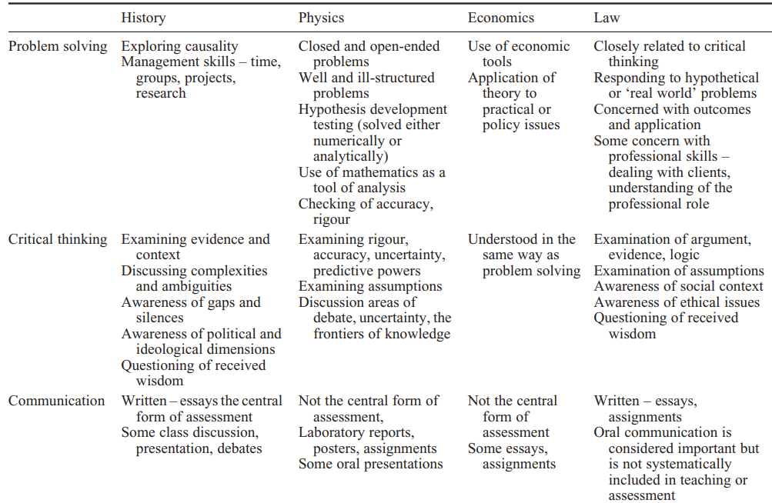
Part –A of the Revised Template
11. Graduate Attributes-discipline specific
Source: Jones, A. (2009) p. 89
Notes:
Staff have found it difficult to translate these ‘top-down’ policies on graduate attributes into the context of their own discipline, since the learning and teaching of graduate attributes are, after all, situated within disciplines, despite the aspiration of graduate attributes to be applicable for all

Slide 17
Part –A of the Revised Template
11. Graduate Attributes-discipline specific
What could be the graduate attributes of social work graduates?
Notes:
Staff have found it difficult to translate these ‘top-down’ policies on graduate attributes into the context of their own discipline, since the learning and teaching of graduate attributes are, after all, situated within disciplines, despite the aspiration of graduate attributes to be applicable for all

Slide 18
Part –A of the Revised Template
12. Program Educational Objectives (PEOs)
PEOs are broad statements that describe the career and professional achievements that the program is preparing the graduates to achieve within the first few years(5-6) after graduation.
What graduates are expected to attain within a few years of graduation.
PEOs are based on the needs of the program constituencies
PEOs should be consistent with the mission of the institution.
Preparing graduates for their career and professional life
Notes:
How to evolve POEs
Consultation with Industry, Alumni, Students, Management, Professional Bodies, Faculty, Parents ,

Slide 19
Part –A of the Revised Template
12. Program Educational Objectives (PEOs)
The number of PEOs should be manageable
PEOs should be achievable by the program
PEOs should be specific to the program and not too broad
PEOs should be based on the needs of the constituencies
Notes:
Program Educational Objective (PEO) is what the programme is preparing graduates for in their career and professional life

Slide 20
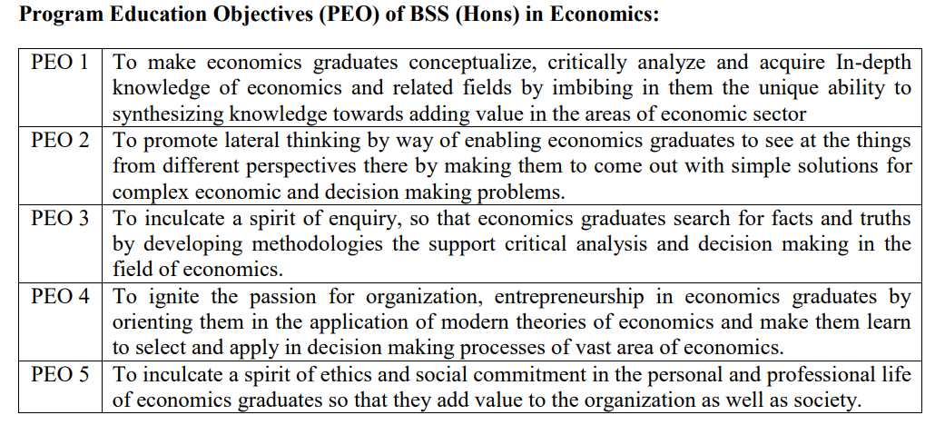
Part –A of the Revised Template
12. Program Educational Objectives (PEOs)
Notes:
How to evolve POEs
Consultation with Industry, Alumni, Students, Management Professional Bodies, Faculty, Parents , Data on trends in the profession

Slide 21
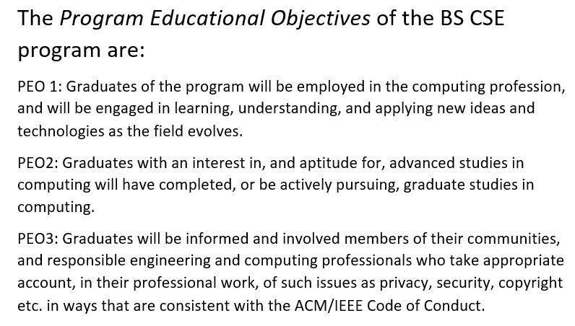
Part –A of the Revised Template
12. Program Educational Objectives (PEOs)
Source: https://cse.osu.edu/content/bs-cse-program-educational-objectives-and-student-outcomes
Notes:
How to evolve POEs
Consultation with Industry, Alumni, Students, Management Professional Bodies, Faculty, Parents , Data on trends in the profession

Slide 22
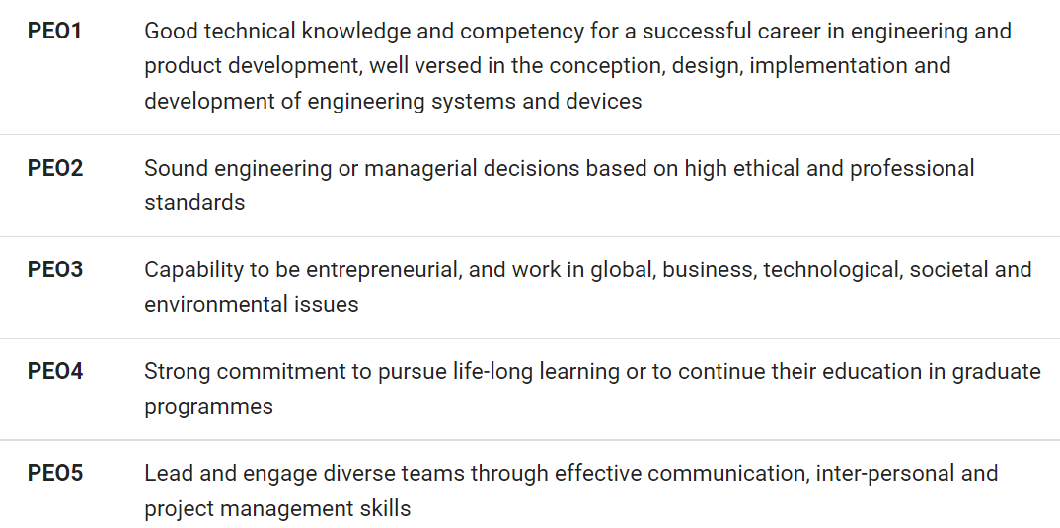
Part –A of the Revised Template
12. Program Educational Objectives (PEOs)
Source: Singapore University of Technology and Design

Slide 23
Part –A of the Revised Template
13. Program Learning Outcomes (PLOs)
What are PLOs?
PLOs are measurable statements that describe knowledge or skills that students achieve upon completion of their academic program.
to demonstrate mastery of knowledge or skills in a summative manner (learning at the end)
to focus on the accumulation of essential learning that takes place over the duration of a program
Notes:
It helps the development of curriculum and learning outcomes for courses
Number of PLOs should be no more than 5 or 6 ( 3 to 5 is better)
PLO হল পরিমাপযোগ্য বিবৃতি যা শিক্ষার্থীরা তাদের একাডেমিক প্রোগ্রাম শেষ করার পর অর্জন করে এমন জ্ঞান বা দক্ষতা বর্ণনা করে।
Program Learning Outcomes (chaffey.edu)

Slide 24
Part –A of the Revised Template
13. Program Learning Outcomes (PLOs)
“An expression of the specific set of knowledge, skills, and dispositions associated with a program (curricular or co-curricular) that distinguishes that program from other programs” ( Maryland Institute College of Art)
No. of PLOs should be less than 6 (3 to 5 is better)
Notes:
It helps the development of curriculum and learning outcomes for courses
Number of PLOs should be no more than 5 or 6 ( 3 to 5 is better)

Slide 25
Part –A of the Revised Template
13. Program Learning Outcomes (PLOs)
PLOs are narrower statements that describe what students are expected to be able to do by the time of graduation. POs are expected to be aligned closely with Graduate Attributes
Notes:
It helps the development of curriculum and learning outcomes for courses
Number of PLOs should be no more than 5 or 6 ( 3 to 5 is better)

Slide 26
Part –A of the Revised Template
13. Program Learning Outcomes (PLOs)
PLOs Are Clear and Measurable
PLOs are assumed to follow the phrase, “Upon successful completion of the program, …”
Please avoid verbs such as “understand” “know” and double barrel outcome statements
Notes:
Avoid unmeasurable verbs such as “ understand,” “appreciate,” “learn,” and “know.” These are difficult to define and hard to measure.
Avoid Double-Barrel Outcome Statements

Slide 27
Part –A of the Revised Template
13. Program Learning Outcomes (PLOs)
Upon successful completion of BSS (Honours) in Economics Program, student will be able to
PLO1 solve complex problems or address problems that do not have a clear answer, with available information, through experimentation and observation, using microeconomic and macroeconomic theory, as well as calculus and statistical tools. ( Problem solving/analytical skills)
PLO2 apply economic analysis to everyday problems helping them to understand events, evaluate specific policy proposals (Critical thinking)
PLO3 develop deeper analytical, critical, and quantitative skills in specialized areas by applying economic concepts to real world situations. (practical application)
PLO4 broaden their global and disciplinary knowledge, enhancing their understanding of the world around them both within economics and beyond. (Interdisciplinary knowledge and global consciousness)
PLO5 build skills to work as part of a team and lead others, ensuring they are prepared to navigate diverse audiences and situations (communication and leadership)
Notes:
Avoid unmeasurable verbs such as understand,” “appreciate,” “learn,” and “know.” These are difficult to define and hard to measure.
Avoid Double-Barrel Outcome Statements.

Slide 28
Part –A of the Revised Template
14. Mapping mission of the university with PEOs
PEOs /Mission | M1 | M2 | M3
PEO1 | 3 | 2 | 2
PEO2 | 2 | 2 | 3
PEO3 | 3 | 2 | 2
PEO4 | 1 | 1 | 3
PEO5 | 1 | 1 | 3
Notes:
Level of correlation: 1 , 2. 3 indicates low , medium and high correlation between the university’s missions and the program’s POEs

Slide 29
Part –A of the Revised Template
15. Mapping PLOs with the PEOs of the program
PLOS | PEO1 | PEO2 | PEO3 | PEO4 | PEO5
PLO1 | X |  | X
PLO2 |  | X |  | X
PLO3 |  |  | X |  | X
PLO4 | X |  | X |  | X
PLO5 |  | X | X | X
Notes:
1, 2, 3…low medium high
Should all PLOs connect all PEOs ? A PLO should be linked with one or two PEOs not all

Slide 30
Part –A of the Revised Template
16. Mapping courses with the PLOs
Courses | Course Title | PLO1 | PLO2 | PLO3 | PLO4 | PLO5 | ..
ECO 111 | Microeconomics 1 | X | X
ECO 112 | Macroeconomics 1 | X | X
ECO 211 | Microeconomics 2 |  |  | X | X
ECO……. | Seminar |  |  |  |  | X
ECO 444 | Resource and Environmental Economics |  |  | X | X
…… | …………………………………… | ……. | ….. | …… | …… | ….. | …..
ECO 449 | Field Work and Report Writing |  |  |  | X | X
Notes:
031 for Social Sciences
0311 for Economics

Slide 31
Part –B of the Revised Template
For 4-Year Bachelor/degree Programme
4 years
8
According to the university policy
Minimum 130 credits for Bachelor
According to faculty ordinance
2.25??
7 years

Slide 32
Part –B of the Revised Template
17.

Slide 33
Part –B of the Revised Template
General education courses are required and typically designed to teach diverse skills that every person should master in order to lead a productive life, become a knowledgeable citizen, and communicate ideas as a useful member of society, regardless of her chosen course of study.
Notes:
Source: What Are General Education Courses? | Study.com

Slide 34
Part –B of the Revised Template
Most general education classes focus on:
Development of critical and analytical thinking skills
Acceptance of cultural diversity in society
Communicating clearly through the formation of logical arguments
Intellectual problem-solving that is effective in a society undergoing constant change
Understanding emerging technologies and how to incorporate traditional information into new ideological perspectives
Appreciation for the arts, humanities, and social sciences
Evaluating environmental issues, to expand knowledge of the natural sciences

Slide 35
Part –B of the Revised Template
Usual General Education Courses
Introduction to Philosophy
Introduction to Sociology
Introduction to Economics
English Composition/ Creative Writing
Principles of Statistics
Introduction to Basic Computing
Business Mathematics
ICT
Bangladesh Studies
According to BAC standards and Criterion at least 25% of total credits will be for general education courses for 4-year bachelor

Slide 36
Part –B of the Revised Template
Core vs. elective courses
Courses can be classified as either core courses or electives.
Core courses are mandatory courses you must study to meet the requirements of your program. (Characterize the discipline)
Electives are courses you can choose, allowing you to study topics that interest you. (specialization within the discipline)

Slide 37
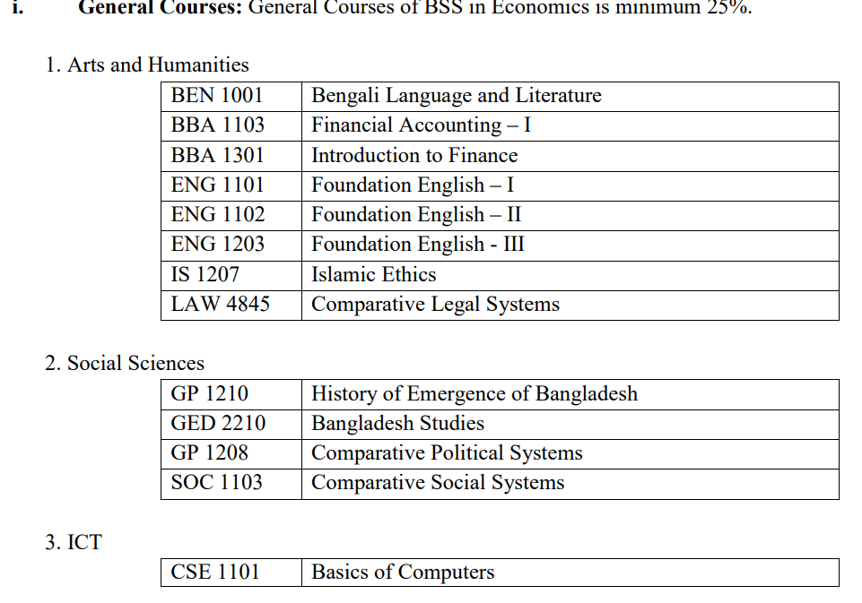
Part –B of the Revised Template

Slide 38
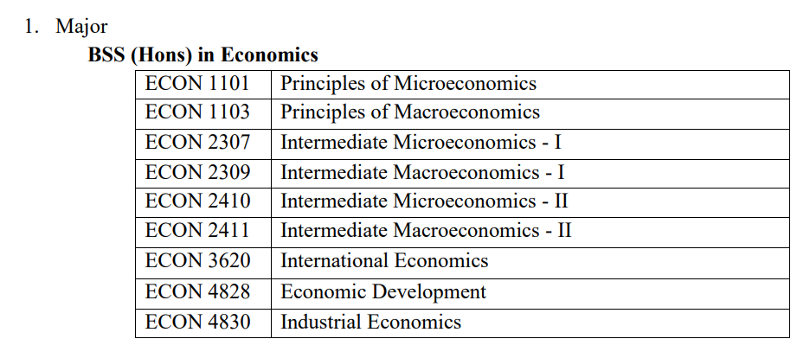
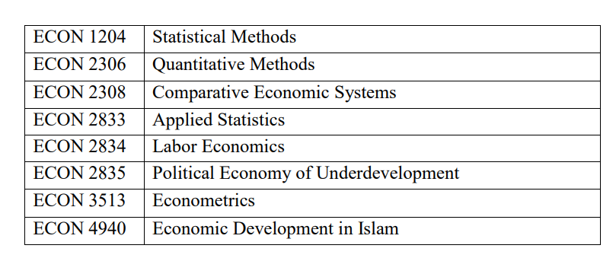
Part –B of the Revised Template
Core Courses for Bachelor Degree in Economics

Slide 39
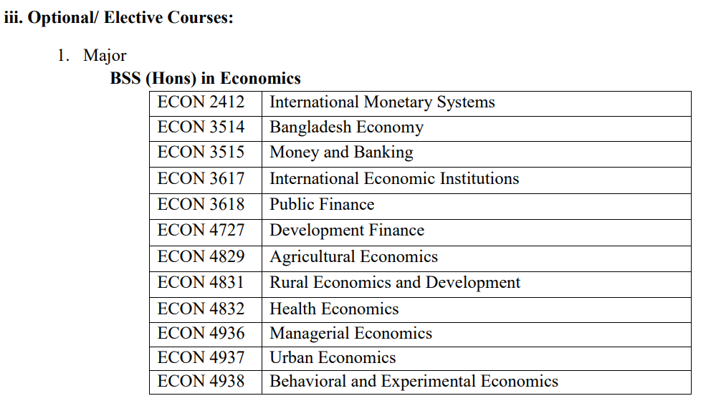
Part –B of the Revised Template

Slide 40
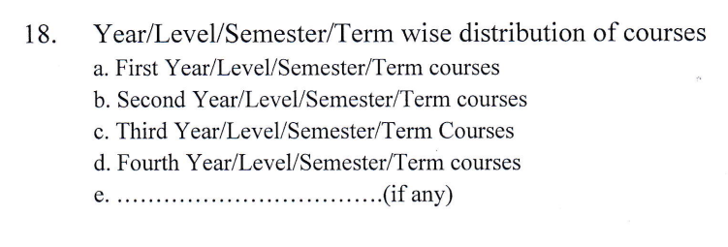
Part –B of the Revised Template

Slide 41
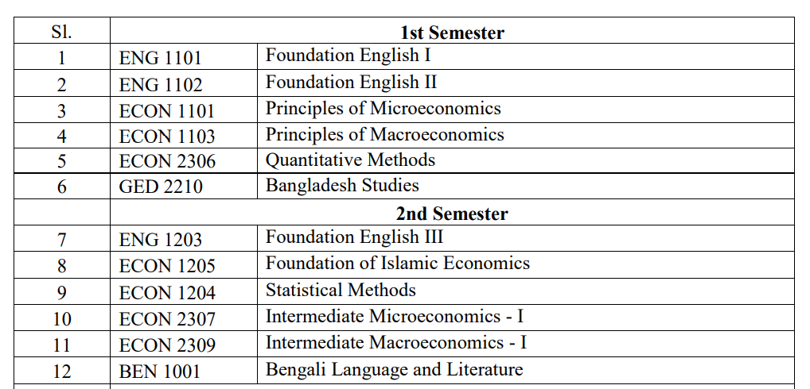
Part –B of the Revised Template
First Year 1st Semester
First Year 2nd Semester
And so on for the remaining semesters

Slide 42
Parts C and D
Description of All Courses
BUSINESS BCONOMICS AND ENVIRONMENT
Course code: ……..(BNQF) Credit:
Rationale of the course
…………………………………………………………………………………………………………………….
Course Learning Outcomes (CLOs)
Notes:
CLO: a statement of what learners are expected to be able to do on successful completion of the course in order to demonstrate their knowledge, skills and understanding

Slide 43
Designing and writing CLOs
Points to consider
Decide what kind of knowledge is to be involved
Declarative knowledge or functioning knowledge?
Select the contents/topics to teach
Wide coverage and surface learning or
Fewer topics and deep learning
Level of understanding or performance to be achieved
Is the CLO for an introductory or an advanced course
No. of CLOs should not be more than 5 or 6
To address topics more than 6, devise integrating CLOs
Notes:
Manageable number of course topics : 4 to 7 for a semester
Declarative : knowing about phenomena, theories, disciplines, specific topics
Functioning : requiring the student to exercise active control over problems and decisions in the appropriate content domains

Slide 44
Designing and writing CLOs
Points to consider
Express your learning outcomes in the second person (‘you’), rather than the third person(‘each student’ or ‘the students’ and in the future tense.
E.g. At the end of this course you will be able to summarize
You will be able to identify
You will be able to apply
You will be able to evaluate

Slide 45
Designing and writing CLOs
Points to consider
Describe the learning that will result from an activity.
Instead of
“You will read one journal article on trade flows”
Write
“You will be able to apply the analysis presented in a journal on trade flows, and predict the effects that higher commodity prices will have on the US trade deficit.”

Slide 46
Designing and writing CLOs
Points to consider
Look for redundant CLOs
“Describe and explain …..” ‘describe’ is redundant if the student can explain the topic, he or she can certainly describe it.
Avoid vague verbs such as understand, know, become familiar with, appreciate etc.

Slide 47
Part –C of the Revised Template
Mapping Course Learning Outcomes (CLOs) with the PLOs
CLO | PLO1 | PLO2 | PLO3 | PLO4 | PLO5 | ..
CLO1 | 3 | 2
CLO2 |  |  |  | 3 | 2
CLO3 | 1 |  | 3
CLO4 |  | 3 |  |  | 2
CLO5 | 1 |  |  |  | 3
Notes:
3= high correlation; 2= medium correlation; 1= low correlation

Slide 48
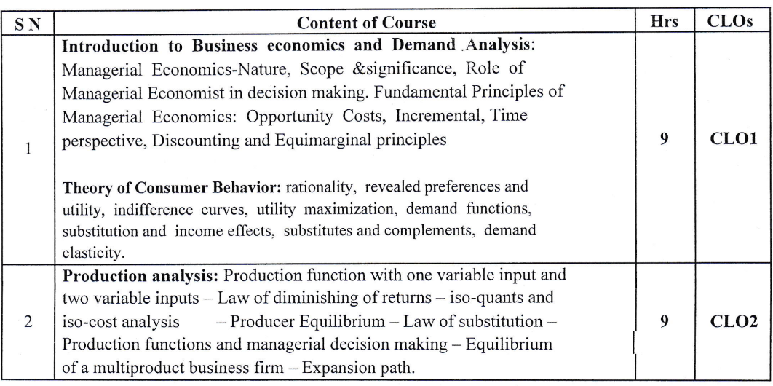
Part: c

Slide 49
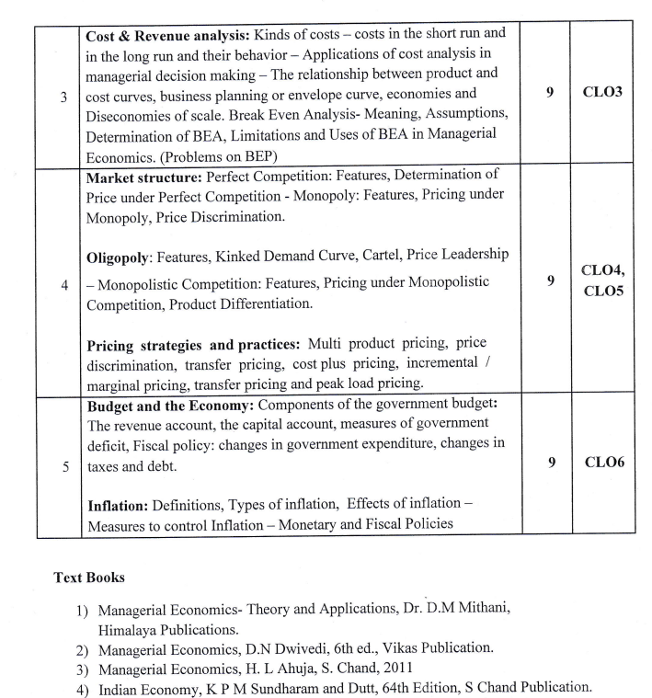
Part: c

Slide 50
Part –C of the Revised Template
Mapping Course Learning Outcomes (CLOs) with the Teaching-Learning& Assessment Strategy
Topic/ Chapter | Teaching-Learning Strategies | Assessment Strategies | CLOs
Topic 1 | Interactive Lecture, Reading, Tutor Consultation, workshops, seminars | Quiz/ Tutorial/Assignments/Class participation /report writing | CLO1,CLO2
Topic 2 | Lecture, Small group discussion, Case Study, online activities | Exam/ Presentation | CLO2
Topic 3 | Lecture , reading , Group Projects, Field Work/Field Trip | VIVA VOCE/Mid semester exam/ Final exam/report | CLO3
Topic 4 | Peer teaching ( for large class) | Peer review / report/assessment | CLO4
Topic 5 | Laboratory | Lab Report | CLO5

Slide 51
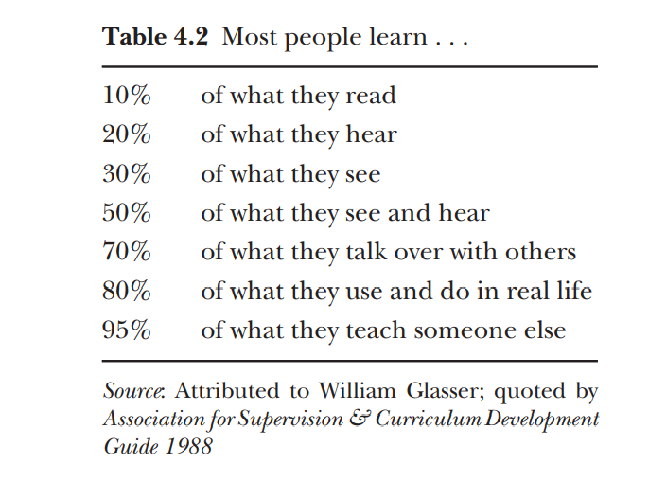
Part –C of the Revised Template
Notes:
The teaching of Eric Mazur
Eric Mazur (1998) asked himself that last question. He was lecturing in physics at Harvard
He set readings that had to be read before the class. He also gave the students two or three simple questions to be answered by email the night before the class: no answers, no admission to class. His email also said: ‘Please tell us what you found difficult and confusing. If you found nothing difficult or confusing, please tell us what you found most interesting.’

Slide 52
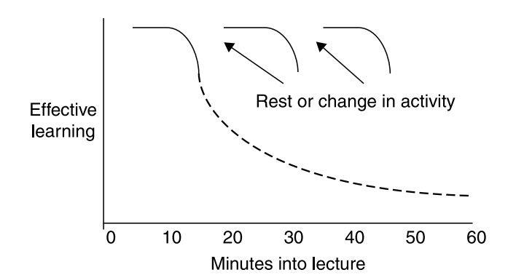
Part –C of the Revised Template
Effect of rest or change of activity on learning
Source: Bligh (1972)
Notes:
A short rest, or a change in activity, every 15 minutes or so restores performance almost to the original level

Slide 53
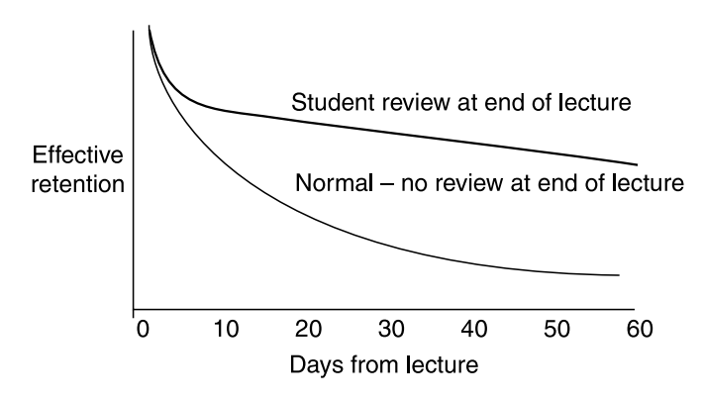
Part –C of the Revised Template
Effect of consolidation at end of lecture on retention
Source: Bligh (1972)
Notes:
Getting students to review at the end of the lecture what has been learned leads to much better and lasting retention than simply finishing and dismissing the students

Slide 54
Part –D of the Revised Template

Slide 55
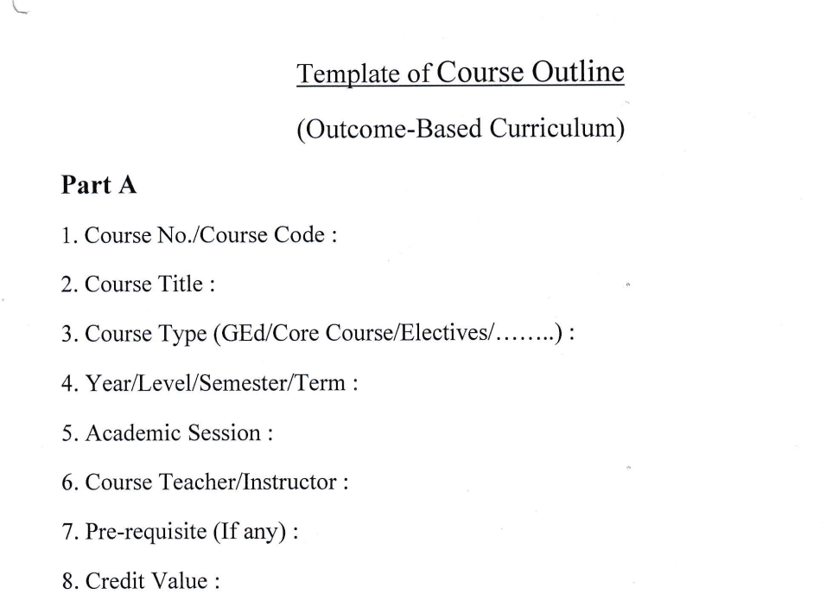
Template of Course Outline: Part A

Slide 56
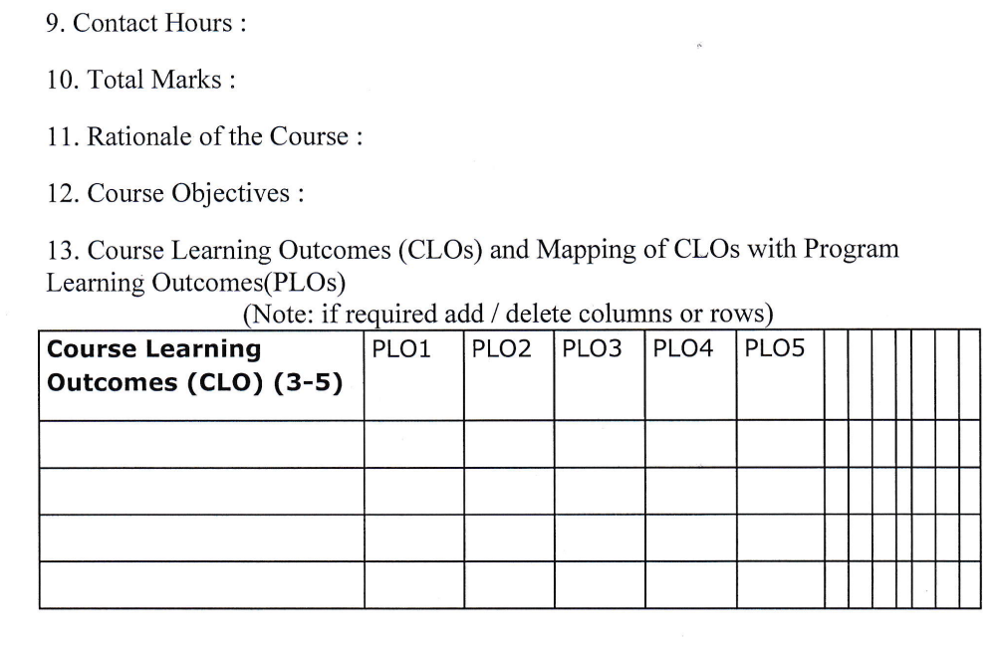
Template of Course Outline: Part A (continued)

Slide 57
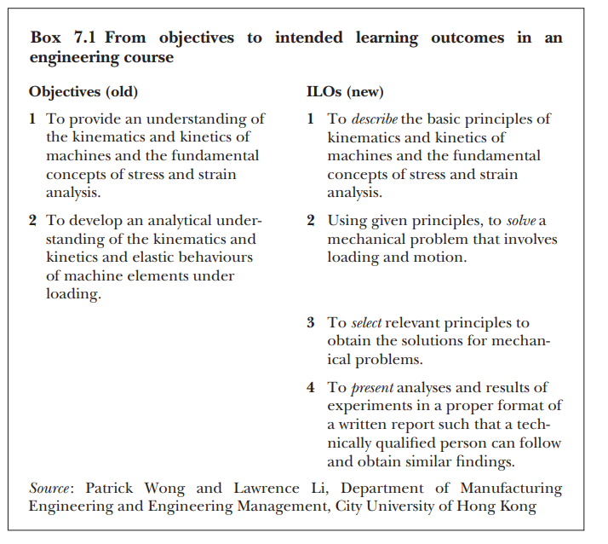
Source: Teaching for Quality Learning at University by John Biggs and Catherine Tang
Notes:
CLOs /ILOs at the course level emphasizes more than does ‘objective’ that we are referring to what the student has to learn rather than what the teacher has to teach

Slide 58
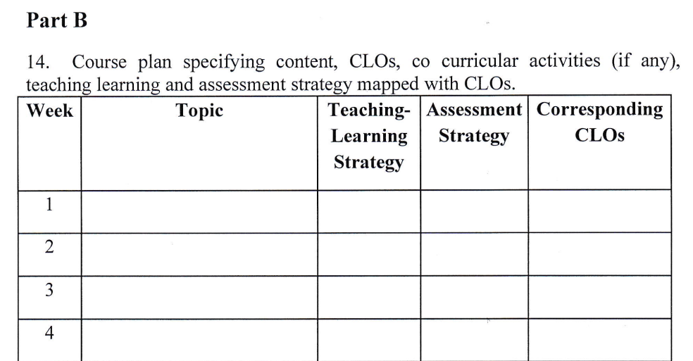
Template of Course Outline: Part B
Notes:
Teaching learning methods: Lecture, Field work, Video, Lab session, Industry visit , group discussion , News paper news analysis
Assessment strategies: formative and summative assessment: quiz, presentation, peer evaluation, class test, report writing

Slide 59
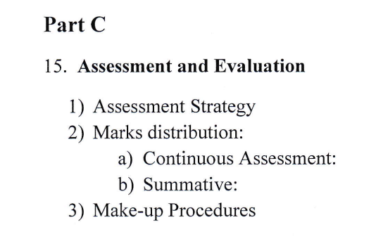
Template of Course Outline: Part C

Slide 60
Template of Course Outline: Part C
Formative assessment
---provided during learning, telling students how well they are doing and what might need improving.
Summative assessment
---after learning, informing how well students have learned what they were supposed to have learned

Slide 61
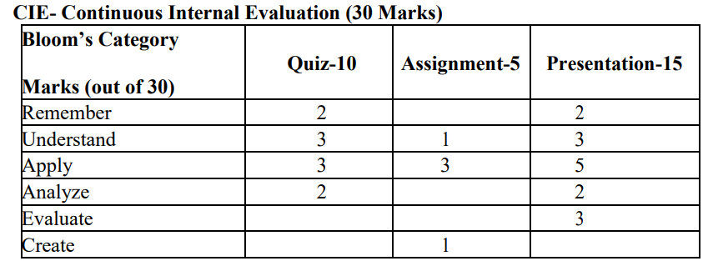
Template of Course Outline: Part C

Slide 62
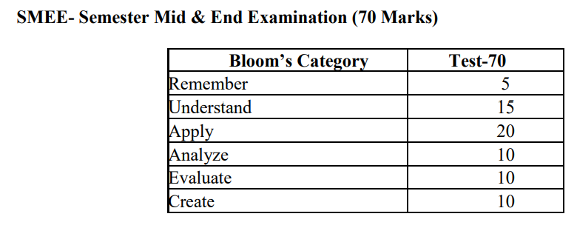
Template of Course Outline: Part C

Slide 63
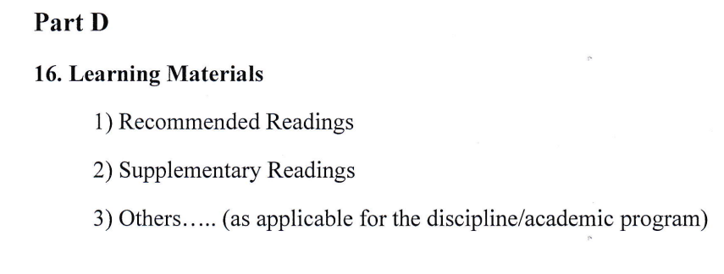
Template of Course Outline: Part D

Slide 64
Thank you

