Slide 1
Revised OBE Curriculum Template
Template for Course File
by
Dr. Md. Abdur Rashid Sarker
Professor, Department of Economics, RU

Slide 2
Template for Course File
1. Course Outline
  An outline for the course/courses a teacher teaches at the program; bachelor or masters.
2. Lecture Materials/Notes
  Handout, Slides, Books
3. Attendance sheet
  Whole sheet, Number of classes, total class attended, and percentages, Marks (if any)
Assignment
Copies of best, mediocre and poor for all assignments

Slide 3
Template for Course File
5. Class test/quiz /mid-term test etc.
  Preserve copies of best, mediocre and poor
6. Copies of question papers/assessment tools
  All types of questions: Class test, Quiz, Assignment/group discussions/internships/ and
  Final questions at the end of the year/semester
Notes:
Formative assessments take place during a course.
Formative assessments are evaluations of someone’s learning progress in a classroom. Common formative assessments include:
Quizzes
Projects
Presentations
Group activities
Summative assessments are the final evaluations at the course’s end. Summative assessments are evaluations of what someone has learned throughout a course.
Common summative assessments include:
Tests
Final exams
Reports
Papers
End-of-class projects

Slide 4
Template for Course File
  7. Rubrics
      A rubric is a coherent set of criteria for students’ work that includes descriptions of levels of performance quality on the criteria.
      Type of rubric: Analytic (problem-solving) and holistic (no single correct answer)
Notes:
Rubrics are important because they clarify for students the qualities their work should have.
How many criteria are there?
What are the names of each criterion?
Standards and criteria for marking assignment and presentation

Slide 5
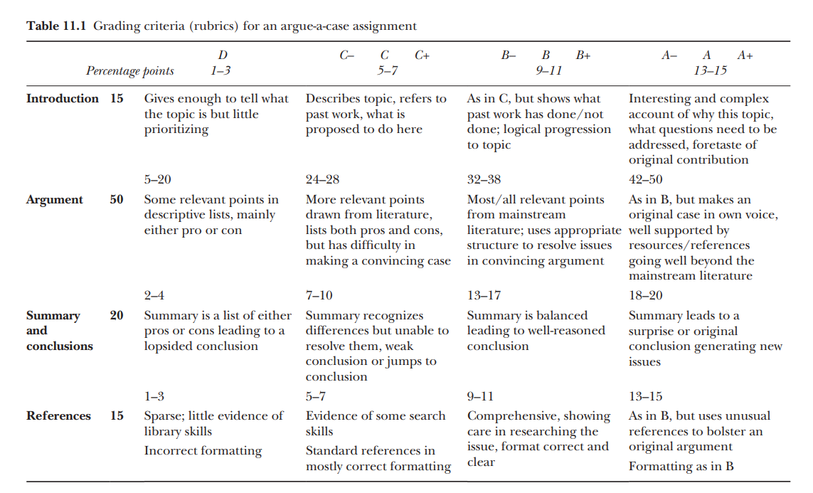
Template for Course File-A Sample Rubric
Notes:
Biggs and Tang (2011) Teaching for Quality Learning at University , Mc Graw Hill

Slide 6
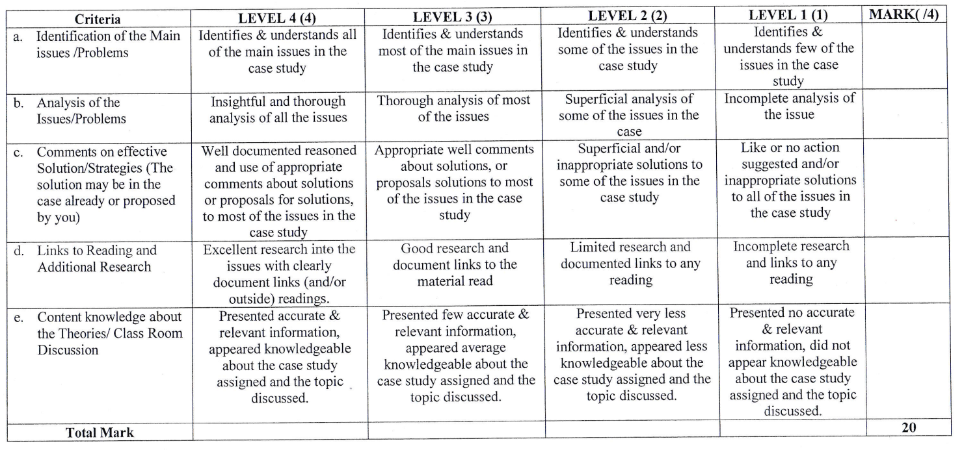
Template for Course File- Rubric for Group/Individual Case Study
Notes:
UGC Template

Slide 7
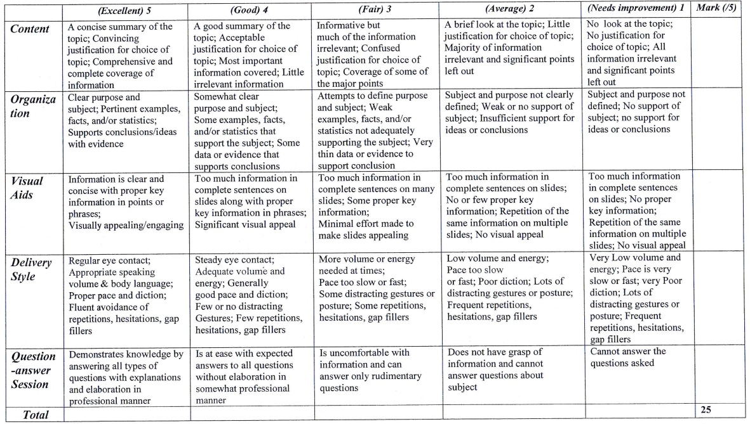
Template for Course File- Rubric for Individual Presentation
Notes:
UGC Template

Slide 8
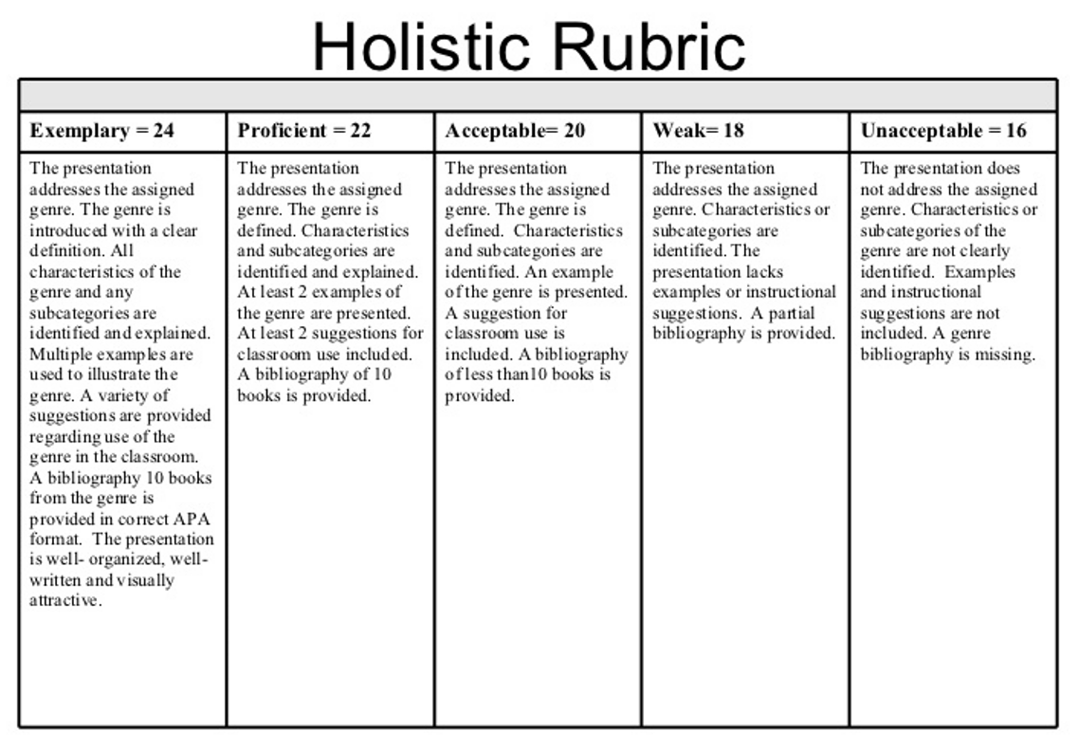
https://courses.dcs.wisc.edu/design-teaching/FacilitationManagement_Spring2016/facilitation-module/5_Course_Management_Strategies/images/holistic.jpg

Slide 9
Template for Course File
8. Course evaluation by course teacher considering feedback from the students
9. Feedback from the students on the course
10. Peer review: Done / not Done
Notes:
A peer review assignment enables students to provide feedback on another student's assignment
Allows communication between students
Help students master the concepts of a course and learn from each other

Slide 10
Template for Course : 11. Attainment of CLO

Slide 11
Template for Course File- CLO attainment

Slide 12
Template for Course File- CLO attainment

Slide 13
Template for Course File- CLO attainment

Slide 14
Template for Course File- CLO attainment
12. Improvement plan for better attainment of CLOs
Here in this example, CLO2 and CLO5 need further improvement plan.

Slide 15
Thank you

