Slide 1
অ্যাক্রেডিটেশন বিধিমালা, জুন ২০২২
(বাংলাদেশ অ্যাক্রেডিটেশন কাউন্সিল আইন, ২০১৭)
Some Insights from BAC Act, BAC Standards and Criteria & BNQF

Slide 2
অ্যাক্রেডিটেশন: আবেদনের শর্তসমুহ
ক। স্থায়ী কোয়ালিটি অ্যাসুরেন্স সেল থাকতে হবে
খ। প্রণীত একাডেমিক কারিকুলাম BNQF এর সাথে সঙ্গতিপূর্ণ হতে হবে
গ। আবেদনের সময় অন্যূন ২ বছর পূর্বে কমপক্ষে একটি ব্যাচের ডিগ্রী প্রদান নতুন কারিকুলামে সম্মন্ন করতে হবে
ঘ। প্রতিষ্ঠানের অ্যাক্রেডিটেশনের জন্য উক্ত প্রতিষ্ঠানের কমপক্ষে ২০% কার্যক্রম বা প্রোগ্রাম অ্যাক্রেডিটেশন প্রাপ্ত হতে হবে ( কমপক্ষে তিনটি প্রোগ্রাম হতে হবে)
ঙ।কাউন্সিল কর্তৃক প্রদত্ত প্রতিটি মানদন্ডে কমপক্ষে ৫০% নম্বর পেতে হবে

Slide 3
অ্যাক্রেডিটেশনের ধরন

Slide 4
Bangladesh National Qualifications Framework: Bachelors
Duration | Minimum Graduating Credits | Maximum duration
5-year | 150 | 8 Years
4-year | 130 | 7 Years
Notes:
40 notional hrs./credit
The time that the average student would need to attend all classes, study for tests and do assignments and homework
Learning time taken by average student

Slide 5
Bangladesh National Qualifications Framework : Masters
Duration | Minimum Graduating Credits | Maximum duration
Taught Course (1 Year) | 40 | 3 Years
Mixed Mode (1.5 years) | 18 credits plus dissertation | 3 Years
Research (Thesis only) | N/A | 3 years
Notes:
For 4 and 5 years Bachelor’s degree

Slide 6
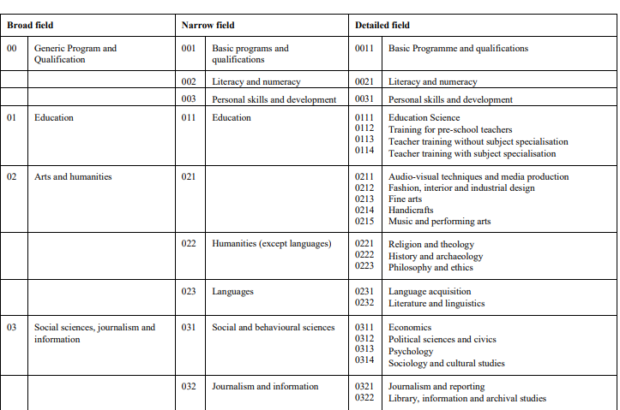
BNQF: Common Classification System for Subjects

Slide 7
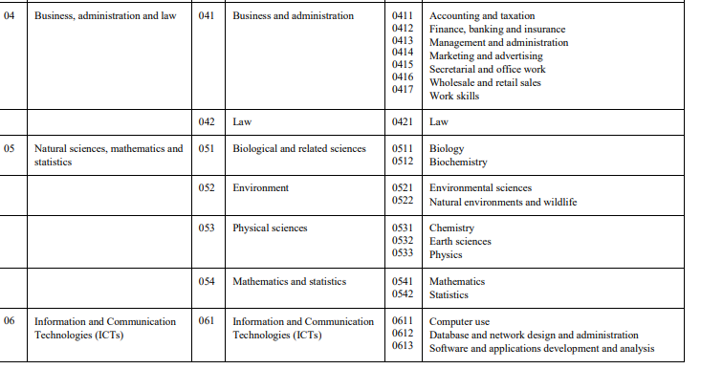
BNQF: Common Classification System for Subjects

Slide 8
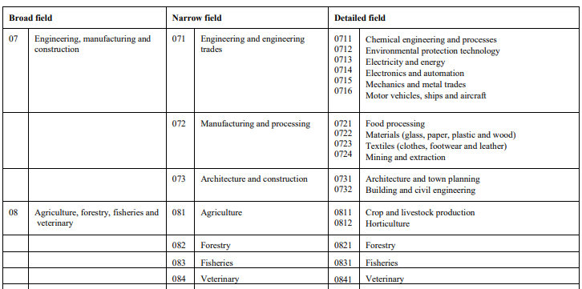
BNQF: Common Classification System for Subjects

Slide 9
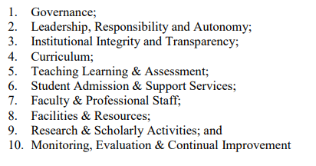
Bangladesh Accreditation Standard: At a glance

Slide 10
Bangladesh Accreditation Standard: At a glance
Standard 1: Governance: Criterion
Criterion 1-1: Defined vision, mission and objectives of the PoE are in accordance of those of the HEI
Criterion 1-2: The PoE has well-communicated strategic plan that effectively guide its activities
Criterion 1-4: The PoE strictly maintains the academic calendar containing schedule of all academic activities under the academic program.
Criterion 1-5: The HEI/PoE has a documented class size policy and maintains class size that is appropriate for effective management of the teaching-learning-assessment

Slide 11
Bangladesh Accreditation Standard: At a glance
Standard 2: Leadership, Responsibility and Autonomy: Criterion
Criterion 2.1: The HEI/PoE has an organizational structure with defined responsibilities in accordance with the legal framework under which the HEI is established
Criterion 2.2: The HEI/PoE maintains a set of values to foster social responsibility, diversity and inclusivity.
Criterion 2.3: The PoE and Head of the PoE have sufficient autonomy with financial support to introduce innovative approaches for effective teaching-learning, research and management of the academic program.

Slide 12
Accreditation Standard by BAC : At a glance
Standard 3: Institutional Integrity and Transparency
Criterion 3.1: Fair /transparent recruitment policy
Criterion 3.4 : HEI/PoE regularly publishes and provides student handbook
Criterion 3.2: well defined code of conduct
Criterion 3.5: a well-designed and informative website
Criterion 3.2: Transparent and fair admission process
Criterion3.6: To redress student grievances and complaints on issues like abusive behavior

Slide 13
Accreditation Standard by BAC : At a glance
Standard 4: Curriculum
Criterion 4.1 The curriculum of the program is designed and reviewed following a well-defined procedure by a specific body or committee with representation from the industry/employers and alumni
Criterion 4.7:
Bachelor degree programme includes 25% of the total credits for general education courses aligned with PLOs
Masters degree program curriculum includes minimum 10% of total credits for general education courses mapped with PLOs

Slide 14
Accreditation Standard by BAC : At a glance
Standard 4: Curriculum
Criterion 4.8 : The PoE maintains documented course file with course plan specifying prerequisite course(s) (if any), credit value, teaching learning & assessment methods and facilities/resources that are mapped out as necessary to facilitate the attainment of course learning outcomes
Criterion 4.9: Provisions of internship/project/dissertation/field work/work integrated learning opportunities are included in the curriculum

Slide 15
Accreditation Standard by BAC : At a glance
Standard 5: Teaching-Learning & Assessment
Criterion 5-3: Course teachers strictly maintain class schedule, keep records of attendance, records of missed classes and make up classes .
Criterion 5-4: Course plan/outlines are available to the students to make them well informed about the CLOs, topics to be discussed, teaching learning and assessment strategy and rubrics that will be used to assess performance/attainment of learning outcomes

Slide 16
Accreditation Standard by BAC : At a glance
Standard 6: Student Admission & Support Services
Criterion 6-1: The HEI/PoE maintains a clearly defined and well-communicated admission policy.
Criterion 6-2: The HEI/PoE maintains a separate administrative setup with a clearly defined and well-communicated comprehensive policy for the international students.
Criterion 6-3: A well-structured student affairs department/office at the HEI
Notes:
Others include academic guidance and counseling, a well-organized alumni association of the PoE, Student progress and achievement monitoring system etc

Slide 17
Accreditation Standard by BAC : At a glance
Standard 7: Faculty and Professional Staff
Criterion 7-2: HEI is maintaining salary structure with incentives to retain the talented and experienced faculty and professional staff.
Criterion 7-3: The HEI/PoE has policy to support the faculty for further enhancement of academic excellence through advanced studies
Criterion 7-4: HEI/PoE supports and motivates faculty and professional staff to attend seminar, training workshop, conference, and academic visits at home and abroad for professional development under a comprehensive faculty and professional staff development policy.
Notes:
Others include academic guidance and counseling, a well-organized alumni association of the PoE, Student progress and achievement monitoring system etc

Slide 18
Accreditation Standard by BAC : At a glance
Standard 7: Faculty and Professional Staff
Criterion 7-6: The HEI/PoE maintains a workload distribution policy balancing teaching, research and administrative activities.
Criterion 7-8: The PoE maintains ideal combination of faculty with 10% Professor, 20% Associate Professor, 40% Assistant Professor and 30% Lecturer with reasonable teacher student’s ratio, depending on the nature of discipline, as necessary for effective teaching learning in the academic program/discipline
Notes:
Others include academic guidance and counseling, a well-organized alumni association of the PoE, Student progress and achievement monitoring system etc

Slide 19
Accreditation Standard by BAC : At a glance
Standard 8: Facilities & Resources
Criterion 8-1: The PoE maintains a policy for student enrollment in a class/semester on the basis of capacity in terms of free space, number and size of class room, common room, washroom
Criterion 8-2: The HEI/PoE has library managed by appropriate library management software and well-trained qualified library professionals with adequate space, workstation
Criterion 8-4: Laboratory facilities, instructional technology & software, IT learning facilities
Notes:
Others include academic guidance and counseling, a well-organized alumni association of the PoE, Student progress and achievement monitoring system etc

Slide 20
Accreditation Standard by BAC : At a glance
Standard 9: Research & Scholarly Activities
Criterion 9-1: A comprehensive policy with budgetary provision is functional to develop capacity with appropriate measures to control plagiarism
Criterion 9-3: HEI/PoE maintains a policy and system to disseminate and transfer the research findings to the industry/community/stakeholders through extension services.
Criterion 9-4: The PoE produces high-quality intellectual contributions including research publication in peer reviewed journal
Notes:
Others include academic guidance and counseling, a well-organized alumni association of the PoE, Student progress and achievement monitoring system etc

Slide 21
Accreditation Standard by BAC : At a glance
Standard 10: Monitoring, Evaluation & Continual Improvement
Criterion 10-2: The PoE maintains a formal system of collection and management of stakeholder’s feedback, comments of the course teacher and student on the courses, emerging changes in the industry and working life, effectiveness of the courses and academic program.
Criterion 10-3: Using the feedback from the stakeholders the PoE continually and systematically monitor, evaluate and review the effectiveness of the programs
Criterion 10-4: The HEI/PoE maintains university industry collaboration (UIC) for mutual benefits and improvement.

Slide 22
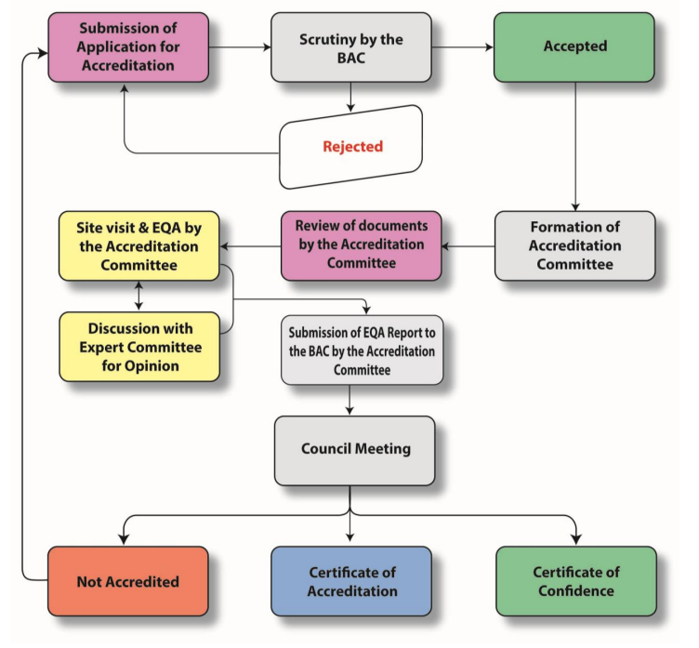
BAC accreditation process Flow

Slide 23
Thank you

